Slide 1
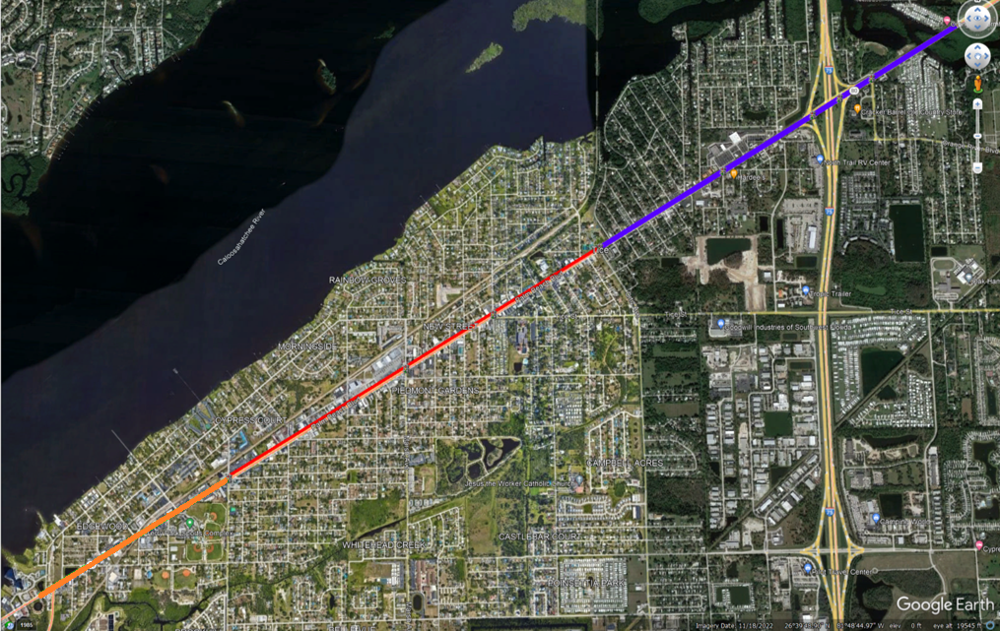

Safety Studies Conducted – SR 80
Veronica Shoemaker Blvd to Ortiz Ave, and at Kingston Dr was studied and finalized in Dec 2017
East Riverside Dr to Veronica Shoemaker Blvd was studied and finalized in Jun 2023
Ortiz Ave to Shoreland Dr the study was studied and finalized in Feb 2024
Ortiz Ave
Riverside Dr
Veronica Shoemaker

Slide 2
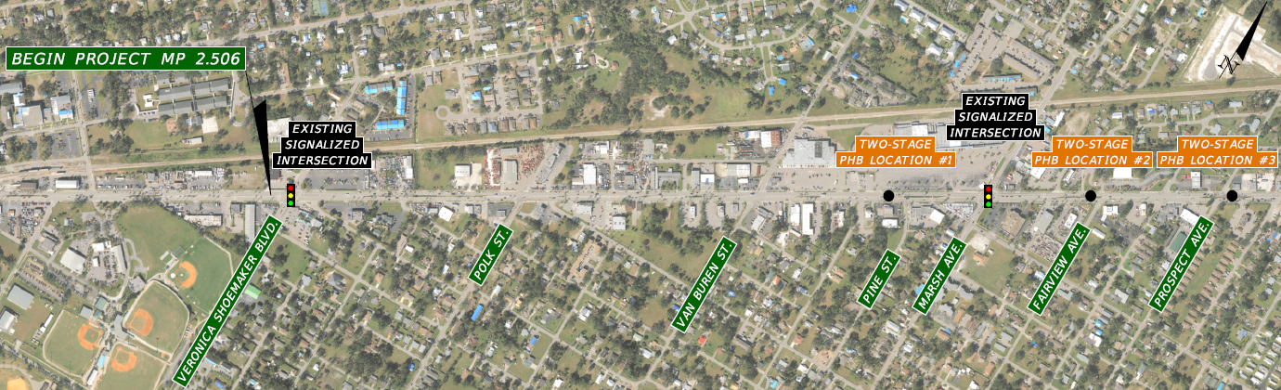
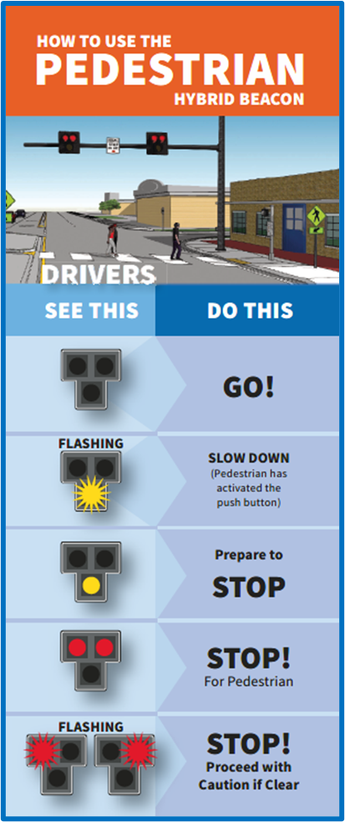


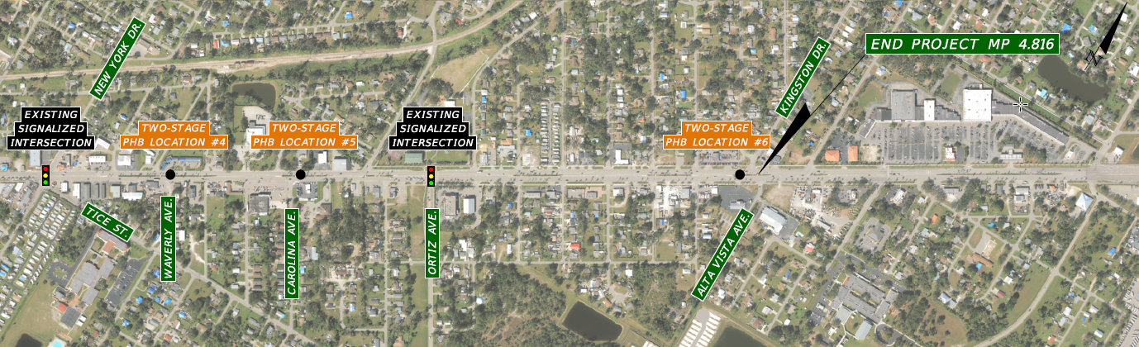
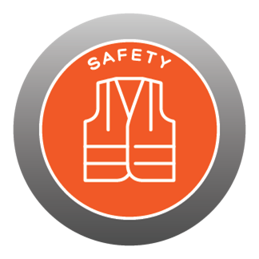


SR 80 from Veronica Shoemaker Blvd to Kingston Dr

