Slide 1
MONTGOMERY HOUSING PARTNERSHIP
Edinburgh House
100%
Redevelopment
AFFORDABLE HOUSING
Community Meeting
MHP's mission - our promise to this community.
7513 Maple Avenue, Takoma Park, MD | September 2026

Slide 2
WHAT WE'LL COVER TONIGHT
Our goals tonight: share where the project stands, hear your input, and answer your questions.
1
Who we are & why we're here
Montgomery Housing Partnership
2
The project: history & the case for redevelopment
Montgomery Housing Partnership
3
Building design & massing
Hickok Cole · Architect
4
Zoning & setbacks
Lerch, Early & Brewer · Land Use Counsel
5
Site & environment: stormwater & trees
MHG · Civil Engineer
6
Our commitment to current residents
Montgomery Housing Partnership
7
Small-group discussion, share-out & next steps
All
Montgomery Housing Partnership | Edinburgh House Redevelopment | mhpartners.org
2

Slide 3
WHO IS MONTGOMERY HOUSING PARTNERSHIP?
A nonprofit developer and neighbor whose only mission is affordable housing.
Founded in 1989
HERE IN TAKOMA PARK
35+ years creating and preserving affordable homes across the region.
30+
years serving the community
A 501(c)(3) nonprofit
Mission-driven, with a diverse community board - no profit motive in this project.
563
affordable homes in Takoma Park
Nearly 3,250 affordable homes
Owned and managed across Montgomery County and beyond.
9
properties we own in Takoma Park
Our mission
We have owned Edinburgh House since 1995. We are part of this neighborhood, and we are here for the long term - invested in this community's future alongside you.
To preserve and expand access to quality affordable housing.
Montgomery Housing Partnership | Edinburgh House Redevelopment | mhpartners.org
3

Slide 4
OUR MISSION: THREE PILLARS
Everything we do fits within three commitments to the people and neighborhoods we serve.
Housing People
Empowering Families
Strengthening Neighborhoods
1
2
3
Acquiring, building, and managing quality affordable housing - nearly 3,250 homes - preserving and expanding access for low- and moderate-income residents.
Community life programs serving 400+ children: Play & Learn preschool, homework club, GATOR for elementary students, and FLOW for teens - closing learning gaps.
Resident services, food and healthcare outreach, career counseling, and financial resources that build stable, vital communities.
Montgomery Housing Partnership | Edinburgh House Redevelopment | mhpartners.org
4

Slide 5
WHY EDINBURGH HOUSE NEEDS TO CHANGE
We want to be straightforward with you about the challenges the building is facing.
Aging building systems
Plumbing, elevators, and other key systems are old and failing. Even with constant repairs, they are reaching the end of their useful life - affecting day-to-day comfort and safety.
Financial reality
Repair costs are outpacing what affordable rents can cover. Without a long-term solution, MHP cannot maintain a safe building and keep rents affordable.
Opportunity to do more and efficiency
Our goal as an organization is to provide high-quality affordable housing. Nowadays it’s very difficult and inefficient to staff and operate a 45-unit property
Doing nothing is not an option - but whatever we do, our commitment to this community remains the same.
Montgomery Housing Partnership | Edinburgh House Redevelopment | mhpartners.org
5

Slide 6
OUR ANALYSIS: WEIGHING THE OPTIONS
MHP's real estate team rigorously studied several paths for Edinburgh House - from targeted repairs to full redevelopment.
OPTION A
Minimal Repairs
Not viable
Targeted fixes only. Does not achieve long-term viability.
OPTION B
Substantial Rehabilitation
Does not meet the need
Renovating the existing building would still require full resident relocation and major construction - while adding no new affordable homes.
OPTION C
New Construction
✓ Recommended
Demolish and replace with a new affordable building on the same site.
Montgomery Housing Partnership | Edinburgh House Redevelopment | mhpartners.org
6

Slide 7
THE PROPOSED PLAN: A NEW EDINBURGH HOUSE
A brand-new, modern, 100% affordable building on the same site - same address, same neighborhood, a better home.
140
100%
8
affordable apartments
affordable
stories
One-, two- and three-bedroom homes
30–60% AMI · no market-rate units
Type III-A wood-frame midrise
What's Changed Since the Concept Plan was Submitted Based on Public Comments
Height: 10 stories → 8 stories
Homes: 176 units → 140 units
Two fewer stories means noticeably less height and massing along the street - reducing the building's visual impact on neighboring homes and creating a gentler transition to the surrounding houses. This scheme also favors more family sized units.
Montgomery Housing Partnership | Edinburgh House Redevelopment | mhpartners.org
7

Slide 8
BUILDING DESIGN
Design & Massing
Presented by Hickok Cole
Project Architect

Slide 9
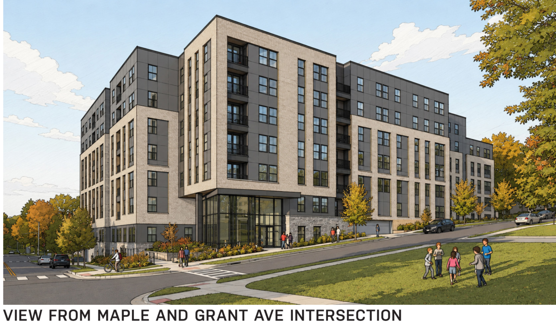
BUILDING DESIGN & MASSING
A midrise on the Maple Avenue corridor
An eight-story building sited on the Maple Avenue corridor, close to transit and services.
Site plan. Renderings, elevations, and massing diagrams follow on the next three slides.
Meeting the neighborhood edge
The building steps down and articulates along the Grant Avenue edge to relate to the neighboring single-family homes.
Materials & transition
Careful attention to façade materials, articulation, and a landscaped transition to soften the interface.
Shorter & less dense than before
The current design is lower and less dense than the earlier concept the neighborhood last saw.
Where your input matters most
Montgomery Housing Partnership | Edinburgh House Redevelopment | mhpartners.org
9

Slide 10
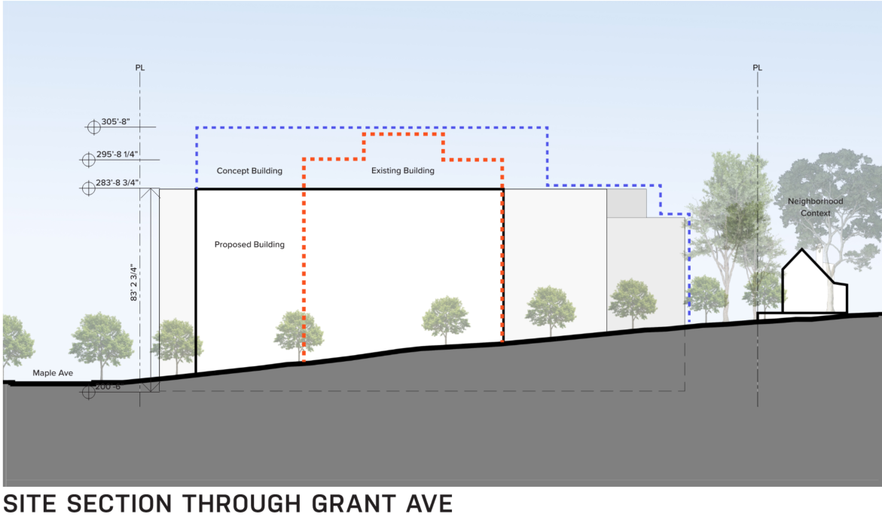
BUILDING DESIGN
[ Hickok Cole drawing to be inserted ]
Montgomery Housing Partnership | Edinburgh House Redevelopment | mhpartners.org
10

Slide 11
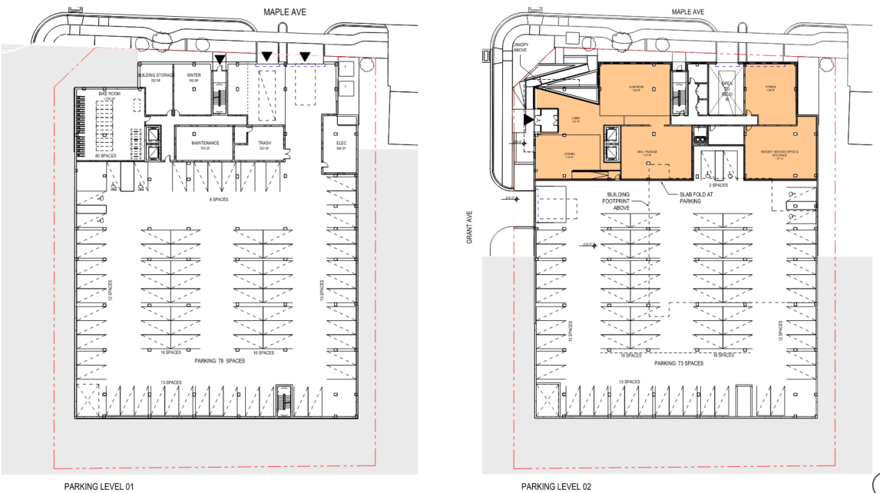
BUILDING DESIGN
STREET-LEVEL RENDERING
[ Hickok Cole drawing to be inserted ]
Montgomery Housing Partnership | Edinburgh House Redevelopment | mhpartners.org
10

Slide 12
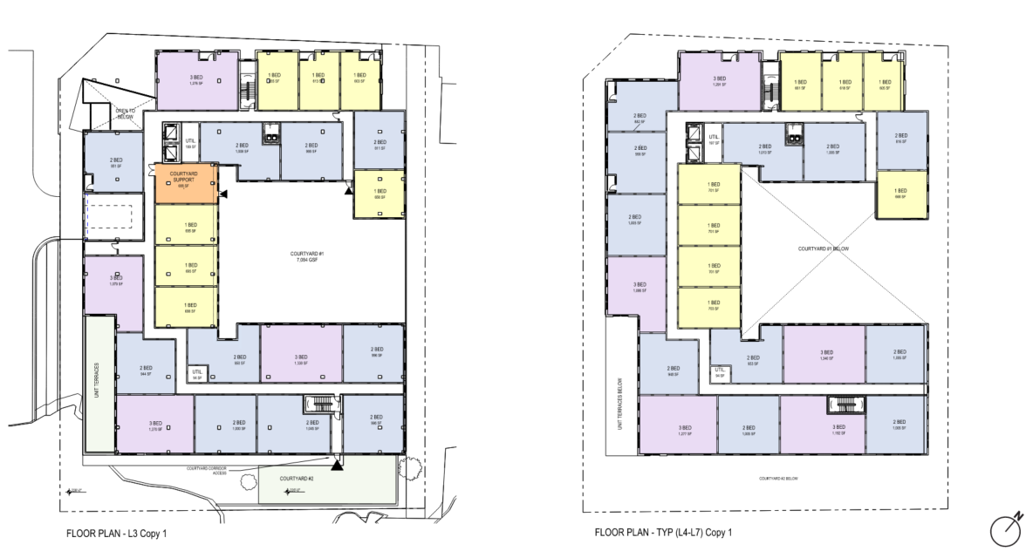
BUILDING DESIGN
[ Hickok Cole drawing to be inserted ]
Montgomery Housing Partnership | Edinburgh House Redevelopment | mhpartners.org
11

Slide 13
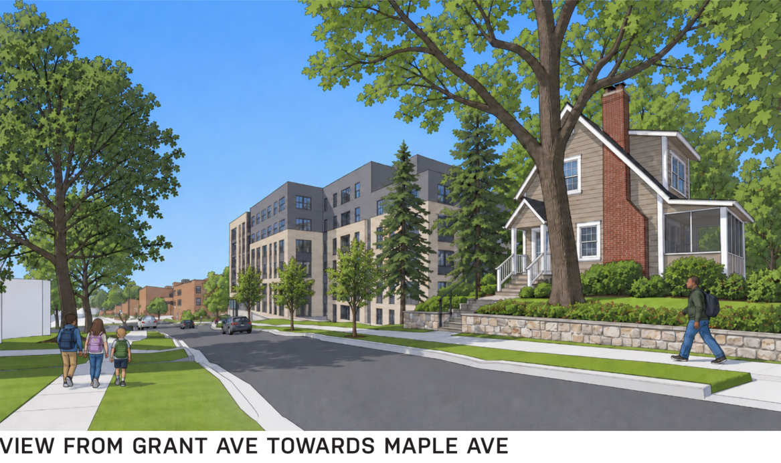
BUILDING DESIGN
MASSING & NEIGHBORHOOD CONTEXT
[ Hickok Cole drawing to be inserted ]
Montgomery Housing Partnership | Edinburgh House Redevelopment | mhpartners.org
12

Slide 14
LAND USE
Zoning & Setbacks
Presented by Lerch, Early & Brewer
Land Use Counsel

Slide 15
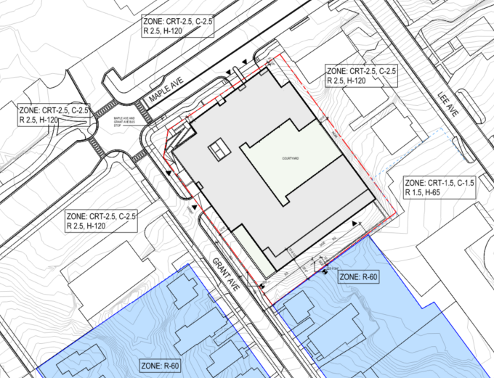
ZONING & SETBACKS
Zoning & what it permits
The site's zoning designation and the height, density, and uses it allows for the redevelopment.
Site plan with setbacks
Setbacks along Grant Avenue
The design meets the required setback along Grant Avenue - and provides additional setback and landscaping where the site allows.
Frontage & streetscape
How the building addresses the street along both Maple and Grant Avenues.
The review path
The entitlement and public-review process - including the points where the community can formally weigh in.
Montgomery Housing Partnership | Edinburgh House Redevelopment | mhpartners.org
14

Slide 16
SITE & ENVIRONMENT
Stormwater · Trees
Presented by MHG
Civil Engineer

Slide 17
STORMWATER MANAGEMENT AND TREES
STORMWATER MANAGEMENT
TREES & LANDSCAPING
Meets Maryland and Montgomery County requirements, using Environmental Site Design (ESD) to the maximum extent practicable to capture and treat runoff on-site - an opportunity to improve on the current site's stormwater performance.
The loss of mature landscaping is a genuine concern - and one we do not want to minimize.
Tree survey
A full survey of the existing trees on and around the site informs the plan.
Forest conservation
Compliance with Montgomery County forest-conservation and tree-protection requirements.
Retain where feasible
The team will look closely at where mature trees can be preserved in place.
Replacement & replanting
A replacement and replanting plan, with coordination with neighbors as needed.
Montgomery Housing Partnership | Edinburgh House Redevelopment | mhpartners.org
16

Slide 18
OUR COMMITMENT TO CURRENT RESIDENTS
A question neighbors often ask: what happens to the people who live there now? Here is the plan for current residents.
✓ RIGHT TO RETURN. Every current resident who wants to come back has priority placement in the new Edinburgh House at an affordable rent.
No cost to residents
Dedicated coordinator
Temporary housing
MHP covers relocation costs. Residents will not pay out of pocket to move.
A personal relocation coordinator guides each household through every step.
MHP helps residents find safe, affordable temporary housing - kept close to Takoma Park where possible.
Rent protection
Plenty of notice
A managed process
Rents in the rebuilt building stay affordable, consistent with current AMI levels.
Relocation won't begin until financing is secured and construction is ready - with several months' notice.
Residents work with the property management team, ResOne, and MHP staff throughout the transition.
Montgomery Housing Partnership | Edinburgh House Redevelopment | mhpartners.org
17

Slide 19
DURING CONSTRUCTION: PROTECTING NEIGHBORS
We heard the concerns raised about construction. Here is how we will protect the surrounding community.
Hazardous materials
Noise
Dust & debris
Licensed survey and abatement of asbestos and lead paint before demolition, under Maryland and federal requirements.
Work confined to permitted hours. A Construction Management Plan governs phasing and mitigation, with a single point of contact for neighbors.
Water application, covered loads, perimeter screening, and regular street sweeping.
Vibration
Sidewalks & construction parking
A direct line
Pre-construction condition surveys of adjacent homes and vibration monitoring during high-impact work.
A maintenance-of-traffic plan keeps pedestrian access open; the contractor manages worker parking
One named MHP contact so neighbors always know who to call if something comes up.
Montgomery Housing Partnership | Edinburgh House Redevelopment | mhpartners.org
18

Slide 20
LET'S HEAR FROM YOU
Small-Group Discussion
We'll break into small groups to talk through the project. A facilitator at each table will capture your thoughts, and then we'll regroup to share.
1
2
3
What questions
What concerns
What priorities
does your group have about the project?
matter most to you and your neighbors?
do you have for the site - design, trees & greenspace, traffic, relocation?
Montgomery Housing Partnership | Edinburgh House Redevelopment | mhpartners.org
19

Slide 21
NEXT STEPS & STAYING INVOLVED
TONIGHT
SEP 24
SEP 29
ONGOING
Your feedback
Next community meeting
City Council presentation
Continued engagement
Small-group discussion and share-out
The project is presented to the Council
More chances to weigh in as plans develop
STAY CONNECTED
Reach the MHP team at:
mhpartners.org · info@mhpartners.org
A dedicated Edinburgh House project website is coming soon
- a place to submit questions, get updates, and find project resources.
Thank you.
Montgomery Housing Partnership | Edinburgh House Redevelopment | mhpartners.org
20

