Slide 1
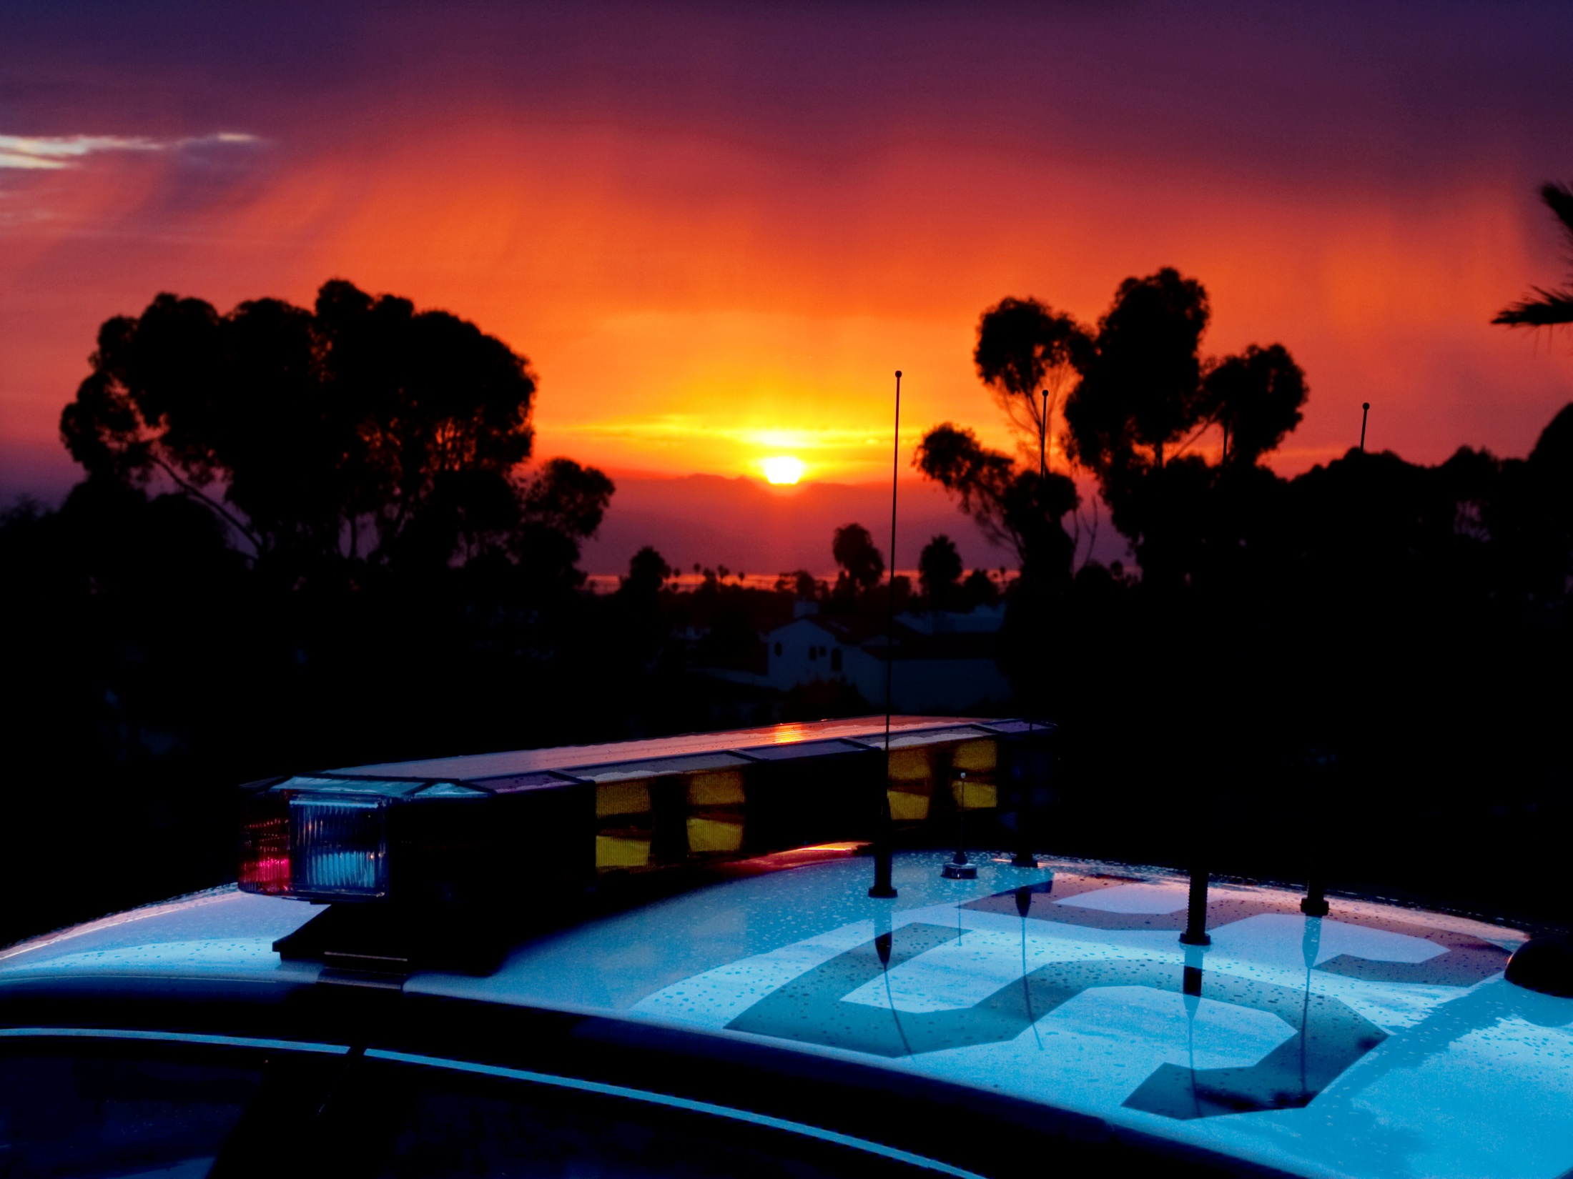
san clemente

Slide 2
Calls for Service | 2018 – 29,601 | 2017 – 31,478 | 2016 – 29,885
Priority 1 | 393 | 367 | 407
Priority 2 | 8,081 | 8,900 | 9,712
Priority 3 | 19,305 | 20,113 | 17,575
Priority 4 | 1,822 | 2,098 | 2,191
Observation | 9,173 | 9,058 | 6,706
Assigned | 20,428 | 22,420 | 23,179
Calls for service down
Observation activity up
Higher P-1 Calls

Slide 3
Traffic
Traffic | 2018 | 2017
Collisions Common Causes: DUI, Right of way, Unsafe passing, unsafe turn, signal violation | 283 | 316
Fatal | 2 | 3
Citations – Hazardous | 1042 | 1007
Citations – Non-Hazardous | 532 (Total 1,574) | 644 (Total 1,651)
DUI | 89 | 103

Slide 4
Crime statistics ~ part 1 crime
Part ONE Crimes:
1014 +12% (903)
Assaults 77 +71% (45)
Thefts 697 +21% (574)
Robbery 28 -24% (37)
Burglary 140 -19% (173)
Notes:
In comparison to October of 2016: Highest months – Jan, May, June, July, Sept
Homicide: NC 0/0
Rape : NC 8/8
Robbery: 19/36 Up 89%
Assault: 39/35 Down 10%
Burglary: NC 157/157
Larceny: 467/489 Up 4%
Auto-Theft: 49/60 Up 22%
Monthly Total: 739/785 Up 6%

Slide 5
Part 1 crimes for 2018
Note: Most Part 1 crimes are theft related.

Slide 6
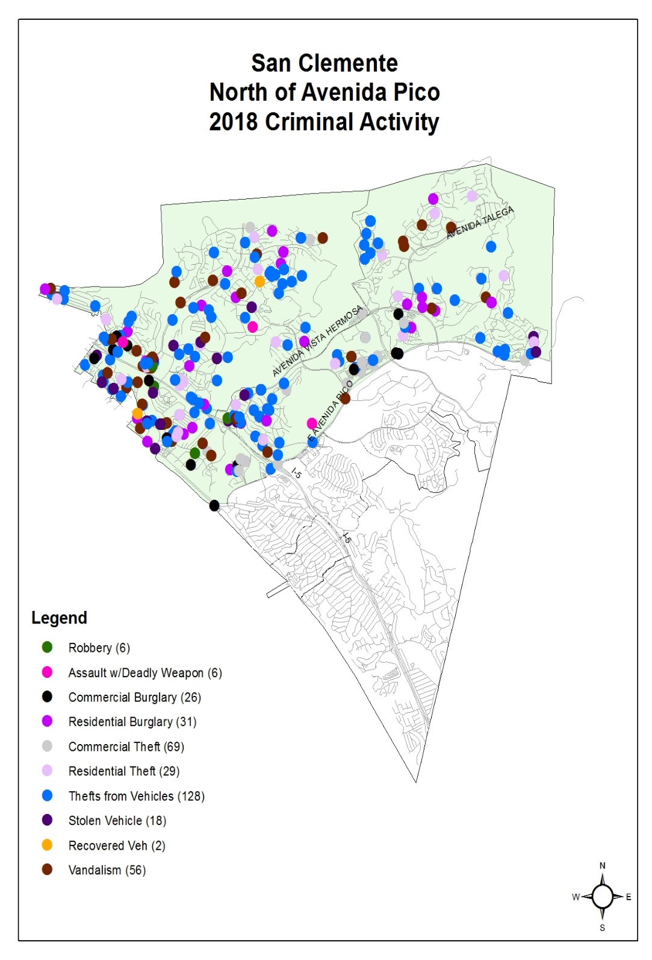
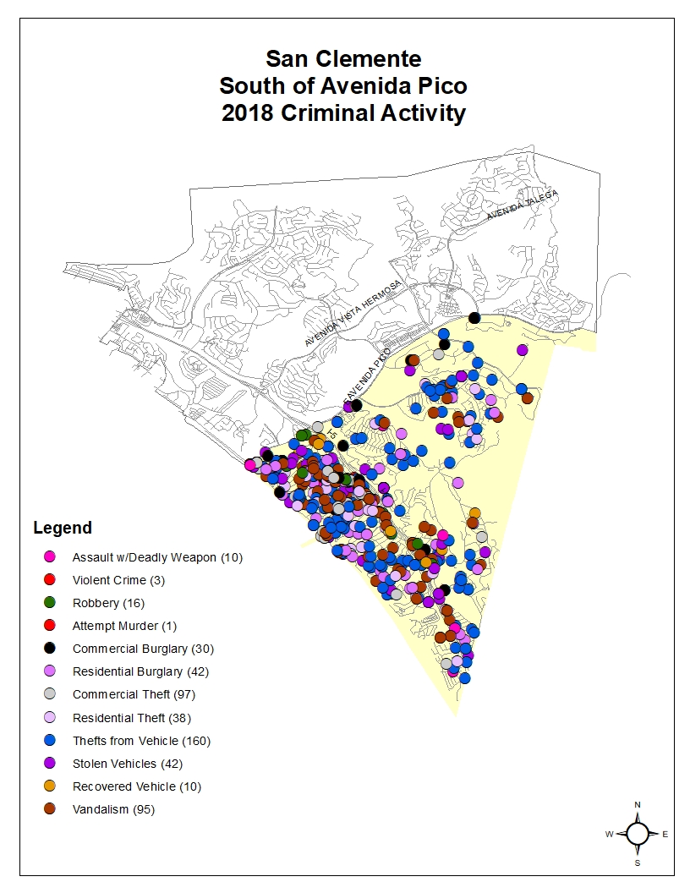

Slide 7
Crime statistics ~ part 2 crimes

Slide 8
Part 2 crime (examples)

Slide 9
Part 2 crime (Examples)

Slide 10
Investigations 2018
1709 Cases submitted for review
Priority 1 cases: 276
Priority 2 cases: 444
Priority 3 Cases: 985
201 Cleared
Case examples: Assaults, Burglary, Robbery, Theft, Threatening behavior, Court order violations, Drinking in Public, Displaying or Discharging a firearm, Narcotics, Missing People, Vandalism, Etc…
All other high priority cases (Sex Crimes, etc…) are investigated by specialty units out of Sheriff’s HQ
S/W Operations: 46% (3,670 Cases)
AV, DP, LN, LH, LW, SJC
LF: 1334
MV:1461
DP: 973

Slide 11
Lock your cars and homes
Valuables out of sight
Watch who you invite in your house
Cameras
SCAMS
Phone (207)
Computer (you have a virus)
Donating Money
Monitor your children’s Social Media (and be a good example for them on yours)
Call the Sheriff’s Department when crimes occur

Slide 12
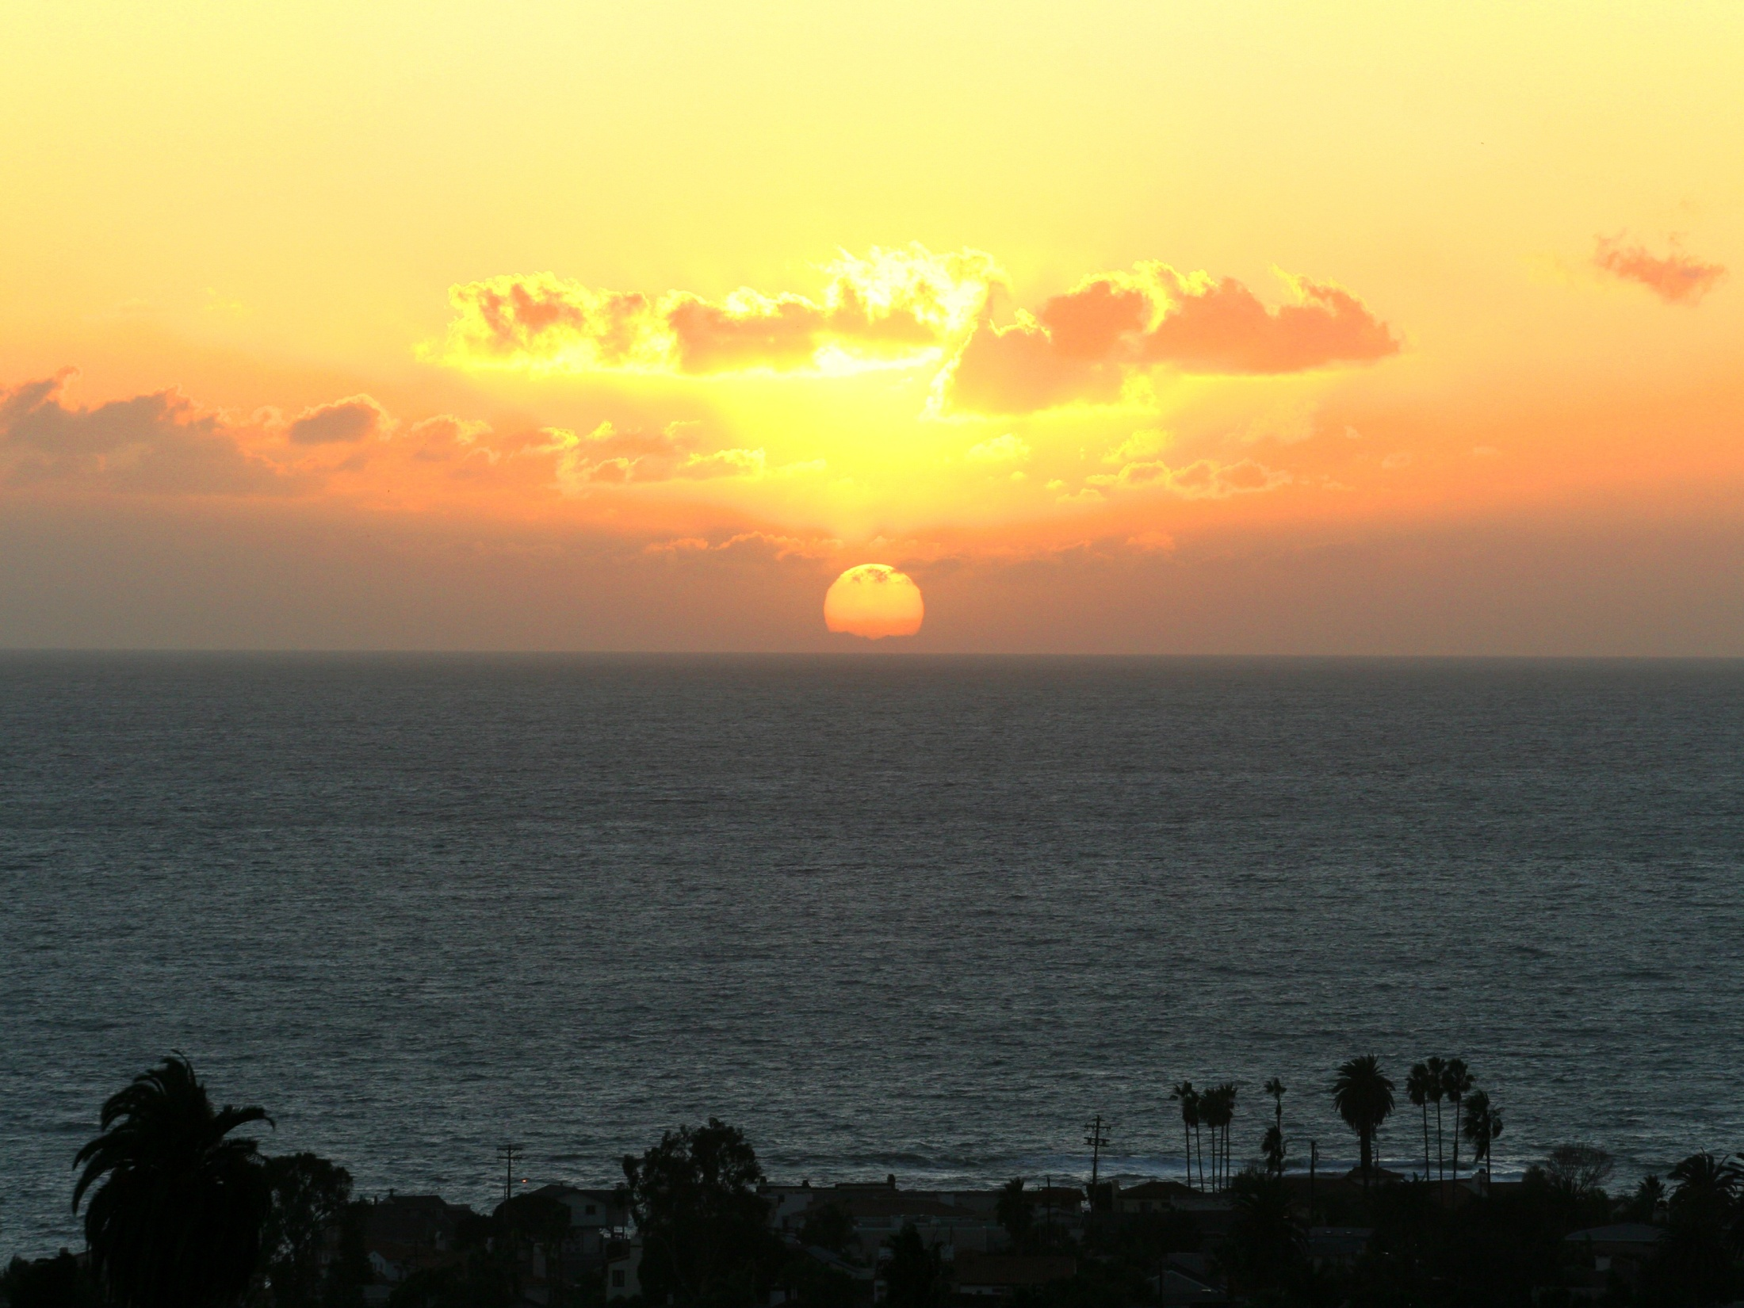
Questions?

