Slide 1
AOGC Brine Unit Hearing El Dorado Arkansas July 25, 2023

Slide 2
Introduction to the TETRA Technologies Brine Unitization Application
A.C.A. § 15-76-308
(a)(1) All producers, as defined in § 15-76-302, may make application to the Oil and Gas Commission for the establishment of brine production units and brine expansion units.
. . .
(b) Unless a smaller area is requested by a petitioner and established by order of the commission, a brine production unit or a brine expansion unit established by order of the commission shall comprise no fewer than one thousand two hundred eighty (1,280) contiguous surface acres which are reasonably established to be underlain by a common aquifer.
(c)(1) A proposed brine production unit shall be approved by the commission if the existing or proposed plan of development is such as to drain efficiently the area of the unit and to protect the correlative rights of each owner therein.

Slide 3
Introduction to the TETRA Technologies Brine Unitization Application
A.C.A. § 15-76-309
A petition for formation of a brine production unit or a brine expansion unit may be filed by a producer and shall contain the following:
. . .
(7)(A) A statement that the petitioner has valid and subsisting leases or otherwise owns or controls the right to produce brine from not less than seventy-five percent (75%) of the entire area of the proposed brine production unit or brine expansion unit.

Slide 4
TETRA Technologies Overview
Global leader in high-value completion fluids, water management and related industrial chemicals. Our aqueous chemistry expertise and key mineral assets position us well for the growing energy transition market.
Publicly Traded on NYSE
Solid Balance Sheet
Over $100M of liquidity and strong 2023 projected earnings and cash flows to fund this initiative.
$569M TTM Revenue Mix
Ticker | NYSE: TTI
Market Cap ^{(a)} | $378M
Net Debt ^{(b)} | $144M
Enterprise Value ^{(c)} | $522M
Completion Fluids & Products
Water & Flowback Services
$269M
$300M
Significance of Bromine for TETRA
Manufacturing bromine completion fluids for the Oil and Gas Industry for 30 years. Significant part of the Company’s revenue and earnings
Recently introduced a bromine-based electrolyte for long duration energy storage (mfg process patent and currently the only U.S. manufacturer to meet significant demand)
Largest global market for bromine is fire retardants where EVs and global electrification is driving increasing demand while new U.S. Supply is challenging
Ability to negotiate long-term cost-effective 3rd party supply for the volumes TETRA requires is no longer possible
We will seek AOGC approval prior to Commercial Production of Lithium

Slide 5

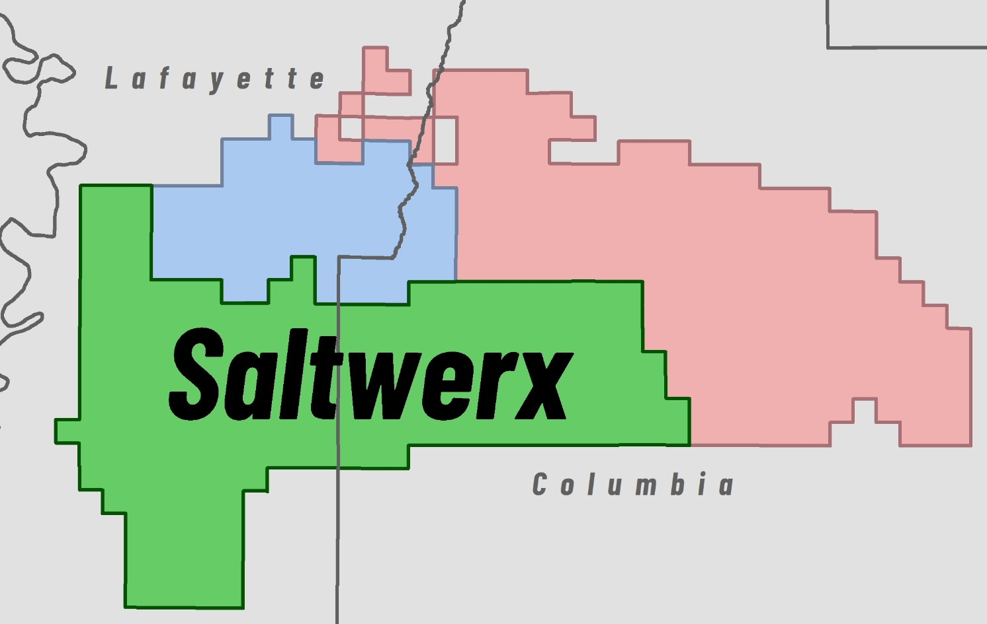
Saltwerx Overview
TETRA
Working in collaboration with southern Arkansas mineral owners and landowners, Saltwerx assembled ~120,000 acres of brine leases

Slide 6
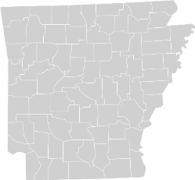
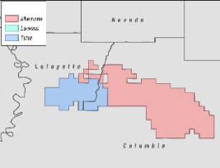
TETRA Arkansas Brine Unit Proposal
West Memphis Bromine Products
Manufacturing Plant
TETRA owns and operates a bromine to finished product chemical plant in West Memphis, Arkansas
The West Memphis chemical plant was constructed in 1992 and processes elemental bromine into brominated compounds sold to TETRA customers
Planned Future Bromine and Lithium
Manufacturing Facilities
TETRA and its JV partner intend to construct both a bromine and lithium brine extraction manufacturing facility in the Southeast portion of its mineral lease
Estimated $500 million investment for both plants, wells, and pipelines
Arkansas
West Memphis Manufacturing Facility
Market Cap
Albemarle
Nevada
$27 B
$5 B
TETRA
$0.4 B
Lafayette
Bromine Manufacturing Facility
Columbia

Slide 7
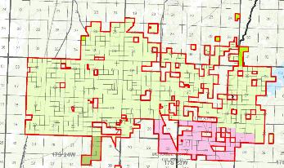
TETRA Brine Unit Lease Discussion
TETRA holds brine leases for nearly 40,000 gross acres shown in red outline on map
TETRA first acquired leases from Dow Chemicals following a 1987 judgement from the U.S. Department of Justice due to the concentration of U.S. bromine producers.
In December 2017, for the leases shaded in yellow (about 35,000 acres), TETRA entered into an agreement to provide Standard Lithium with the option to acquire the lithium mineral rights. These options have not been exercised and are due to expire in 2027
The TETRA leases shaded in pink are within the proposed Unit boundary

Slide 8
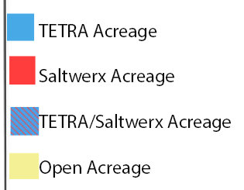
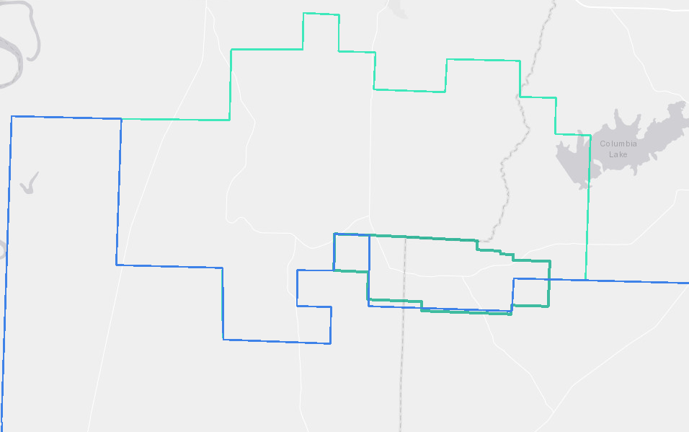
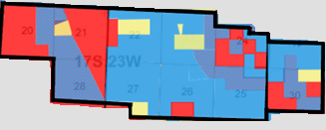
Brine Unit Lease Discussion - Efficient Lease Utilization
Acreage to the North of the Proposed Unit boundary is largely TETRA leases with Standard Lithium option on lithium
Acreage to the South of Proposed Unit boundary is largely controlled by Saltwerx with TETRA owning additional leases in the Southeast area
The Proposed Unit is a good collaboration between TETRA and Saltwerx to optimize leases between TETRA leases to the North and Saltwerx leases to the South
TETRA and Saltwerx own ~90% of the proposed Unit brine mineral rights
Core TETRA area
Core Saltwerx area
Notes:
Remove details of open acreage outside the proposed

Slide 9
Brine Unit Lease Discussion - Efficient Lease Utlization
Execution of TETRA / Saltwerx Agreement is contingent on formation of this Brine Unit
If executed, TETRA will transfer additional leases that it holds South of the Unit to Saltwerx. This will facilitate future potential Units South of the Unit
Higher likelihood of stranded leases that may not fit well in a future Unit
Without this unit approval TETRA will have to participate through brine collecting from disjointed acreage, complicating future Unit formation and inefficient use of capital

Slide 10
Why the TETRA / Saltwerx Unit Approval Is Important
Through excellent collaboration between TETRA and Saltwerx, this unit represents the most efficient way to produce the leases within the Unit while facilitating more efficient future Unit formations bordering the Unit
If the Brine Unit is approved, both parties will execute on the MOU that was signed June 19th, 2023 that sets out an accelerated path towards a Final Investment Decision (FID) targeted for late 2023 / early 2024.
Saltwerx and TETRA are collaborating on the evaluation of Direct Lithium Extraction (DLE) technologies and are in late stages of due diligence to select the DLE provider. TETRA completed a Bromine FEED study at the end of last year and initiated a Lithium FEED study that is due for completion in November
We believe this unit size is optimized ;
Large enough to meet TETRA’s 20-year Bromine demand requirements
Small enough to reduce the technology risk for an early commercial U.S. Direct Lithium Extraction plant
We estimate the combined investment for the wells, pipelines, and both plants to be over $500 million, providing exceptionally good employment opportunities and benefits to lease holders and the State of Arkansas

Slide 11
Evergreen Brine Unit TETRA Technologies, Inc.
July 25, 2023

Slide 12
TEAM LIST
Emily Olson, P.G. – Geologist
Dick Lonquist, P.E. – Engineer
Nate Byars, P.E. – Engineer
Lesly Carter – Geologist
Patricia Pistoun – Geophysicist
Walt Denny – Geophysicist
Brian Davis – Petrophysicist
Jared Coker – Engineer
Jeff Corwith - Engineer
Braxton Reese – Engineer
Connor Lovingfoss – Engineer
John Moltz – Engineer
James Hoff – Engineer

Slide 13
Emily Olson, P.G.
Geology Overview

Slide 14
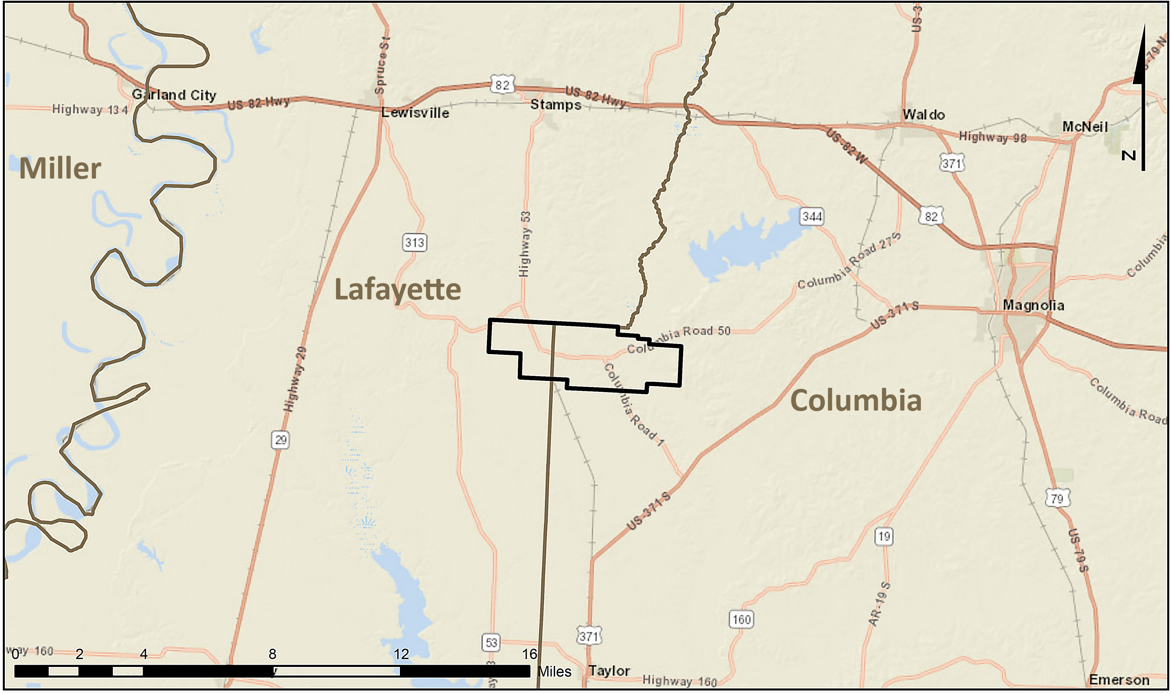
Project Location
Evergreen Unit

Slide 15
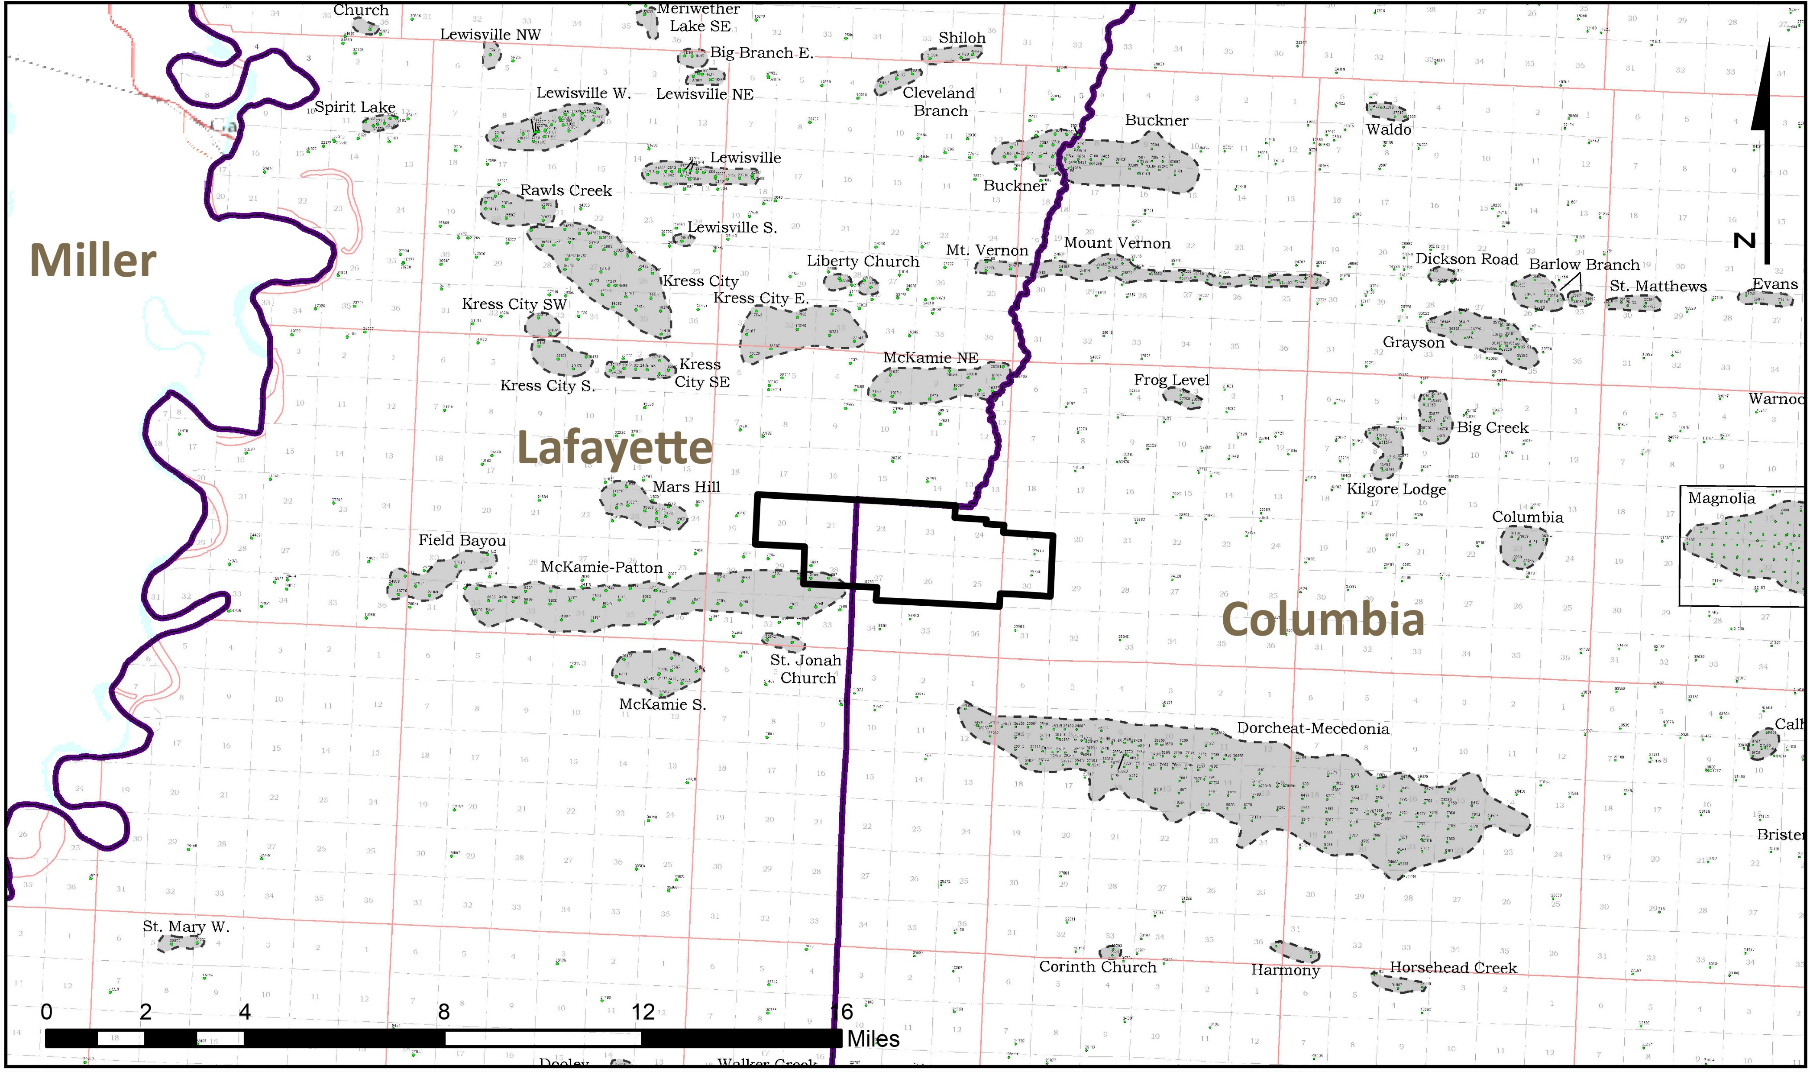
Oil Fields Map
Evergreen Unit
Source: Arkansas Geological Survey, Li and Mills, 2019

Slide 16
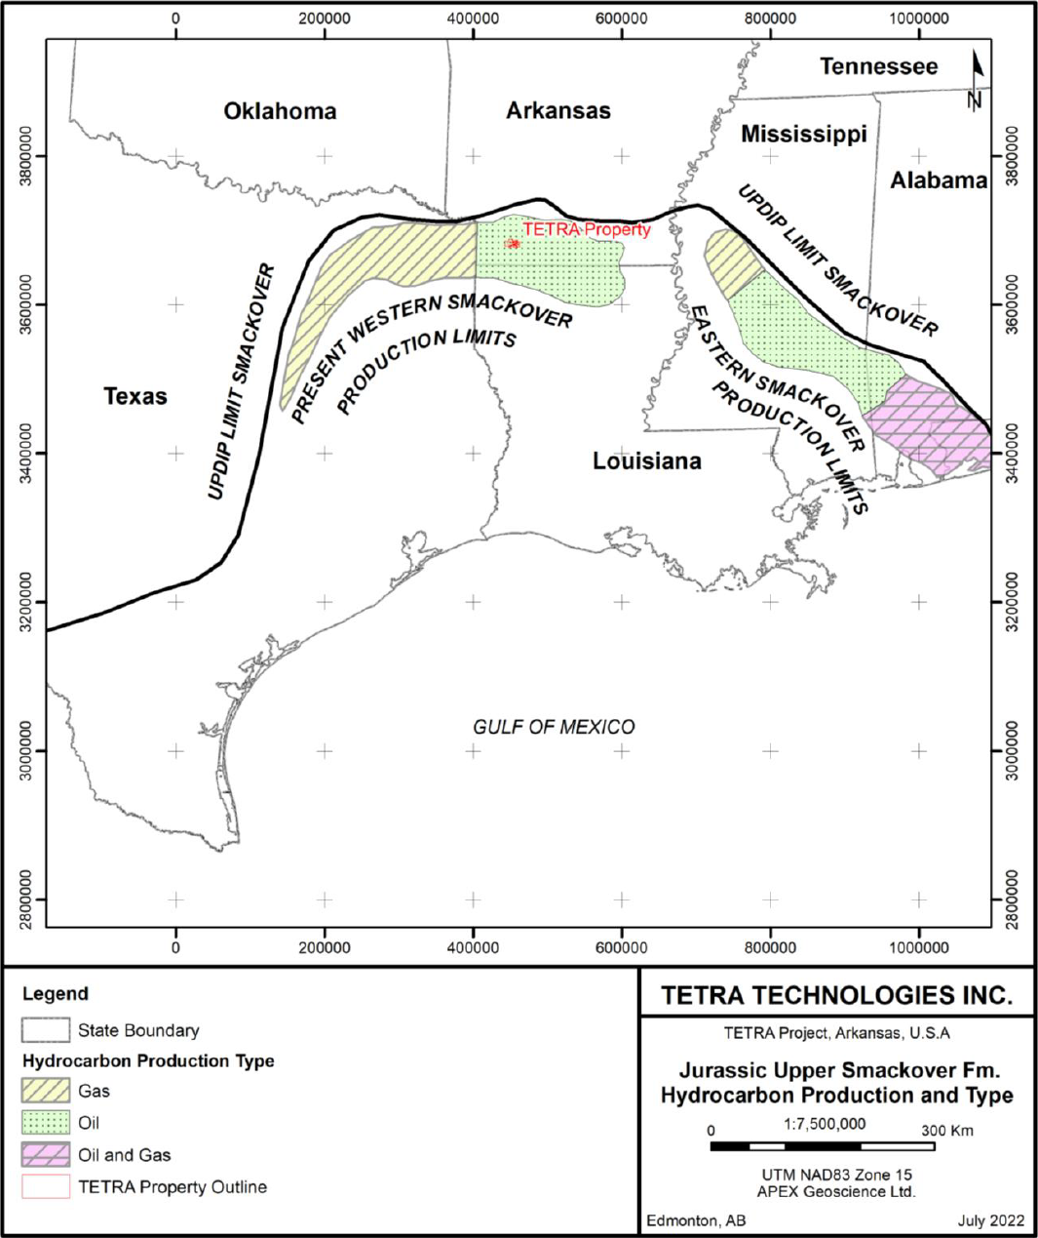
Smackover Extent
Evergreen Unit
Source: APEX Geoscience, S-K 1300 Technical Report, 2022

Slide 17
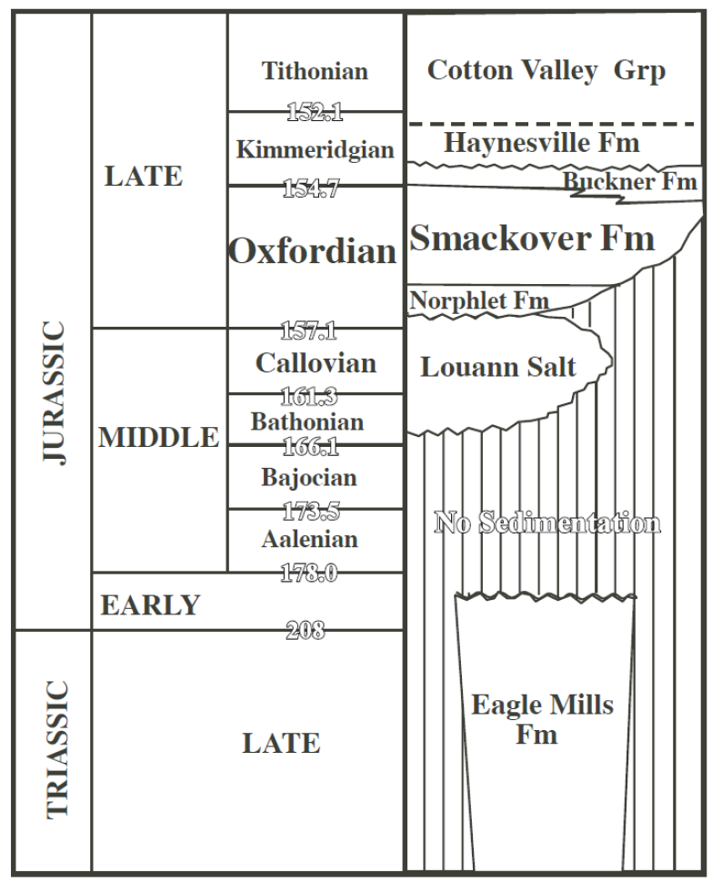
Regional Stratigraphic Column
Source: Heydari and Baria (2005)

Slide 18
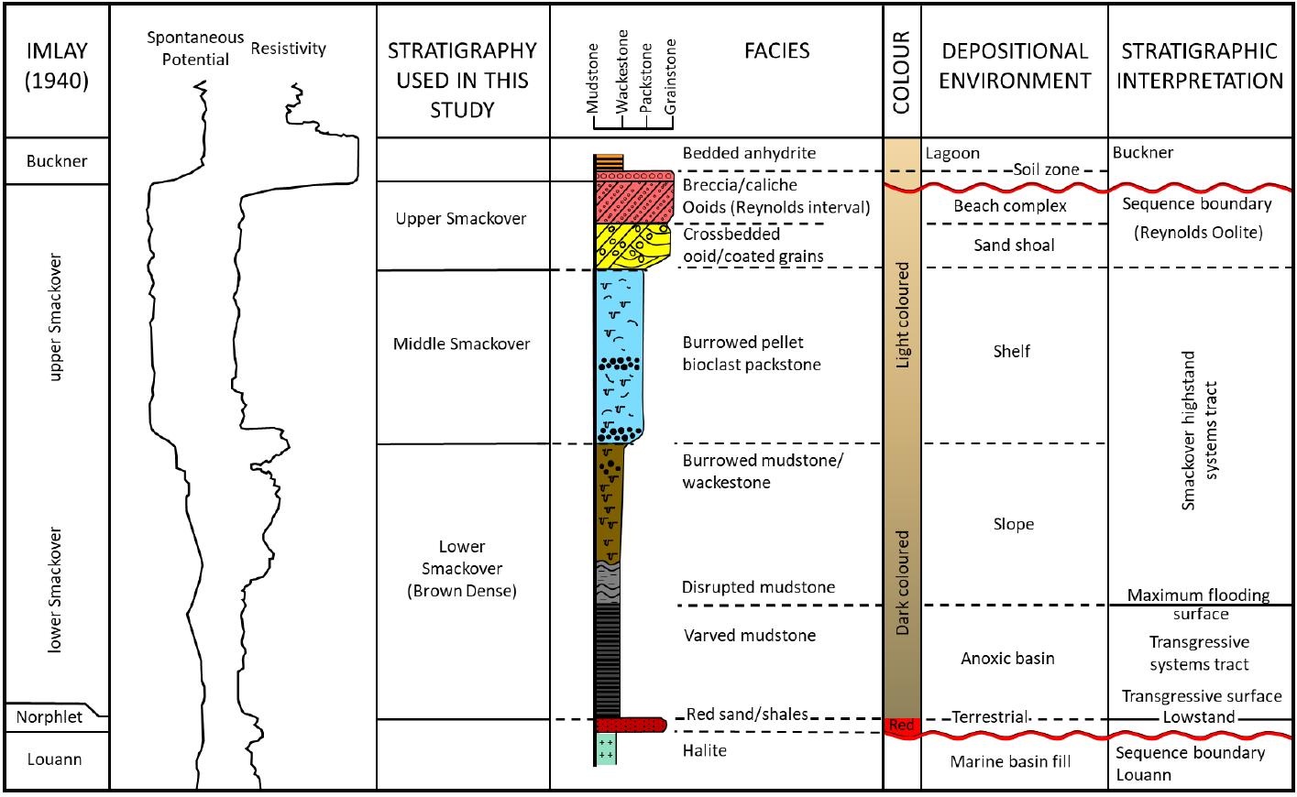
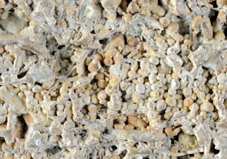
Detailed Stratigraphic Column
Oolitic Limestone
Source: https://www.virtualmicroscope.
org/content/oolitic-limestone-weldon
Source: APEX Geoscience, S-K 1300 Technical Report, 2022

Slide 19
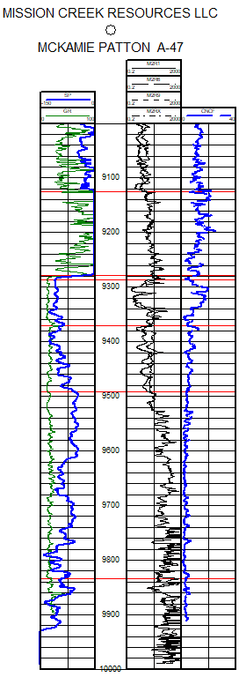
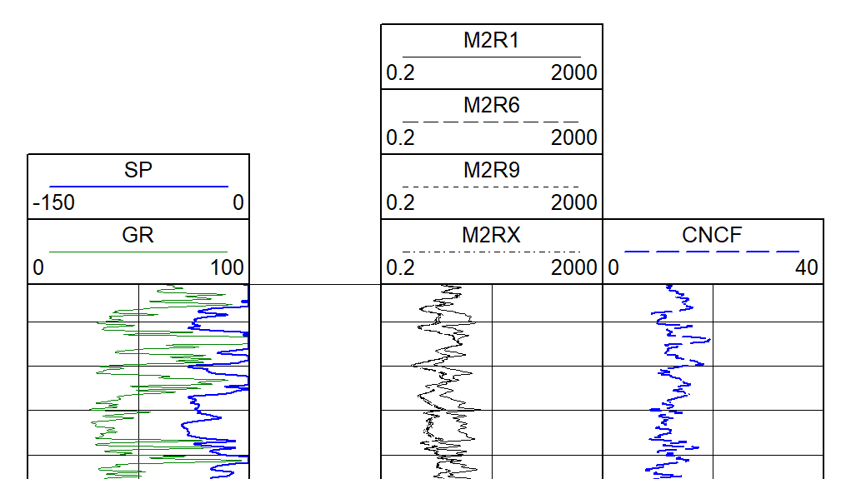
Type Log
McKamie Patton Smackover Unit No. A-47
Buckner
Anhydrite
Upper Smackover Lime
Reynolds
Oolite
Log Header
Middle Smackover
Lower Smackover

Slide 20
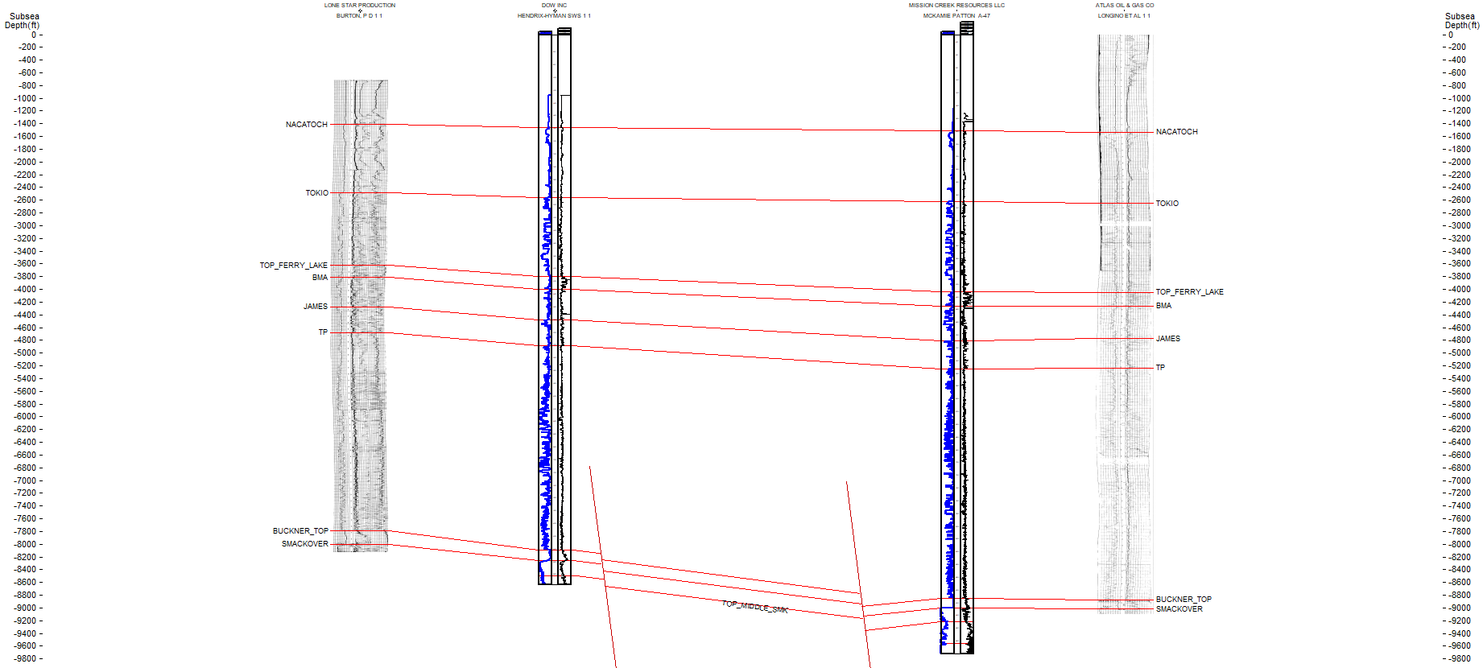
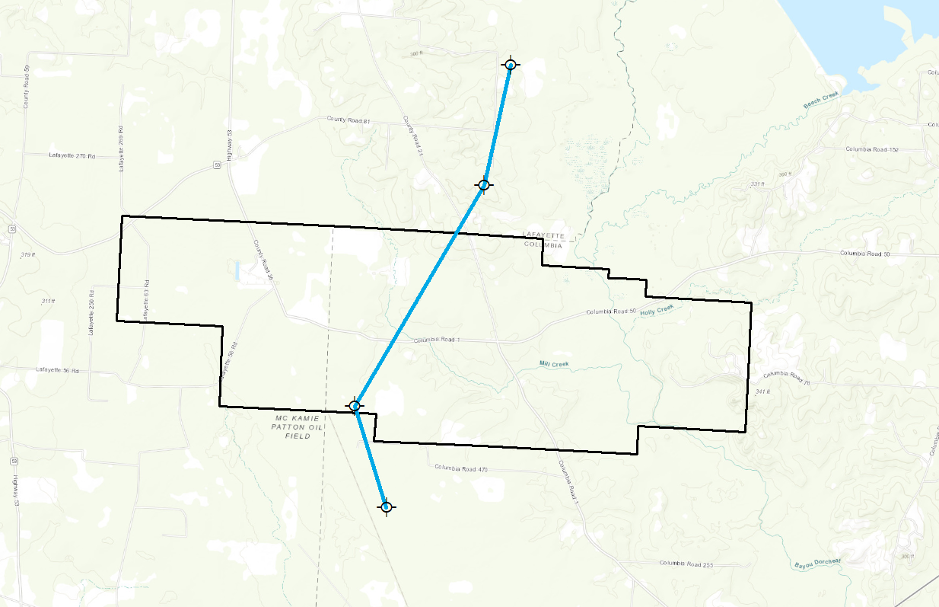
Cross Section
A
A’
A
A’
MIDDLE SMACKOVER
LOWER SMACKOVER

Slide 21
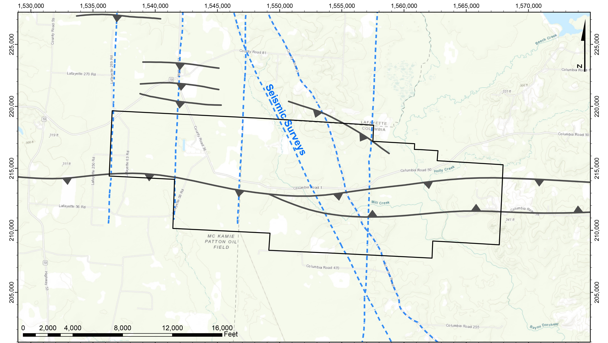
2-D Seismic Surveys

Slide 22
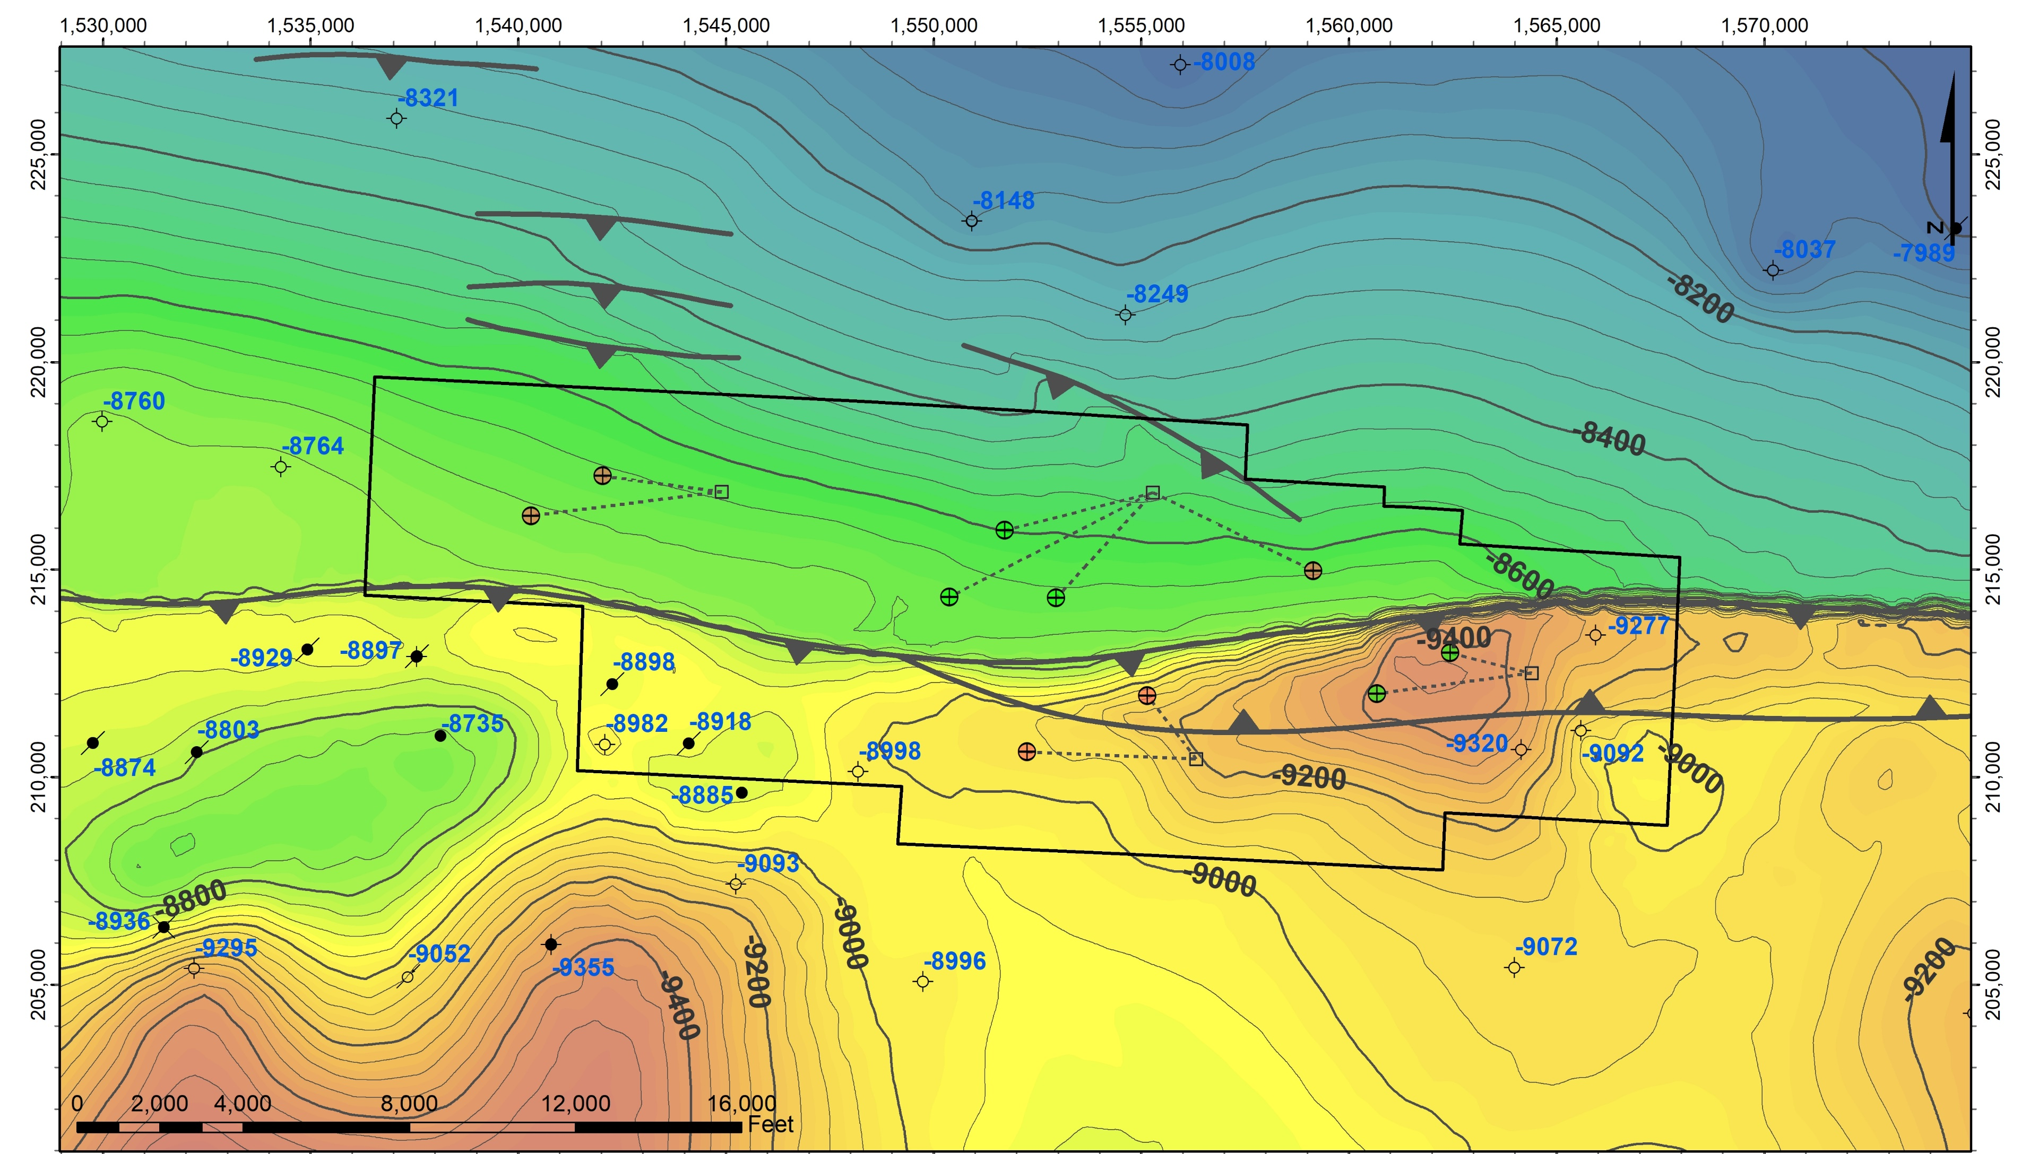
Top of Smackover Structure - Exhibit D-1, Page 2

Slide 23
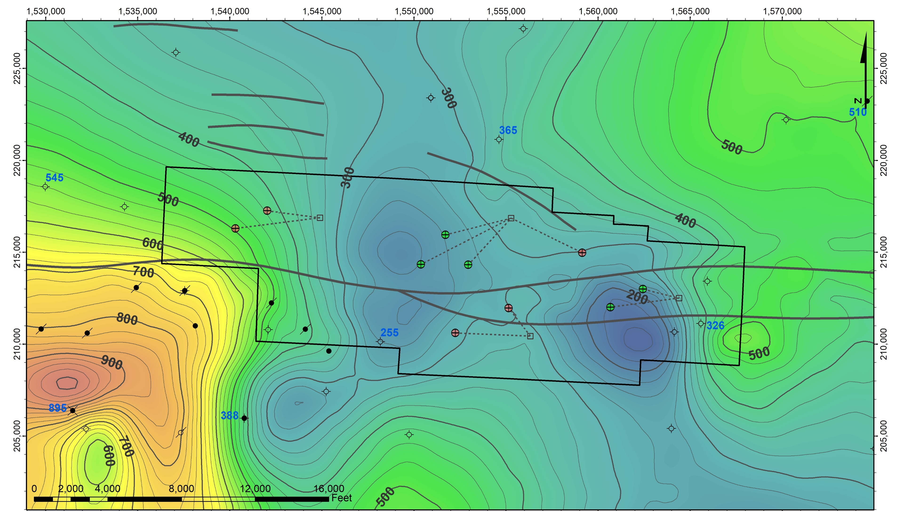
Gross Thickness - Porous Smackover - Exhibit D-1, Page 1

Slide 24
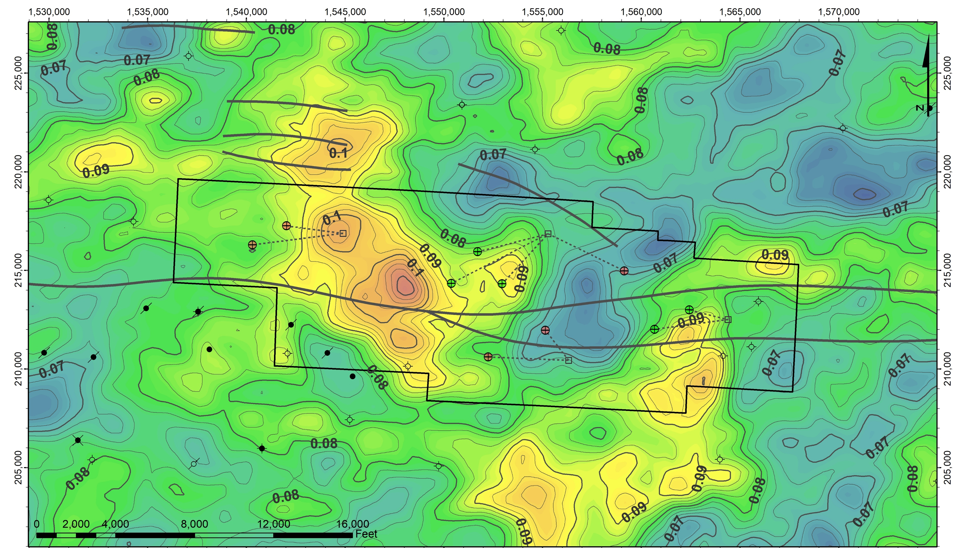
Average Porosity - Porous Smackover - Exhibit D-1, Page 1

Slide 25
Richard R. Lonquist, P.E.
Brine Resource and Drainage Area

Slide 26
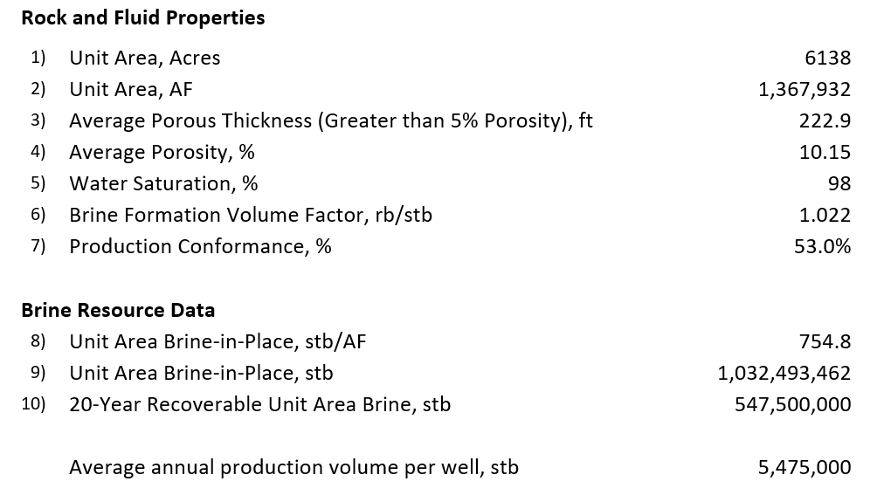
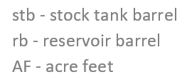
Rock and Fluid Properties – Brine Resources Data – Exhibit D-2

Slide 27
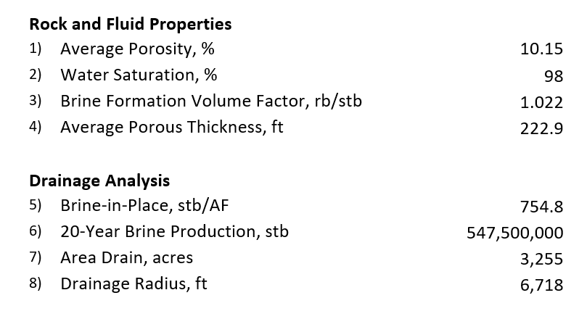
Analysis of Brine Drainage – Exhibit D-5

Slide 28
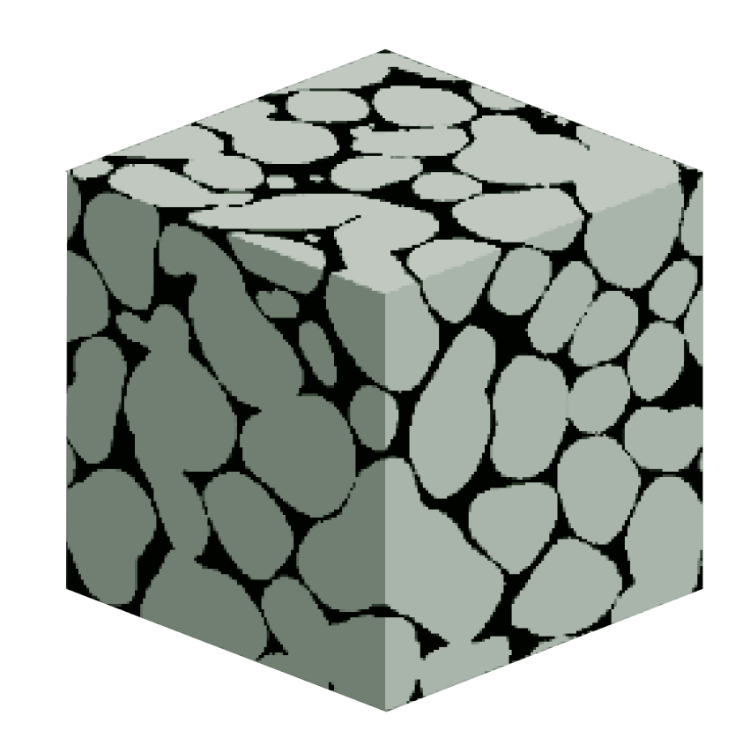
Classic Drainage Calculation – Components
The Drainage Area can be calculated from a volumetric comparison of:
The brine-filled volume in a specific area of reservoir rock
The brine volume produced over time
Drainage
Area
Radius
Rock
Grain
Average Porosity
Fluid
Flow
Reservoir
Thickness
Brine-filled
Pore Space

Slide 29
Classic Drainage Calculation – Example
A single brine supply well producing 15,000 bbl/day for 20 years:
Drainage area: 651 acres
Drainage radius: 3,004 feet
Unit Brine-in-Place Produced: 10.6%
The same volume of Tail Brine is injected nearby to maintain the same overall pressure in the reservoir
3,004 feet
651 acres
15,000 bbl/day
222.9 ft

Slide 30
Classic Drainage Calculation – Limitations
This does not account for:
Flow direction induced by offset Injection wells
Production of previously injected Tail Brine
Variations in reservoir geometry and rock properties
Shape of drainage is not represented by this method
Drainage
Area
Radius
Fluid
Flow
Reservoir
Thickness

Slide 31
Classic Drainage Calculation – Recovery Percentage
The volumetric drainage calculation does allow for an estimate of the percentage of the resource that will be produced
Considering 5 brine supply wells, each producing 15,000 bbl/day:
20-year operation will produce 53% of the Unit Area Brine-in-Place
Hypothetically, it would take 37.7 years to produce 100% of the resource (Not possible due to physical limitations)
These calculations do not consider secondary production of previously injected Tail Brine which will lower percentage of resource produced

Slide 32
Richard R. Lonquist, P.E.
Basics of Reservoir Simulation

Slide 33
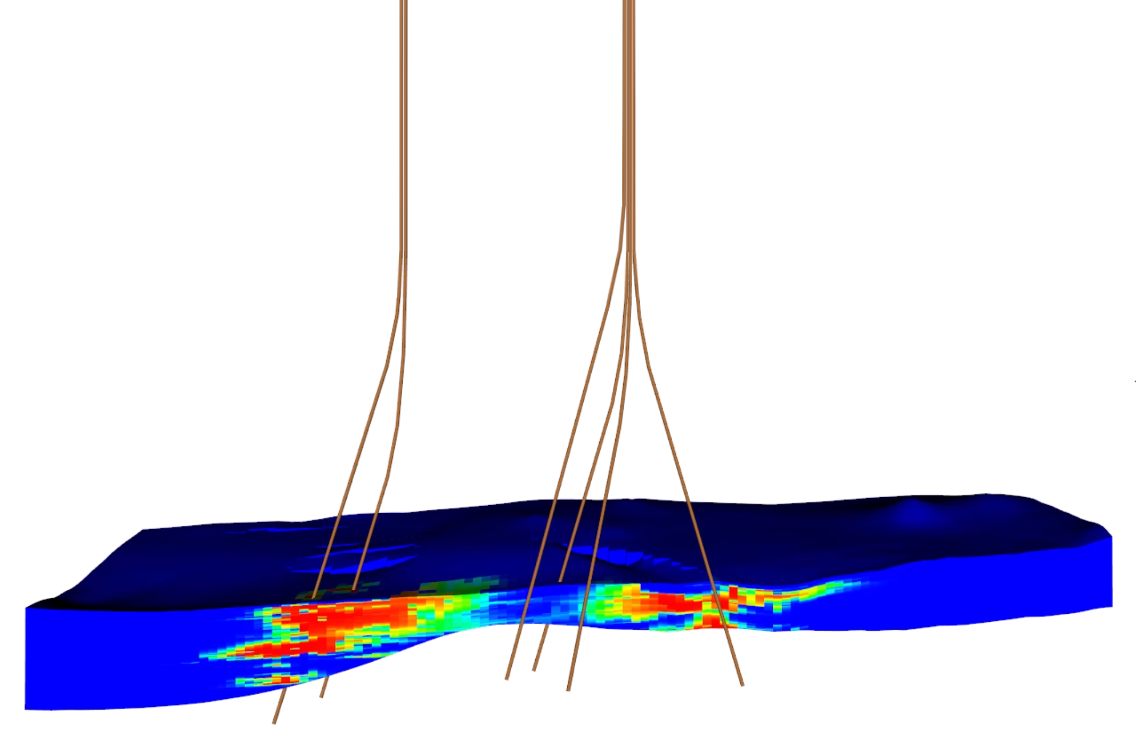
Why Use Reservoir Simulation?
The modeling of pressure distributions, formation variations, flow channels and flow barriers allow for more accurate modeling of fluid movement and sweep efficiency
Reservoir Simulation
Classic Volumetrics

Slide 34






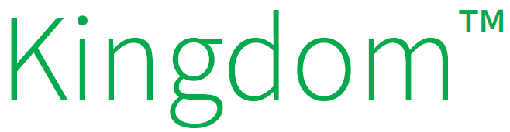
Basic Workflow
Interpret Geologic Data
Create 3D Structural Model
Distribute Rock Properties
Build Reservoir Model
Design and Run Simulations
Review and Optimize

Slide 35
Computer Modeling Group’s GEM Software
Equation-of-State (EOS) reservoir simulation software for compositional, chemical and reservoir modelling
Why use this software?
Computer Modeling Group (CMG) founded in 1978 in Calgary, Alberta
First version of GEM software released in 1982
Continuously improved to provide increasingly advanced capabilities
Has become the World-leading 3D EOS reservoir simulator
Source: https://www.cmgl.ca/gem

Slide 36
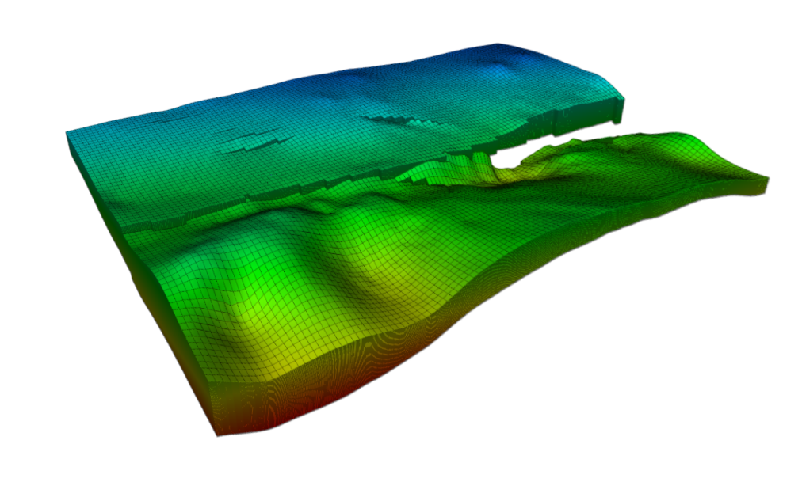
What is Reservoir Simulation?
Combines physics, mathematics, reservoir engineering, and computer programming to develop a tool for predicting reservoir performance under various operating conditions Basic Applied Reservoir Simulation Vol. 7
Can help identify:
Resource recovery over time
Spatial variability of fluid flow
Optimal well positioning and flow rates
Pressure gradients throughout reservoir

Slide 37
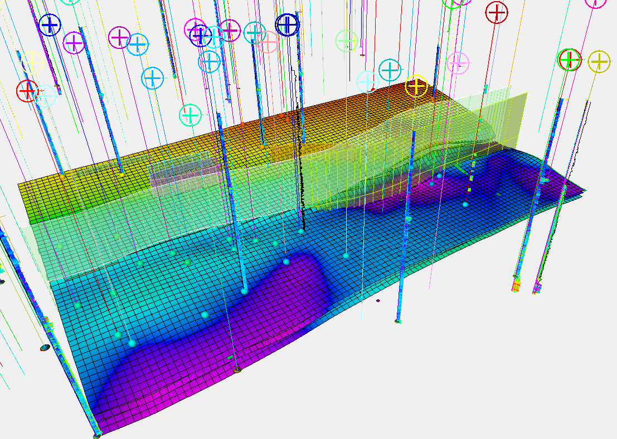
Simulation Fundamentals: Geocellular Model
The geometry of the grid is modeled from well logs, core data and seismic survey data
Formation structure and thickness, lithologic facies, and fault geometry are used to define the grid’s 3D characteristics

Slide 38
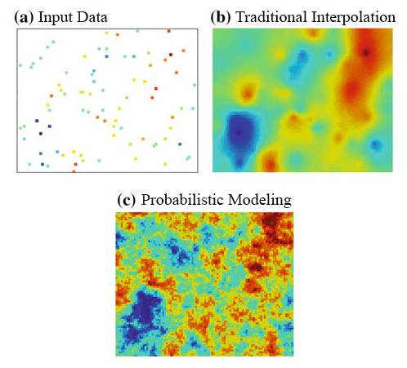
Simulation Fundamentals: Geostatistics
Geostatistics is used to analyze and predict spatial geologic properties
Using well logs and core data, rock properties are statistically distributed between the control points
Traditional interpolation techniques lack the ability to generate realistic distributions of formation properties
Source: https://www.researchgate.net/figure/Comparison-between-the-results-of-Kriging-b-and-stochastic-simulation-c-using_fig1_326106457

Slide 39
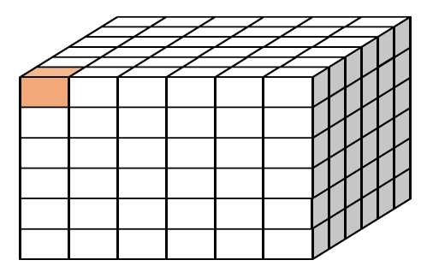
Simulation Fundamentals: The Grid
The reservoir is characterized by a grid
This is comprised of thousands of grid cells
Each grid cell is assigned values that represent the reservoir
Porosity, Permeability, Depth, etc…
Each cell is simulated in the model
Solves for pressure, flow rate, fluid composition, etc.
Fundamental Theory: Conservation of Mass
(Volume In) – (Volume Out) = 0
If brine flows into a cell, then an equal amount must flow out
Grid Cell
5 ft
400 ft
400 ft
Porosity, Permeability, Depth, etc…
In
Out

Slide 40
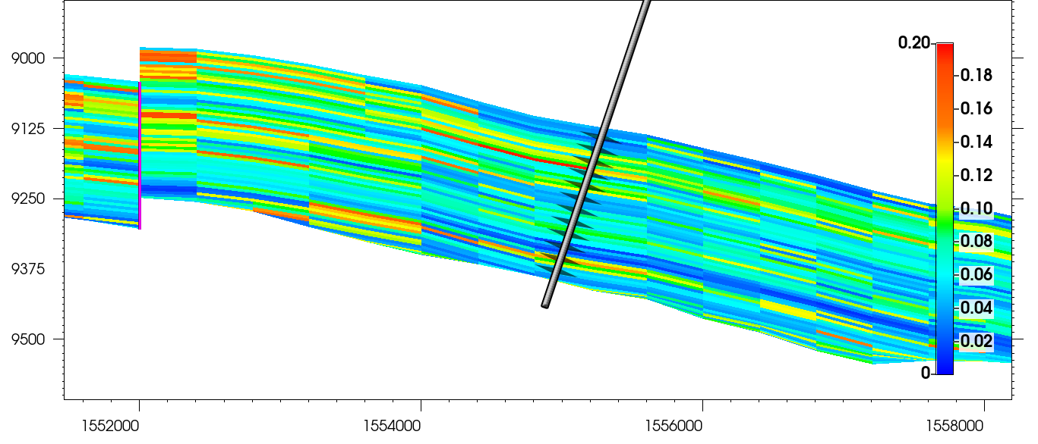
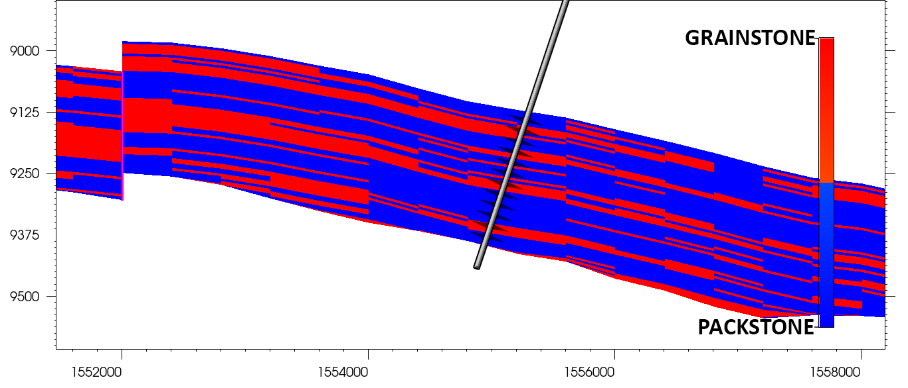
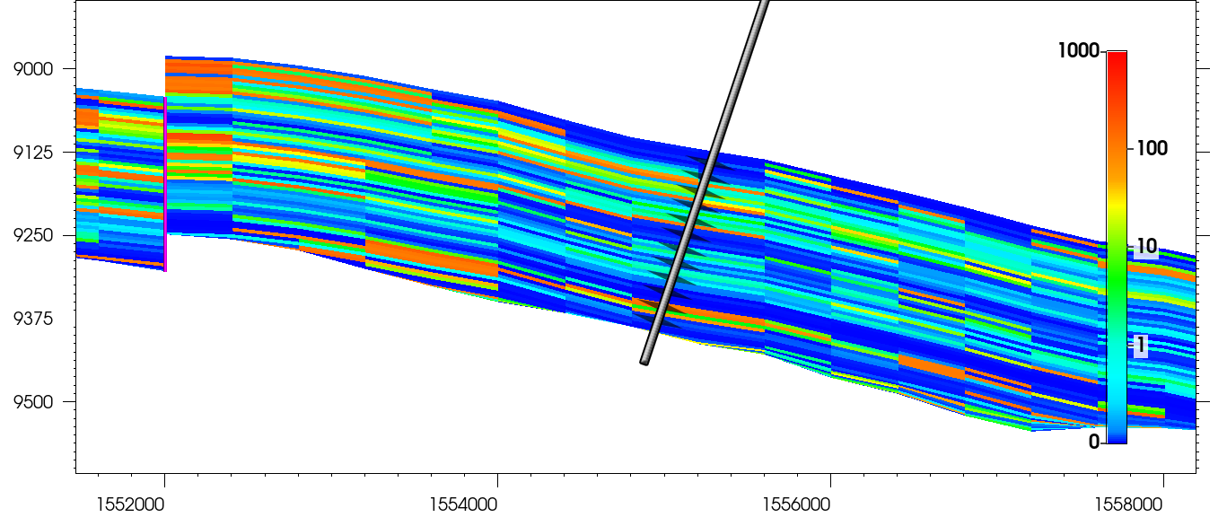
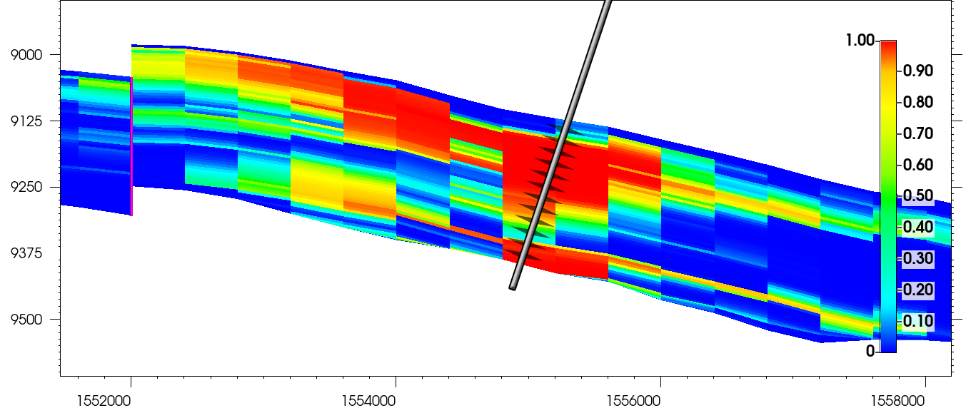
Model Properties and Flow Distribution – Cross Section Through Injection Well
Porosity Distribution
Facies Distribution
Permeability Distribution
Tail Brine Concentration (3 years)

Slide 41
Nathaniel L. Byars, P.E.
Reservoir Simulation Results

Slide 42
Reservoir Model Properties
Following import of the geocellular grid, a few additional properties were defined in GEM:
Fluid properties were defined from geochemical data for Smackover brine
Initial formation pressure and temperature were modeled from available data including pressure depletion in the McKamie Patton field
Grid boundary conditions were defined to simulate connectivity to a broader but finite aquifer outside of the grid extent
Fault transmissibilities were estimated from modeled fault geometry and historical field data

Slide 43
Modeling Iterations
The primary goal of the reservoir simulation efforts was to effectively harvest the resource without impacting reservoir brine outside of the unit boundary
50+ simulations were run throughout this process to improve sweep efficiency and confine effect of operations within the unit
The following slides depict the resulting proposed development plan

Slide 44
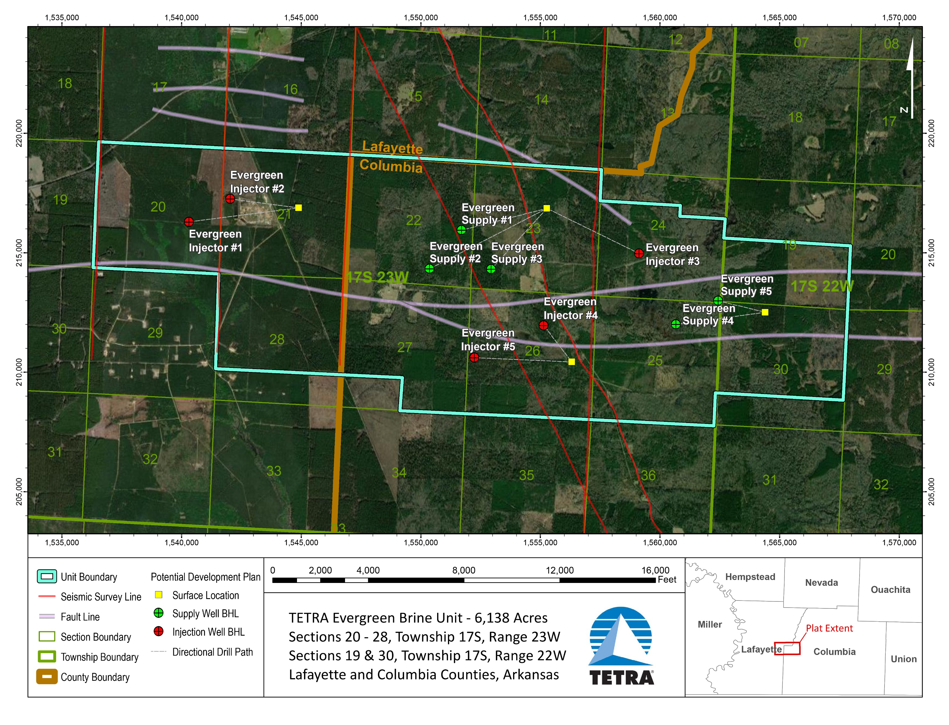
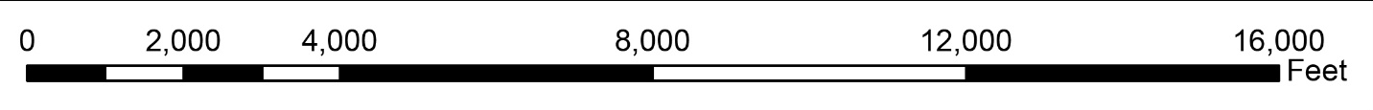
Development Plan – Exhibit A-2

Slide 45
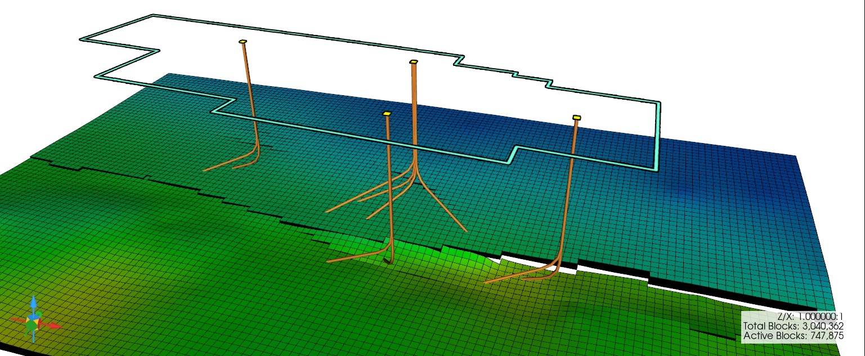
Directional Well Trajectories from Surface to Top of Reservoir

Slide 46
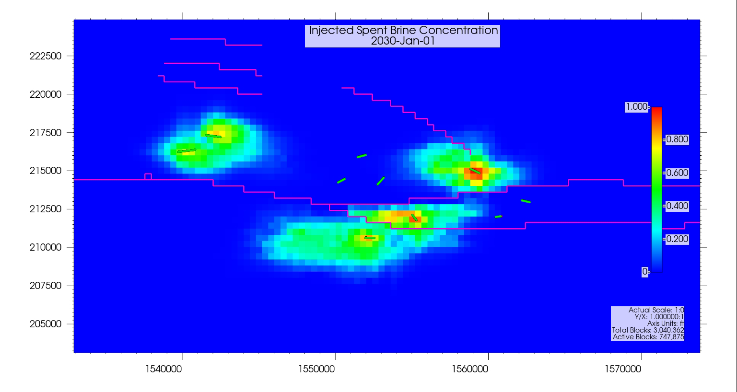
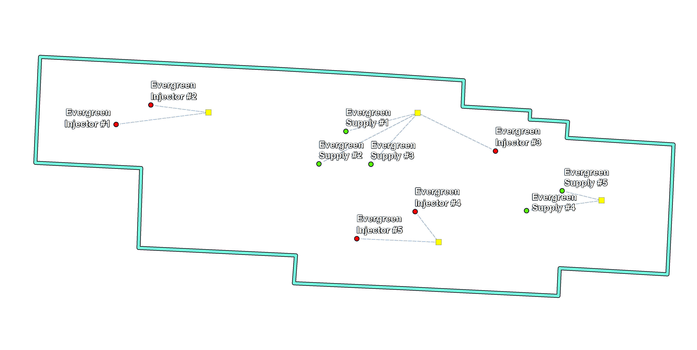
Injected Tail Brine Flow – Concentration in Reservoir – 5 Years

Slide 47
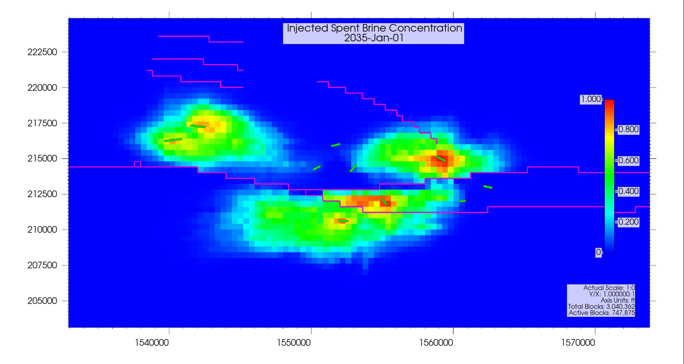
Injected Tail Brine Flow – Concentration in Reservoir – 10 Years

Slide 48
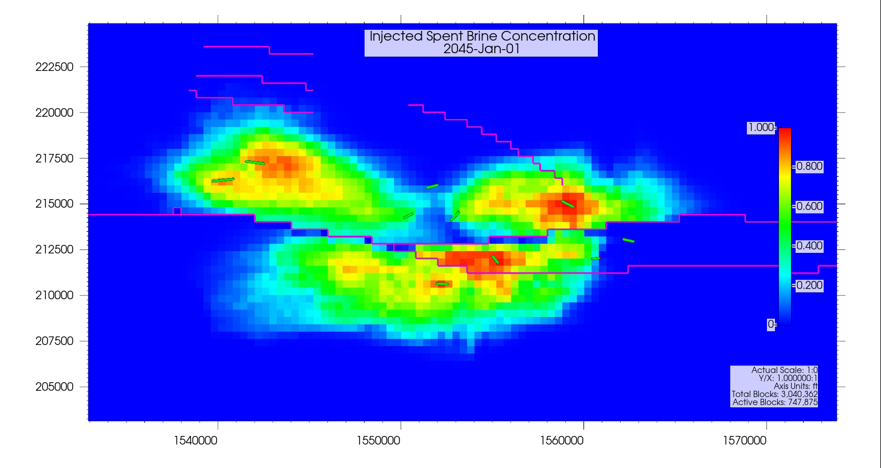
Injected Tail Brine Flow – Concentration in Reservoir – 20 Years

Slide 49
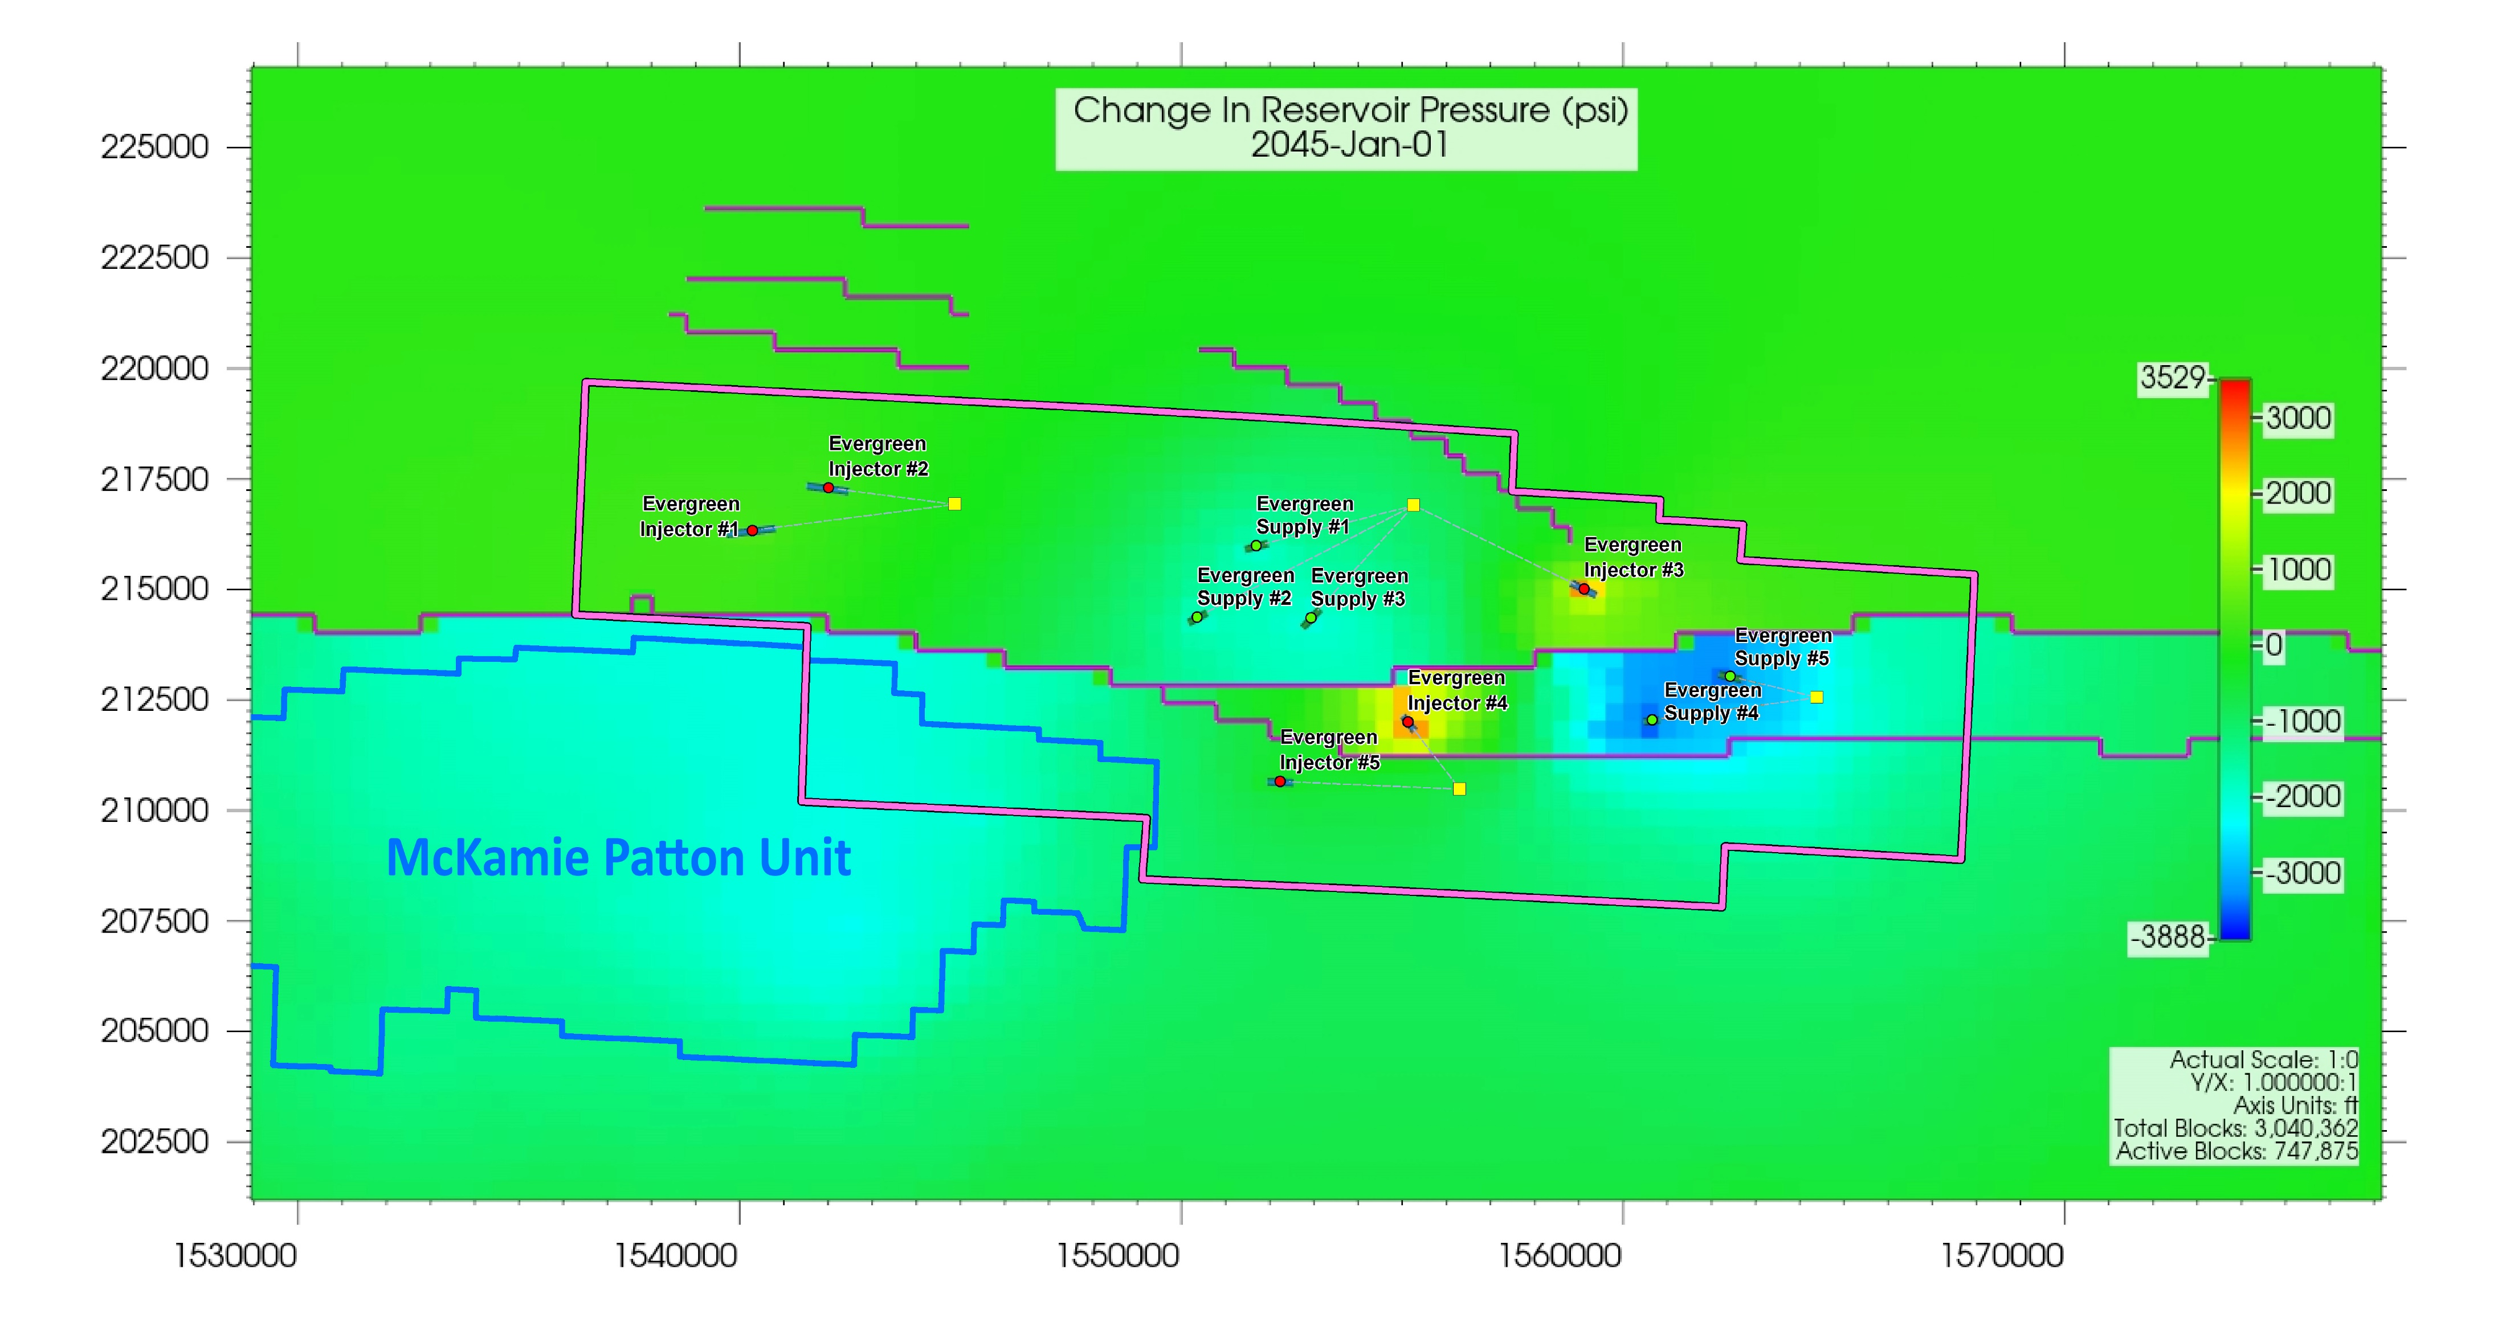
Pressure Distribution Relative to Native Pressure at 20 years

Slide 50
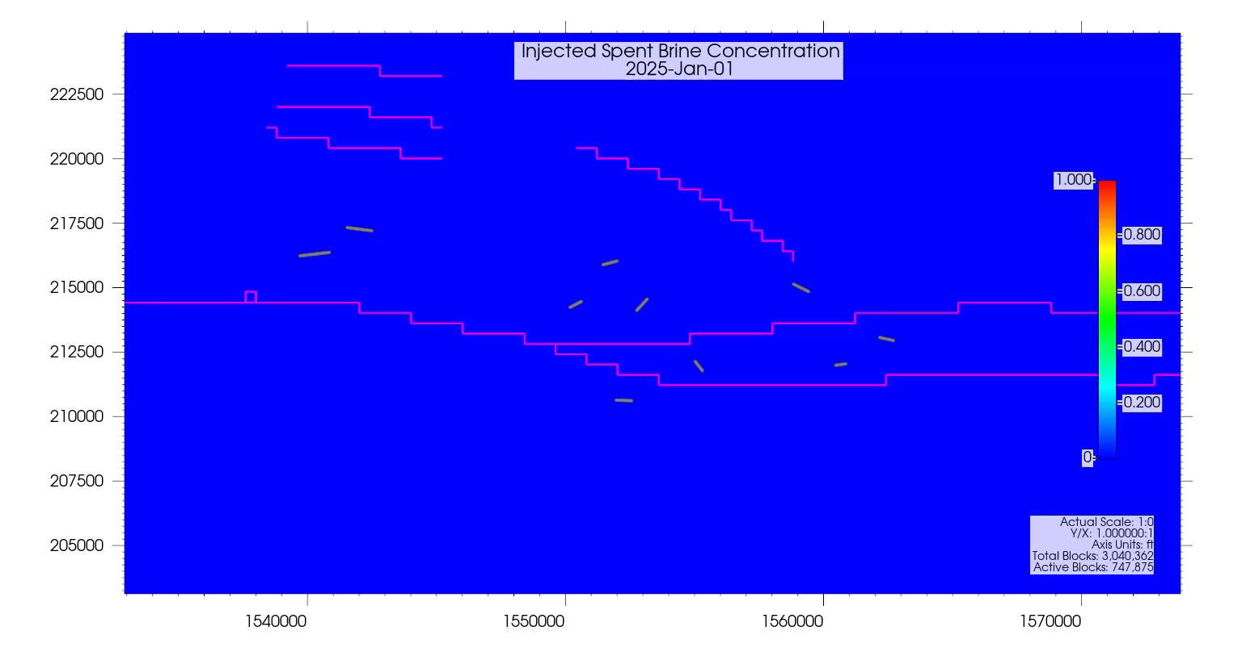
Injected Tail Brine Flow Video – Concentration in Reservoir

Slide 51
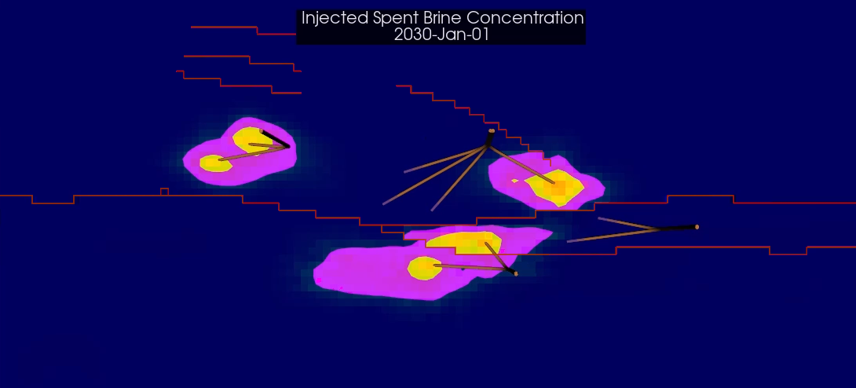
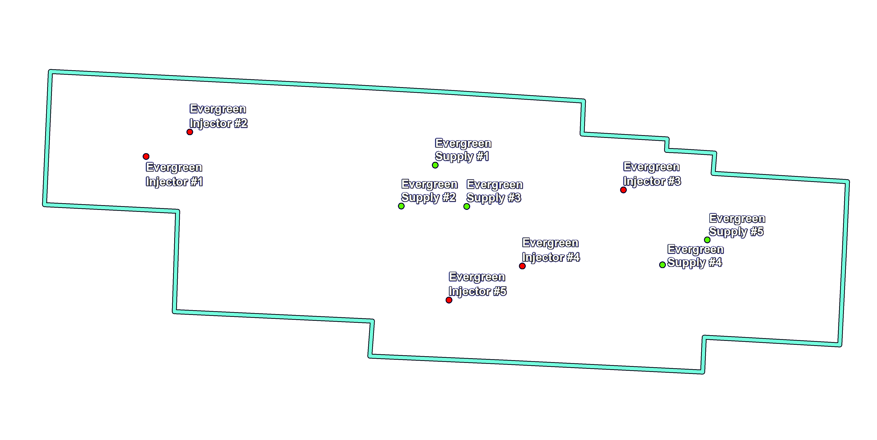
Injected Tail Brine Flow – Iso-Contours – 5 Years
Tail Brine
Concentration
50%
20%

Slide 52
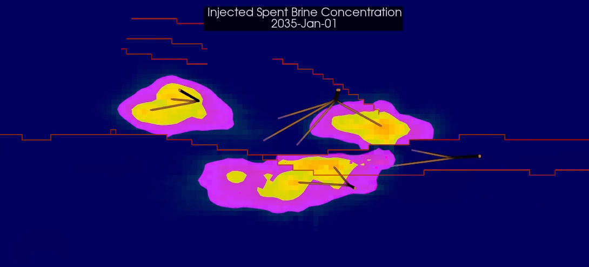
Injected Tail Brine Flow – Iso-Contours – 10 Years
Tail Brine
Concentration
50%
20%

Slide 53
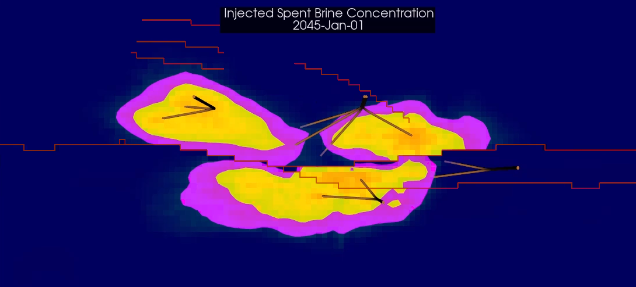
Injected Tail Brine Flow – Iso-Contours – 20 Years
Tail Brine
Concentration
50%
20%

Slide 54
Resource Recovery
The modeled production of Reservoir Brine over 20 years totaled:
501.3 MMbbl
(Total Brine production) minus (Production of previously injected Tail Brine)
Relative to the Total Unit Brine-in-Place* (Exhibit D-2), this represents a recovery of:
48.6%
*Excludes brine in reservoir rock with less than 5% porosity

Slide 55
TETRA – Mineral Lease Update
Mineral Leasing Activities Since July 5, 2023 Unit Application Submission
Made additional contact with (63) unleased owners, some multiple times, between 4/24/2023 and 7/17/2023 (Exhibit I updated)
ALL unleased owners that could be located were contacted at least once prior to June 24, 2023
Leased additional 16.42 acres, with (5) mineral owners
Increased TETRA-Leased acreage from 3,607.58 acres to 3,624.00 acres (Exhibit A-1 updated)
Increased TOTAL (TETRA + Saltwerx) Leased acreage from 5,339.28 acres to 5,355.70 acres (Exhibit A-1 updated)
Increased % of 6,138-acre Unit Leased from 86.98% to 87.25% (Exhibit A-1 updated)
McKamie Gas Cleaning Company
Confirmed (29) owners are deceased
Discovered (76) heirs tied to (29) deceased owners, and are in process of identifying addresses, etc.

