Slide 1
A FEASIBILITY STUDY FOR THE
FORMATION OF AN
INDEPENDENT MUNICIPAL SCHOOL SYSTEM
Prepared for the
City of Fairhope, Alabama
January 7th, 2026

Slide 2
Introduction Narrative

Slide 3
Our study begins with a look at the City of Fairhope. Our projections in this study are for a system that includes only students who currently reside within the Fairhope City limits. Demographic data from the U.S. Census website and financial data from the latest published audit is included.
Next is the School Capacity Analysis showing the schools that are in the current Baldwin County School System’s Fairhope City Feeder Pattern and the projected attendance if only Fairhope citizens were attending those schools. This will show the excess capacity of each school to determine the feasibility of allowing students outside of Fairhope city limits to attend, as well as adding other programs like Pre-K and expanded vocational programs.
The Pro Forma Budget section of this report begins with a compilation of estimated start-up costs the City of Fairhope could expect to incur in the eighteen months prior to the new system’s grand opening. These expenditures relate mostly to administrative costs required to getting the new school system established and ready for students. The worksheet also provides a timeline of when those expenditures will be incurred. Since local, state and federal revenues will not be available until after school begins, the funding for those costs would have to come from the City of Fairhope.

Slide 4
The Pro Forma Budget section then illustrates annual revenues and expenditures after the new system’s doors are opened. The reports of Combined Revenues, Expenditures and Changes in Fund Balances are in the same format that the Alabama State Department of Education requires for monthly reporting. These reports, called F-II reports, estimate revenues and expenditures that a new Fairhope City School System could have expected to incur during the fiscal year ended September 30, 2025.
We estimated revenue based on actual amounts received by Baldwin County and Gulf Shores School Systems since their tax structures would be similar to what would be expected in a Fairhope City School System. Expenditures were also estimated using those same school systems with the addition of three other Alabama school systems of similar size and demographics. Average revenues and expenditures were calculated on a per pupil basis for those comparable systems and then projected to various expenditure categories on an average daily membership (“ADM”) basis.
We also included a report showing the estimated total revenues and expenditures for the new Fairhope City School system compared to those same similar school systems’ actual revenues and expenditures for the fiscal year ended September 30, 2025.
The proforma budgets are also presented in two different scenarios. Scenario #1 is a straight comparison without any adjustments to the average numbers other than removing large capital outlay project expenditures.

Slide 5
Scenario #2 has more expenditures removed by limiting capital outlay only to maintenance projects, with no new capital improvements. In addition, debt service expenditures are reduced by refinancing all debt and spreading the payments over 20 years. This would allow the system to have lower payments initially, which would be paid out over a longer time, but would result in more interest expense.
Next is a discussion of property taxes and what a “mill” would generate in the City of Fairhope. Also included is a chart to estimate what additional millage would cost citizens based on their property values.
The final sections of the report would be a list of financial considerations in forming a new Fairhope City School System and a compilation of the specific costs to the citizens of Fairhope, both upfront costs and ongoing.

Slide 6
Acknowledgements
Fairhope, Alabama City Officials
Name | Position
Sherry Sullivan | Mayor
City Council
Jack Burrell | Place 1
Joshua Gammon | Place 2
Jimmy Conyers | Place 3
Jay Robinson | Place 4
Andrea Faust Booth | Place 5
Acknowledgements
  The Criterion project team expresses its appreciation to thank Joseph Davis, Chief Clerk of the Baldwin County Revenue Commissioner, for his help with property tax projections.

Slide 7
Attendance projections based on students living in the Fairhope City Limits
SCHOOL | GRADES | 2024-2025 PROJECTED ATTENDANCE
Fairhope High School | 9-12 | 822
Fairhope Middle School | 7-8 | 399
Fairhope East Elementary | K-6 | 548
Fairhope West Elementary | K-6 | 697
J. Larry Newton School | K-6 | 136
Baldwin Preparatory Academy | 10-11 | 22
TOTAL |  | 2,624

Slide 8
Population Data
City Population Data
Geographical Area |  |  | 2010-2020
Area | 2010 | 2020 | Growth | % Growth
Fairhope | 15,326 | 22,469 | 7,143 | 47%
Source: U.S. Census Bureau Redistricting Data
Geographic Area | April 1, 2020 |  | Population Estimate 2024
 | Census | Estimates Base | 26,044
Fairhope | 22,469 | 22,477
Source: U.S. Census: City and Town Population Totals 2020-2024 and U.S. Census: City and Town Population Totals 2010-2020

Slide 9
Housing Data
New Issued Building Permits
Building Permits - Fairhope, AL
Year | Single-Family | Multi-Family
2013 | 268 | 2
2014 | 266 | 0
2015 | 303 | 0
2016 | 348 | 0
2017 | 380 | 0
2018 | 321 | 0
2019 | 404 | 44
2020 | 306 | 2
2021 | 288 | 0
2022 | 259 | 260
2023 | 296 | 240
2024 | 162 | 0
2025* | 183 | 0
Source: SOCDS Building Permits Database
*Preliminary through August 2025

Slide 10
City of Fairhope
Balance Sheet per 9/30/24 Audit
Net Position-Balance Sheet |  | FY 2024 | FY 2023
Current and Other Assets |  | $ 48,733,731 | $ 46,647, 229
Capital Assets |  | 122,653,701 | 107,329,390
Total Assets |  | 171,387,432 | 153,976,619
Deferred Outflows of Resources |  | 5,234,906 | 7,356,798
Long-term Liabilities |  | 18,053,002 | 17,220,236
Other Liabilities |  | 8,280,237 | 8,182,444
Total Deferred Inflows of Resources |  | 2,217,944 | 3,462,977
Net Position |  | $ 148,071,155 | $ 132,467,760
Total Revenues |  | $ 54,640,960 | $ 47,497,097
Total Expenses |  | 39,037,565 | 34,285,016
Change in Net Position |  | $ 15,603,395 | $ 13,212,081

Slide 11
Fairhope City School Capacity Analysis
School | Grade Structure | Student ADM for FY 26 | Projected Enrollment City Limts Only | Under Capacity | Building Utilization Factor
Fairhope High School | 9-12 | 1513 | 844 | 669 | 56%
Fairhope Middle School | 7-8 | 768 | 399 | 369 | 52%
Fairhope East Elementary | K-6 | 885 | 548 | 337 | 62%
Fairhope West Elementary | K-6 | 925 | 697 | 228 | 75%
J. Larry Newton Elementary | K-6 | 754 | 136 | 618 | 18%
TOTAL |  | 4,845 | 2,624 | 2,221 | 55%
* This is known capacity based on current ADM and there is probably additional capacity at each school.
ALSDE: Building Capacity of 80-90% is considered 100% Utilization.
Only 55 percent of the students in the Fairhope feeder pattern currently reside in the city limits of Fairhope. This has far-reaching implications if a new school systems would be formed:
The excess capacity would indicate that even with the high population growth of Fairhope, there would be no immediate need for additional classroom space and no need to budget anything but maintenance and buses in the capital budget.
Adding students by “grandfathering” in existing enrolled students who live outside the city limits should not cause overcrowding.
We are not including Pre-K students in this analysis, but there appears to be adequate space to have Pre-K classes at every school.

Slide 12
Pro Forma Budgets
Jeff Middleton

Slide 13

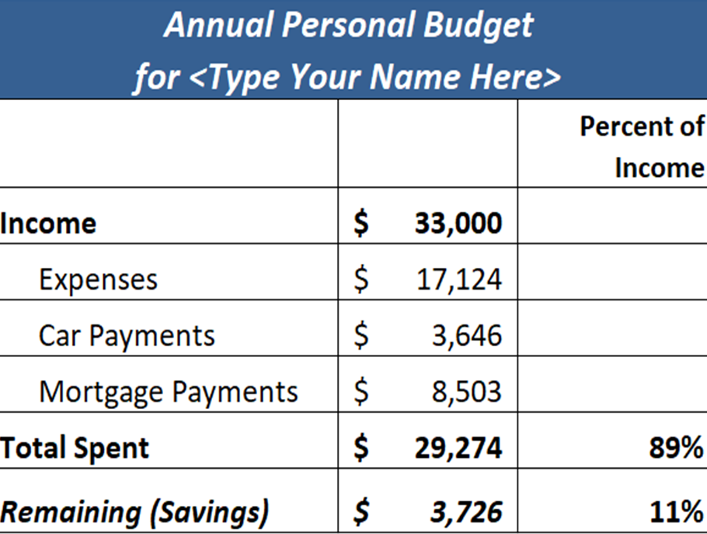
Revenues and Expenditures

Slide 14
Fairhope City Schools - Startup Budget
 | City Only ADM | Comments
Revenues
Local Tax Revenue- Sales Tax Only | 1,000,000.00 | Monthly sales tax collections from July 1 will be received starting in August
 |  | Ad Valorem tax revenue and state/federal revenue will begin in October
Expendit
Payroll (includes fringe benefits)
Central Office:
Board Members (5) | 65,000.00 | 15 months, starting July of previous year
Superintendent | 260,000.00 | 15 months, starting July of previous year
Admin. Secretary | 60,000.00 | 10 months, starting December of previous year
CSFO | 120,000.00 | 10 months, starting December of previous year
Technology Coordinator | 88,000.00 | 9 months, starting January of current year
Director of Operations/Transportation | 100,000.00 | 9 months, starting January of current year/ Transportation, Maintenance, Custodial, etc.
Curriculum & Instruction Director | 65,000.00 | 6 months, starting April of current year
Special Education Supervisor | 46,000.00 | 5 months, starting May of current year
CNP Supervisor | 40,000.00 | 5 months, starting May of current year
Bookkeepers | 85,000.00 | 5 months, starting May of current year
Secretaries | 85,000.00 | 5 months, starting May of current year
Custodial | 55,000.00 | 4 months, starting June of current year
Mechanics | 30,000.00 | 4 months, starting June of current year
Career Tech Director (.25) | 9,000.00 | 3 months, starting July of current year
Principals | 120,000.00 | 3 months, starting July of current year
Asst. Principals | 100,000.00 | 3 months, starting July of current year
Maintenance Worker | 30,000.00 | 3 months, starting July of current year
Teachers/Support: | 2,000,000.00 | September payroll (excluding detail positions above) including fringe benefits
Other Expenses:
CO Supplies/Copier Lease | 23,000.00 | Central Office, monthly expense beginning March of current year
Custodial/Maintenance Supplies | 15,000.00 | Custodial services and supplies/Maintenance supplies, July - Sept of current year
Transportation | 64,000.00 | 3 months' insurance, fuel, tires, parts and supplies
Insurance | 130,000.00 | Annual premium for general liability, property, boiler, employee blanket & official bonds.
Utilities | 90,000.00 | 3 months' power, gas, water, sewer
Legal Fees | 150,000.00 | Estimated 15 months
Hardware/Software | 1,500,000.00 | Central Office, new teachers, instructional software, switches, servers, fiber, data center
Classroom Supplies | 10,000.00 | New teachers in August
Professional Learning/Travel (AASB) | 30,000.00 | Estimated costs July - Sept of current year
Total Expenditures | 5,370,000.00
Expenditures Over Revenue | (4,370,000.00)

Slide 18
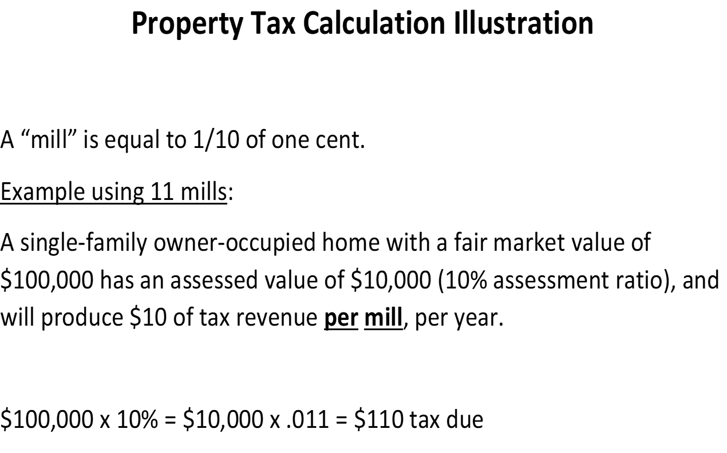

Slide 19
Illustration of Millage Increase Impacts
Impact of 30 Mills to an Individual Taxpayer
Fair Market | Assessed | Annual | Monthly Tax
Value of Single- | Value | Tax | Increase | Daily
Family Home | (10%) | Increase | (Rounded) | Costs
$200,000 | $20,000 | $600 | $50 | $1.64
$250,000 | $25,000 | $750 | $63 | $2.05
$300,000 | $30,000 | $900 | $75 | $2.47
$400,000 | $40,000 | $1,200 | $100 | $3.29
$500,000 | $50,000 | $1,500 | $125 | $4.11
$1 million | $100,000 | $3,000 | $250 | $8.22
Three examples of millage increase impact to an individual taxpayer follow and are presented solely for the purpose of illustration.
Impact of 20 Mills to an Individual Taxpayer
Fair Market | Assessed | Annual | Monthly Tax
Value of Single- | Value | Tax | Increase | Daily
Family Home | (10%) | Increase | (Rounded) | Costs
$200,000 | $20,000 | $400 | $33 | $1.10
$250,000 | $25,000 | $500 | $42 | $1.37
$300,000 | $30,000 | $600 | $50 | $1.64
$400,000 | $40,000 | $800 | $67 | $2.19
$500,000 | $50,000 | $1,000 | $83 | $2.74
$1 million | $100,000 | $2,000 | $167 | $5.48
Impact of 10 Mills to an Individual Taxpayer
Fair Market | Assessed | Annual | Monthly Tax
Value of Single- | Value | Tax | Increase | Daily
Family Home | (10%) | Increase | (Rounded) | Costs
$200,000 | $20,000 | $200 | $17 | $0.55
$250,000 | $25,000 | $250 | 21 | $0.68
$300,000 | $30,000 | $300 | $25 | $0.82
$400,000 | $40,000 | $400 | $33 | $1.10
$500,000 | $50,000 | $500 | $42 | $1.37
$1 million | $100,000 | $1,000 | $83 | $2.74

Slide 22
Summary

Slide 23
A city’s consideration of forming its own public school system is a significant deliberation that requires a permanent financial commitment of its citizenry both in beginning a new school system and sustaining it over future years.
Therefore, the study’s purpose is not to make a recommendation to the City of Fairhope as to whether or not city leaders should consider moving forward with the formation of the city’s own municipal school system. Instead, the various financial, student and demographic data presented within the study have been completed to provide both city officials and citizens with the information needed to make a thoughtful and enlightened decision in determining how they may move forward with the possibility of a new school system’s formation.
If a determination is made to move forward with the formation of a Fairhope City School System, past formations of other municipal school systems within Alabama in many instances have experienced a timeline of approximately two years for all needed steps to be completed prior to the new school system commencing its operations.
It is the wish of the Criterion team preparing this feasibility study that the data contained within may be of assistance both to city officials and the citizens of Fairhope as future education-related decisions are made that most effectively meet the needs of students and their families, both now and into the future. The team expresses its gratitude to the City of Fairhope for this opportunity to have been of service with the preparation of the study.

