Slide 1
The Pier at the Potomac Science Center
Town Hall Meeting

Slide 2
Speakers you will hear from
Project Team:
  University Project Manager – Mike Herman, George Mason University
  Architectural and Engineering Services – Vik Desai, VHB
George Mason University faculty:
  Dr. Amy Fowler
  Dr. Reid Nelson
  Dr. Leigh McCue
Ethan Gardner, Associate Director of Community and Local Government Relations at George Mason University

Slide 3
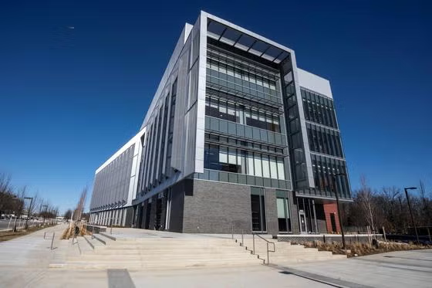
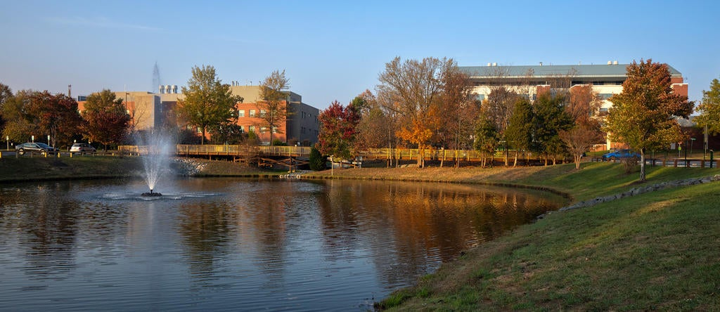
George Mason University At a Glance
Virginia’s largest public research university, with over 40,000 students​ and over 8,100 faculty and staff
Campus locations:
  Fairfax
  SciTech (Prince William)
  Mason Square (Arlington)
  Mason Smithsonian School of Conservation (Front Royal)
  Mason Korea (Incheon, South Korea)
Strong regional impact, with 73% of in-state graduates and 29% of out-of-state graduates launching their careers in Virginia.
Prince William County: 4,397 George Mason students, 21,102 alumni, and 485 employees.

Slide 4
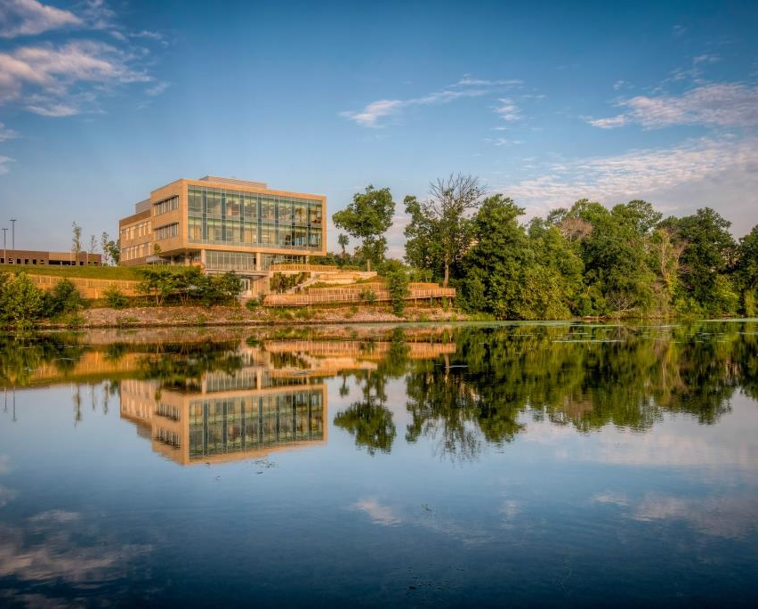
Potomac Science Center
Established in 2017
50,000 square-foot research facility with lecture rooms, laboratories, event rental space, and outdoor trails
Academic programs:
  Atmospheric, Oceanic, and Earth Sciences
  Environmental Science and Policy
  Chemistry and Biochemistry
  Civil, Environmental and Infrastructure Engineering
  Environmental Science and Policy
  Mechanical Engineering

Slide 5
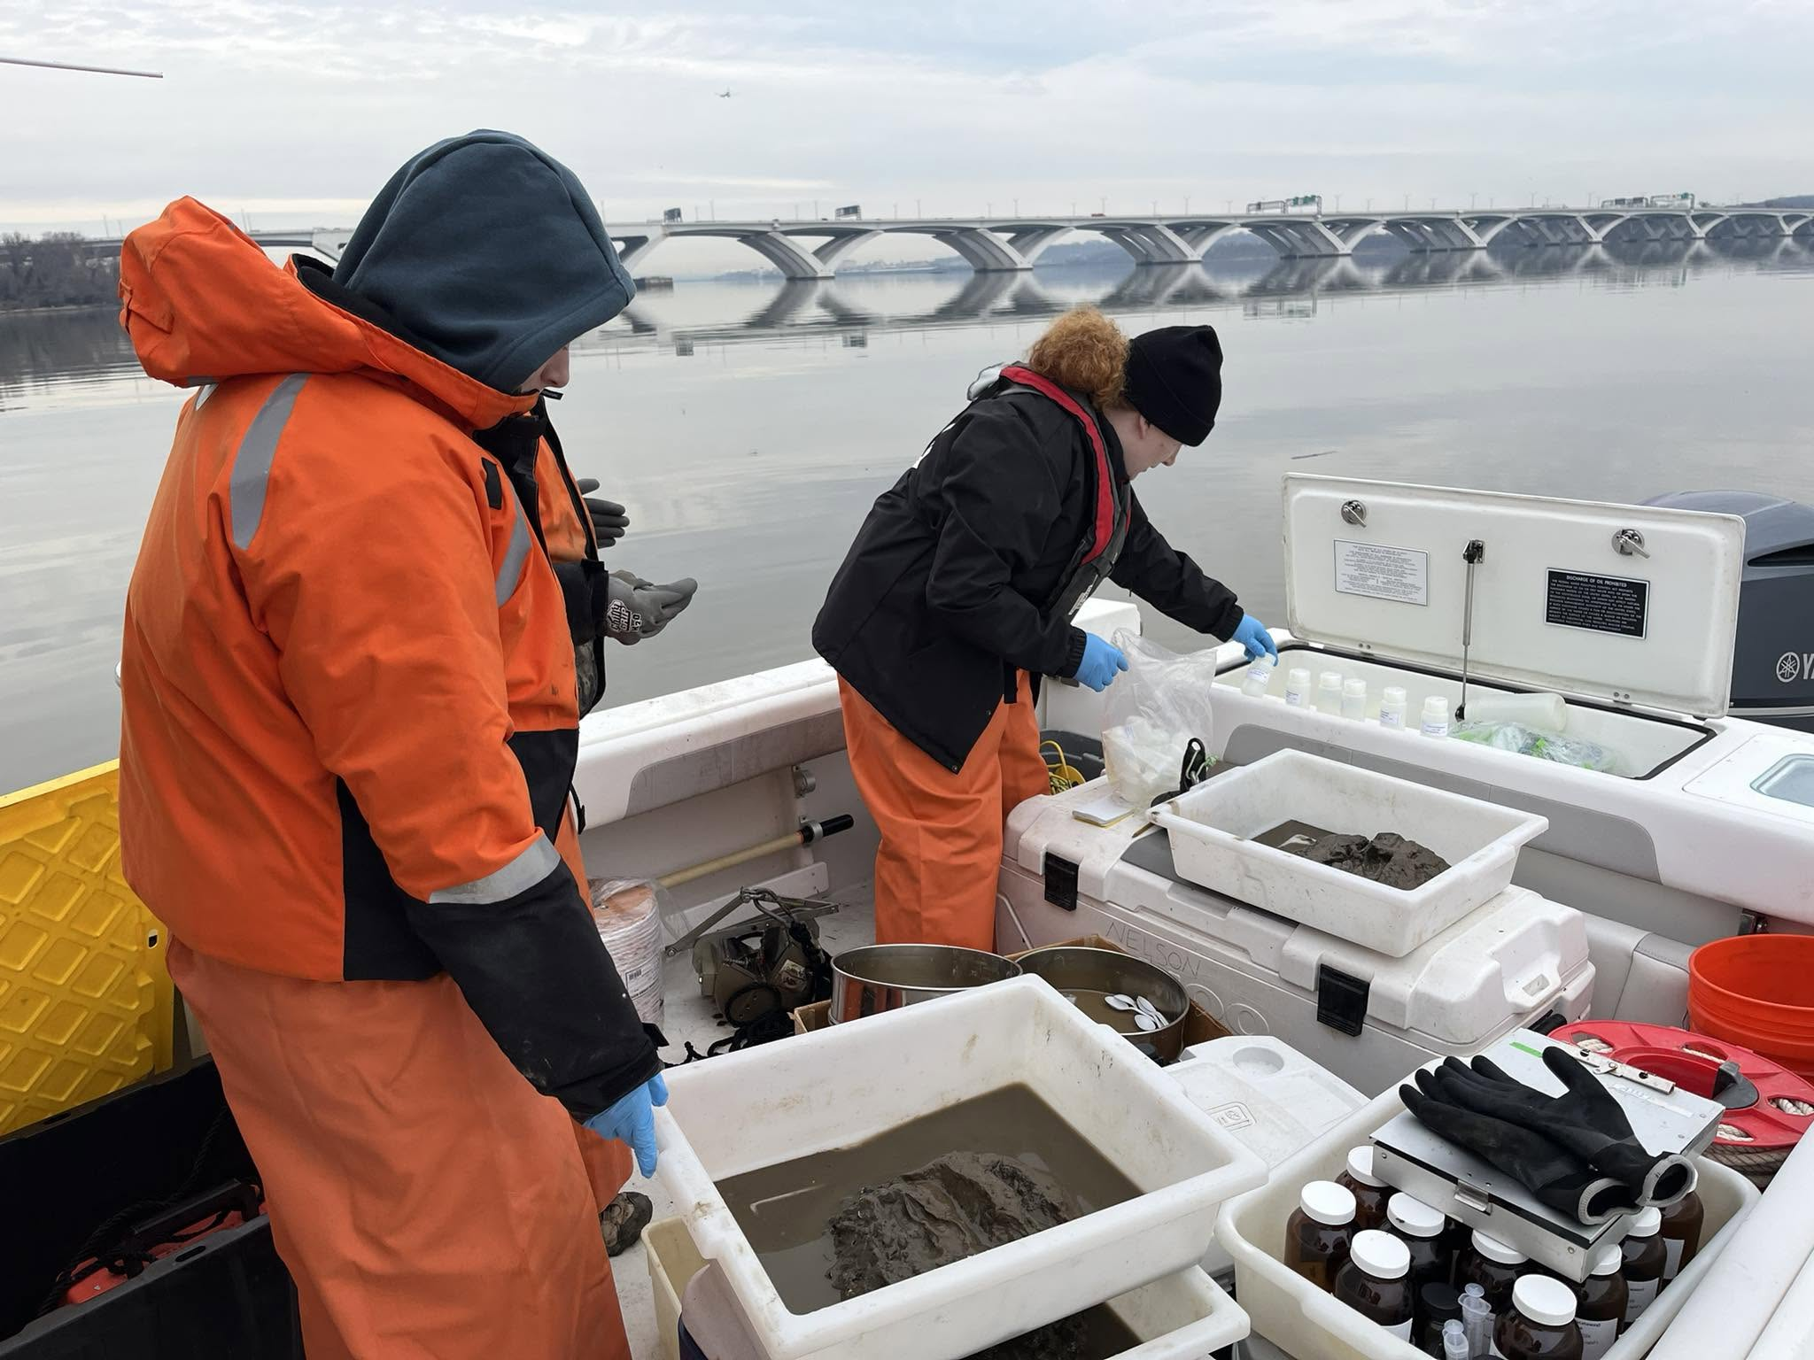
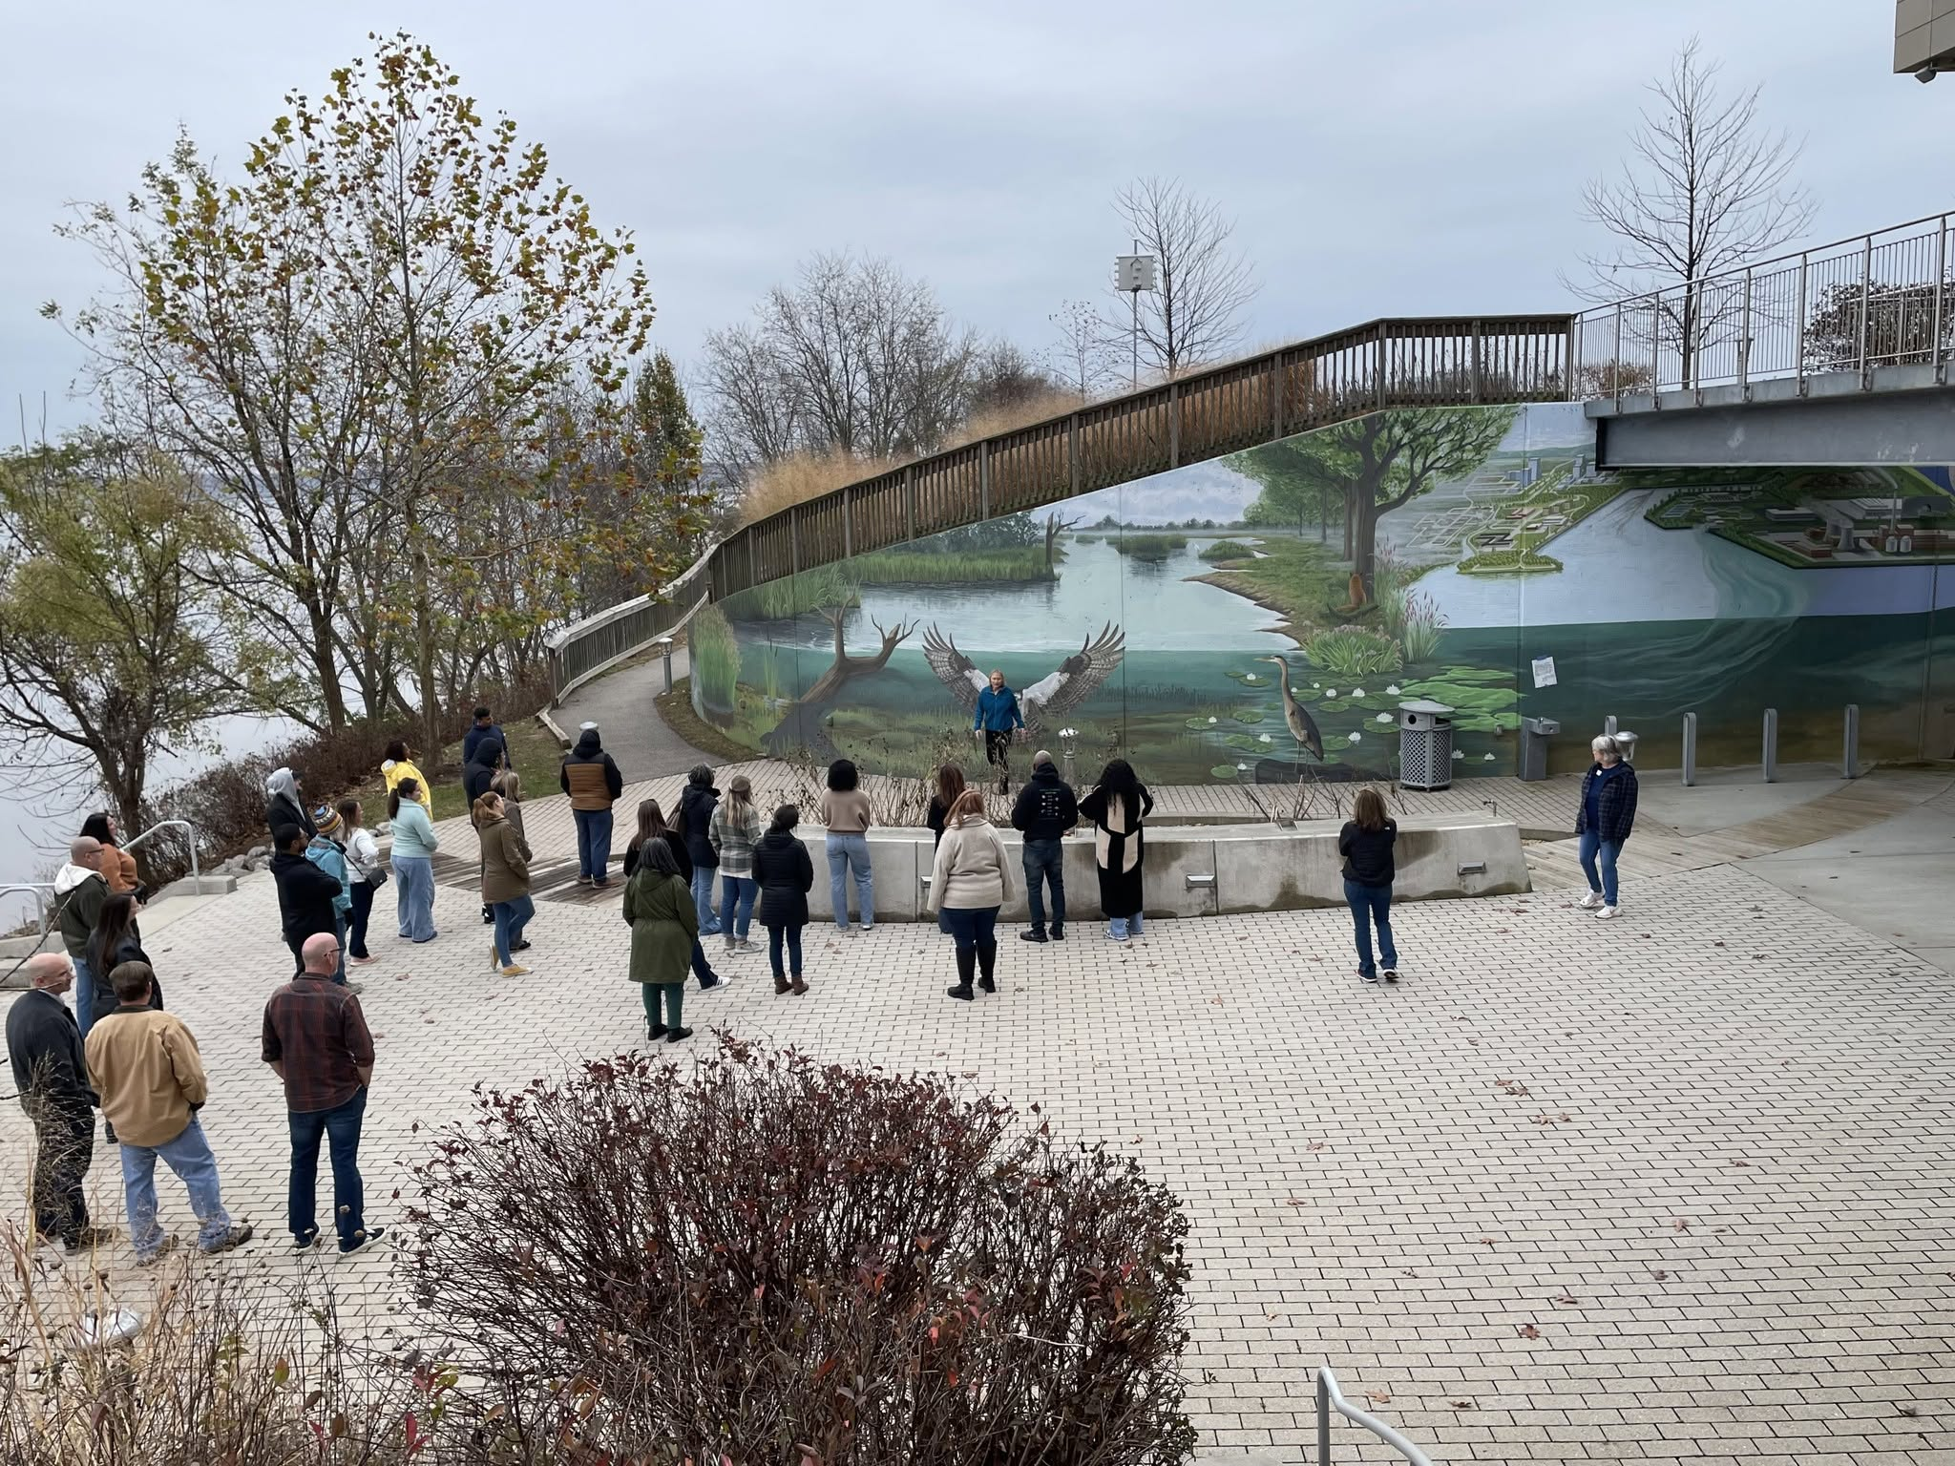
Research and Academic Programs
Potomac Environmental Research and Education Center (PEREC)
  Potomac River Sewage Spill Impact Study
  Gunston Cove water quality study – Over 30 years of ecological study
  Watershed stewardship education experiences for K-12 students – over 15,000 middle school students served per year
  Partnerships with government agencies, including Fairfax County and Loudoun County
Occoquan Acoustic Research System for tracking fish movement
Naval Ship Design graduate certificate

Slide 6
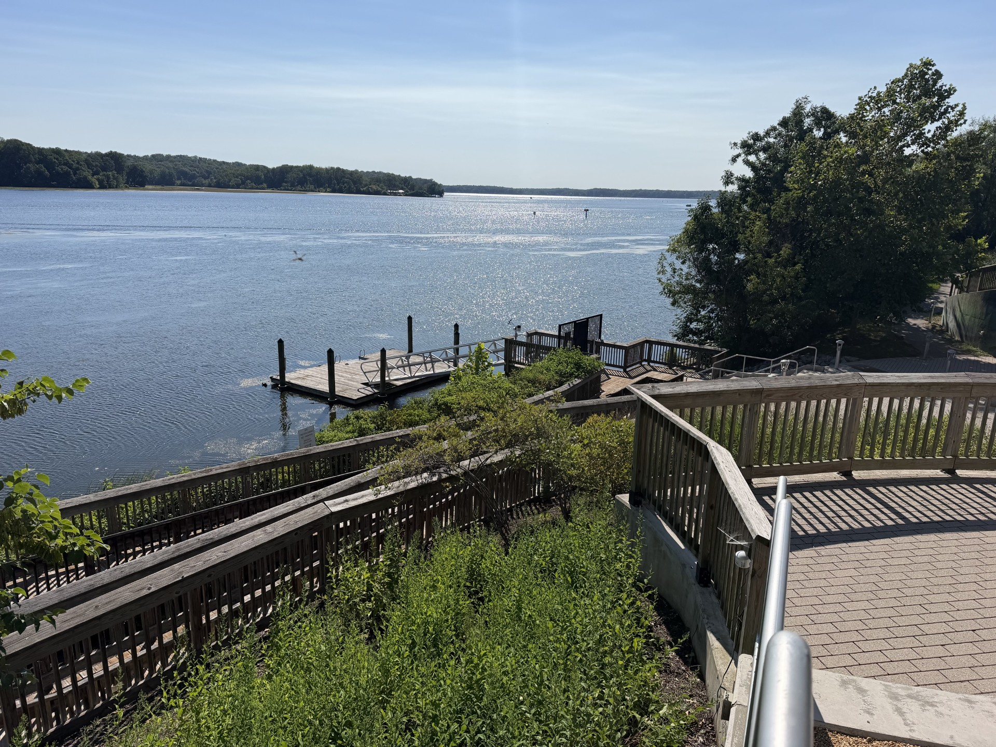
Why Build the Pier?
The Potomac Science Center is not accessible by boat.
Aquatic research activities are extremely limited by the small dock on-site. Enhance student accessibility to the water and provide greater learning and research opportunities for generations to come.
  Small number of participants accommodated.
  No motorized boat access.
Boats used by the university are stored on land. Using for academic and research purposes is more time and labor intensive.
Enhance student accessibility to the water and provide greater learning and research opportunities for generations to come.
Facilitate outreach activities for students in area schools demonstrating career pathways in science and engineering for learners with a love for water.
Notes:
Mike Herman

Slide 7
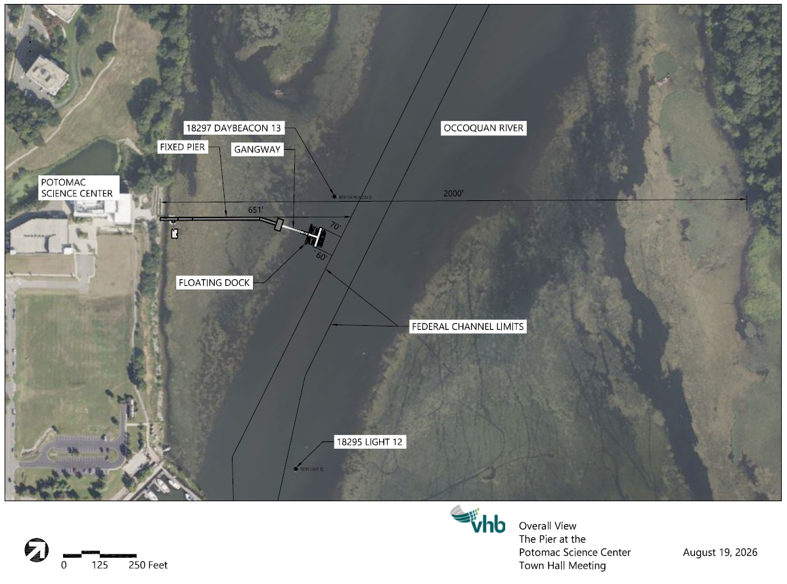
The Pier at the Potomac Science Center - Overall View

Slide 8
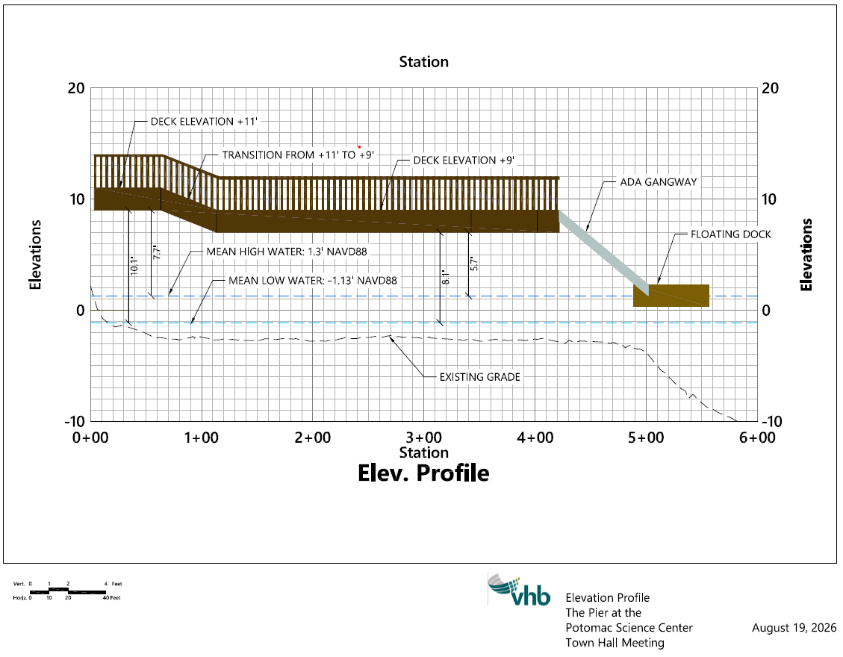
Elevation Profile

Slide 9
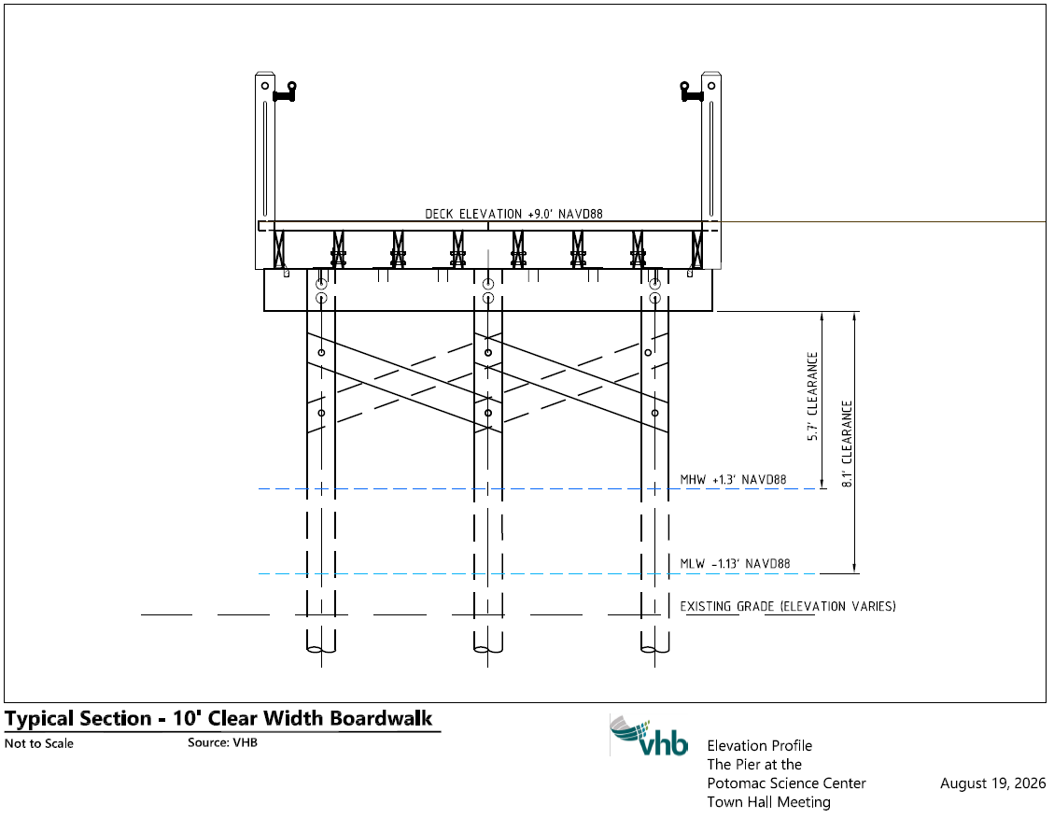
Typical Section

Slide 10
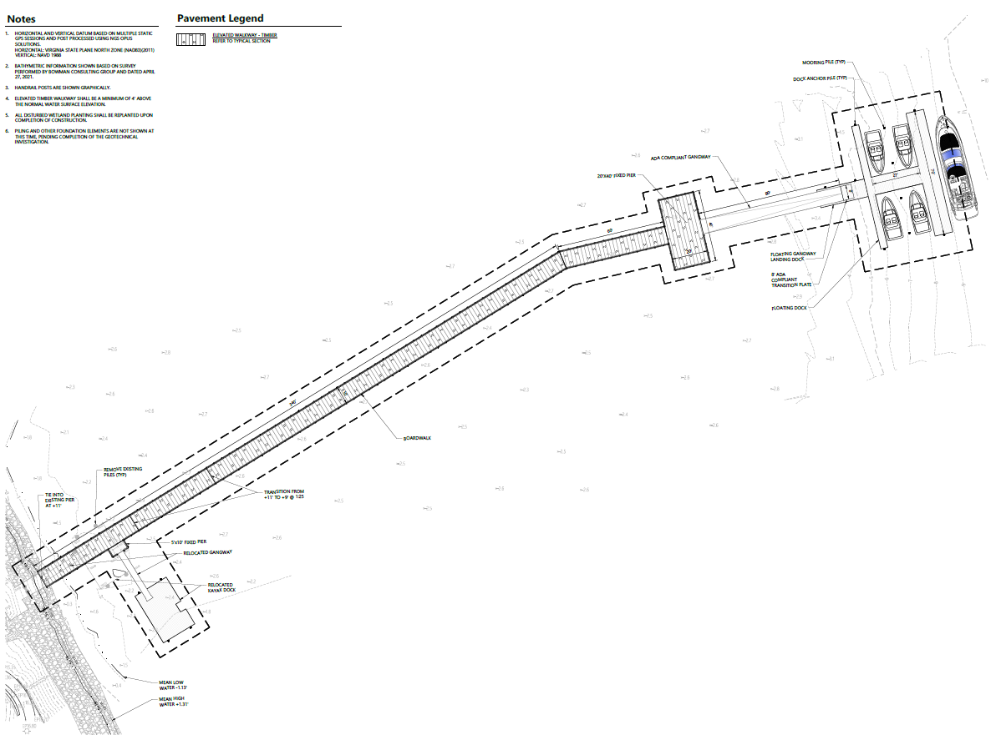
Project Scope
Design and construction of a new pier to access the Occoquan River
Support mooring of a 40ft research vessel and several smaller vessels
Electrical and water services
Existing floating platform will be repurposed

Slide 11




Permitting
Agencies Involved:
George Mason's Office of University Building Official (OUBO)
US Army Corps of Engineers – Section 10 and 408 permits
VA Marine Resource Commission – Submerged Lands
Local wetland board – Tidal Wetlands

Slide 12
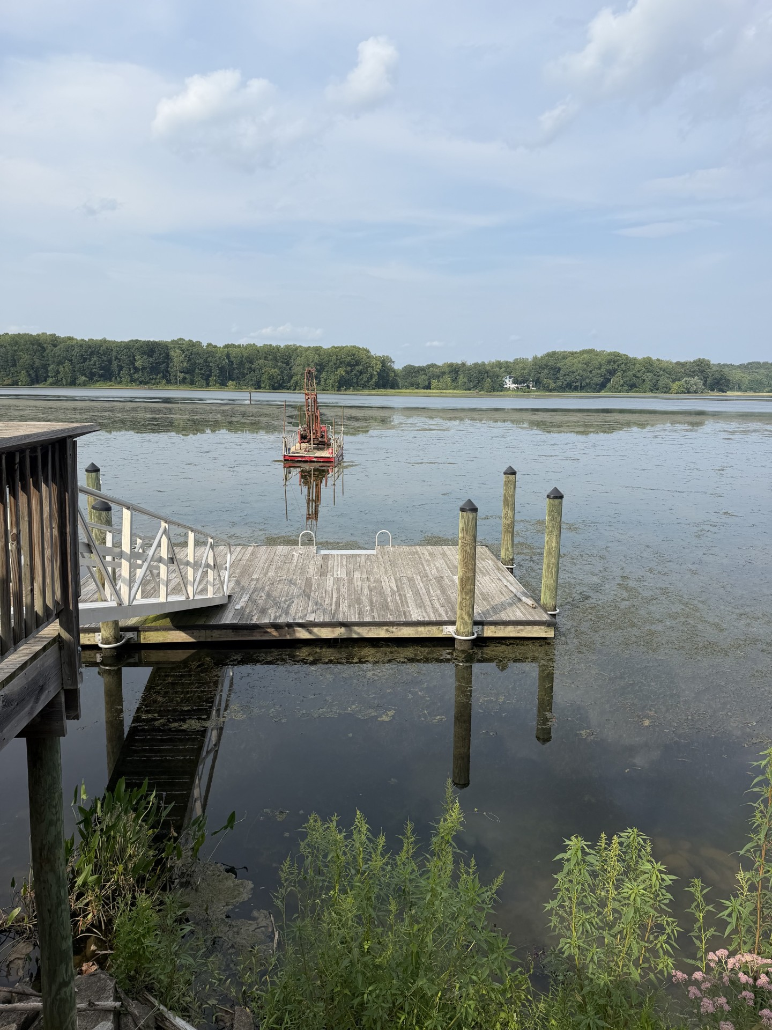
Project Timeline
Design Start: May 2026
Design Complete: February 2027
Construction Start: July 2027
Construction End: December 2027

Slide 13
Questions?
Please use microphones provided in the room
State your name
Limit questions/comments to no more than 1 minute so everyone gets a chance to participate
Please remain on topic to the pier project.
Any questions unable to be answered tonight will be followed up with via email (see Ethan Gardner to share contact information)

Slide 14
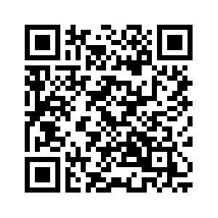
THANK YOU!
Visit the Project Website!
construction.gmu.edu/pier-potomac-science-center
Ethan Gardner
703-993-8376
egardn2@gmu.edu

