Slide 1

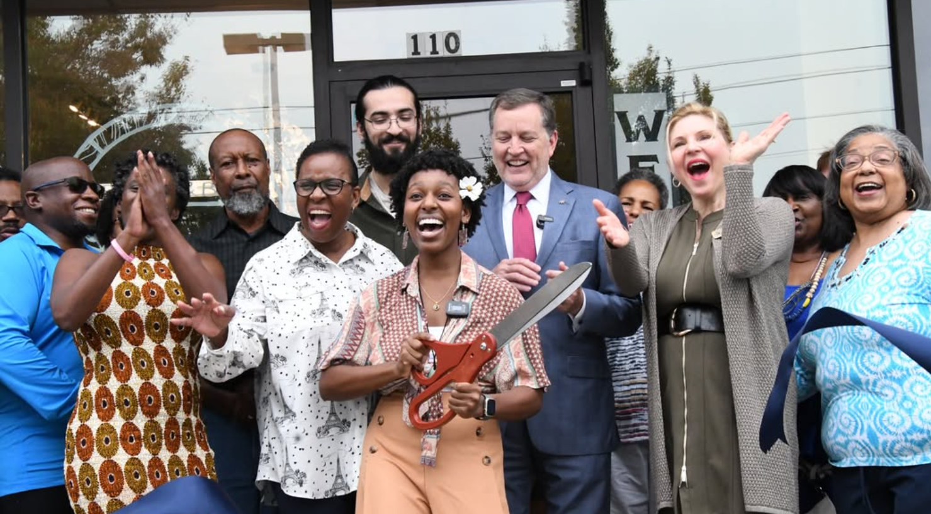
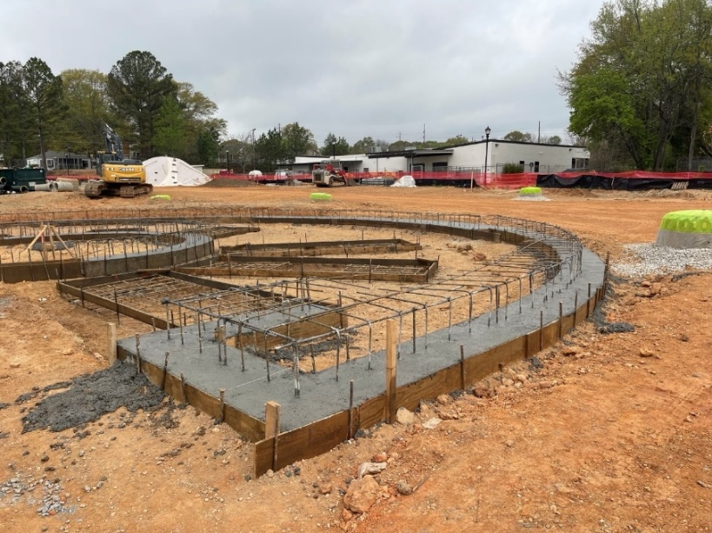
CITY MANAGER
DRAFT FY 2026 BUDGET
April 14, 2025

Slide 2
Presentation of the City Manager’s recommended balanced budget, a requirement of the Charter.
SECTION 3.04. - City manager; powers and duties enumerated.
The city manager shall have the power, and it shall be his or her duty, to:
  (2)Propose a budget for city operations from a zero base with input from the actual expenditures of the city from the prior year;

Slide 3
FY 2026 BUDGET APPROVAL
March 5 -10 Depts meet with Finance and City Manager
March 18-20 Individual budget briefings with Council Members
April 14 Draft of Budget delivered to Council
April 28 Budget Workshop (at Council Meeting)
TBD Budget Workshop #2 – As needed
May 12 1st Read and Public Hearing
June 9 2nd Read and Public Hearing/Adoption

Slide 4
Our adopted budget for the upcoming fiscal year is:
  Policy Document – Incorporates City Goals
  Financial Roadmap – Ensures a Balanced Budget
  Operations Guide – Dictates Staffing & Contracting Levels
  Communications Tool – Showcases City’s Agenda
  Evaluation Mechanism – Ability to Review Trends
  Capital Investment Program – Presents Annual Work Program

Slide 5
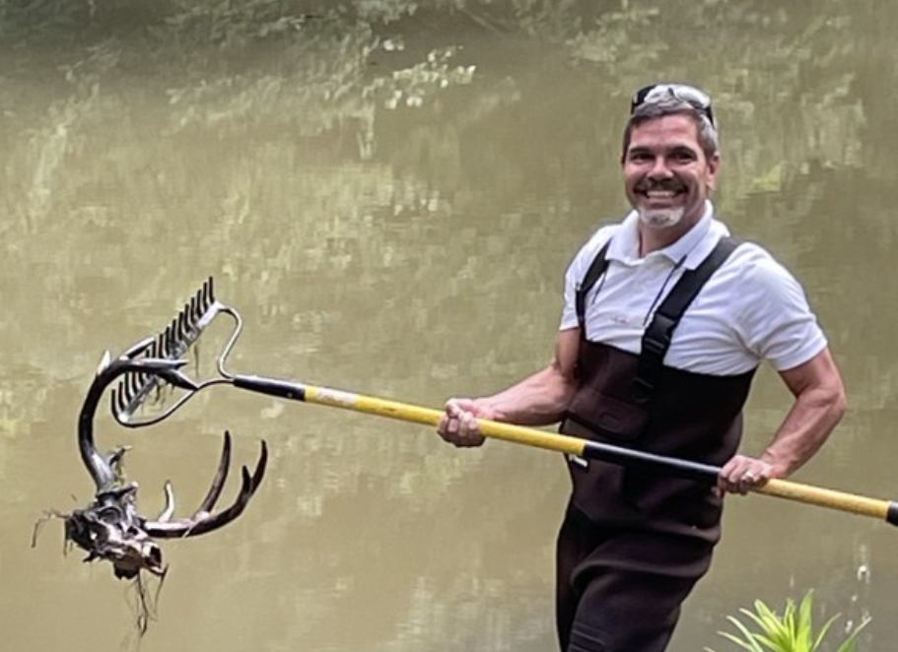
To discuss:
    Achievements in FY 25
    City’s Strong Financial Position
      Revenues
      Expenditures
    Proposed Operating Budget
      Current Staff & Contracted Employees
      Personnel Requests
      Studies
    Proposed Capital Budget

Slide 6
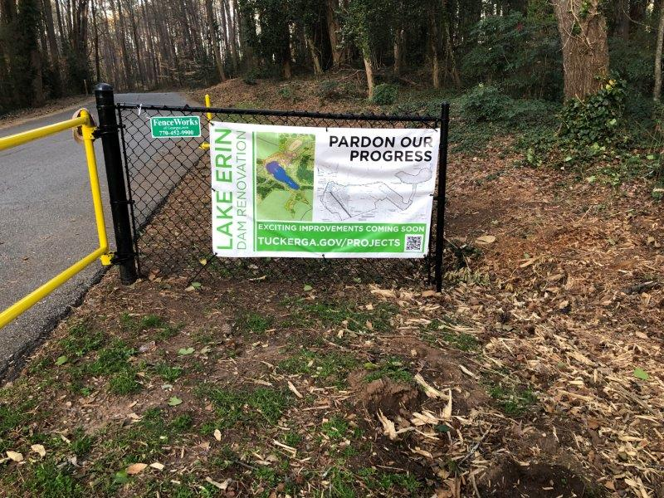
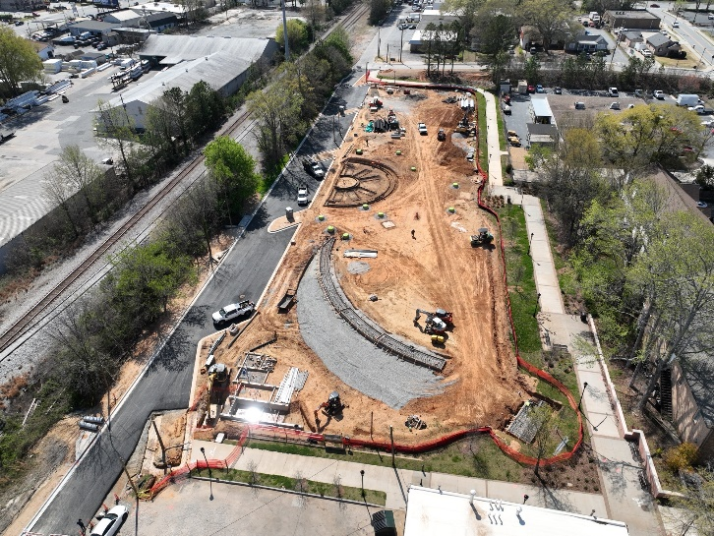
Achievements in FY 25 Budget
Projects
Fitzgerald park opening with new state of the art athletic fields.
Tucker Town Green on way to Fall 2025 opening.
Dams
  Johns Homestead – construction underway
  Lake Erin – construction coming soon
Continued stormwater system repairs.

Slide 7
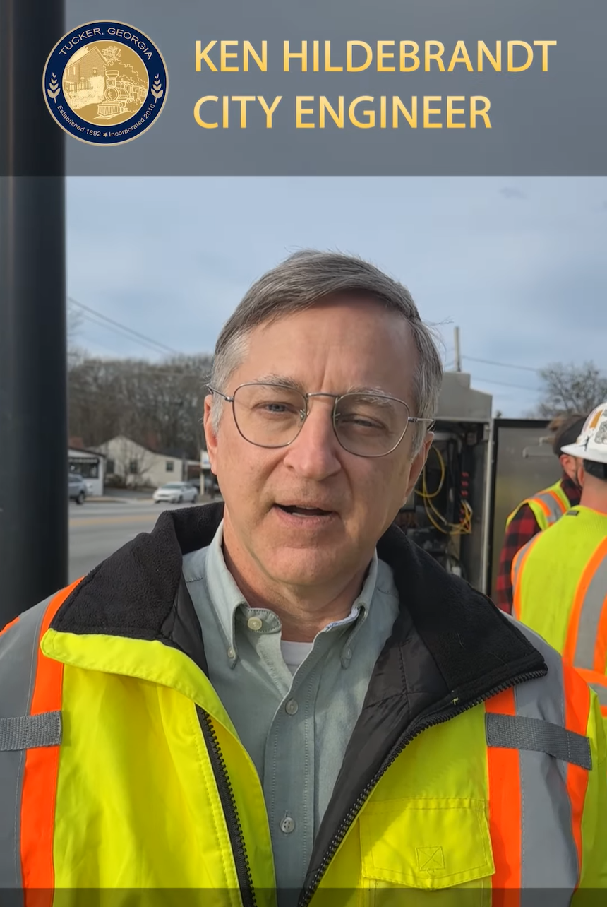
Achievements in FY 25 Budget
Projects
Road resurfacing
  37 Streets
  9 Miles
Major Road repair
  Lilburn Stone Mountain Road
Intersection improvements
  Fellowship Road Safety Improvements

Slide 8
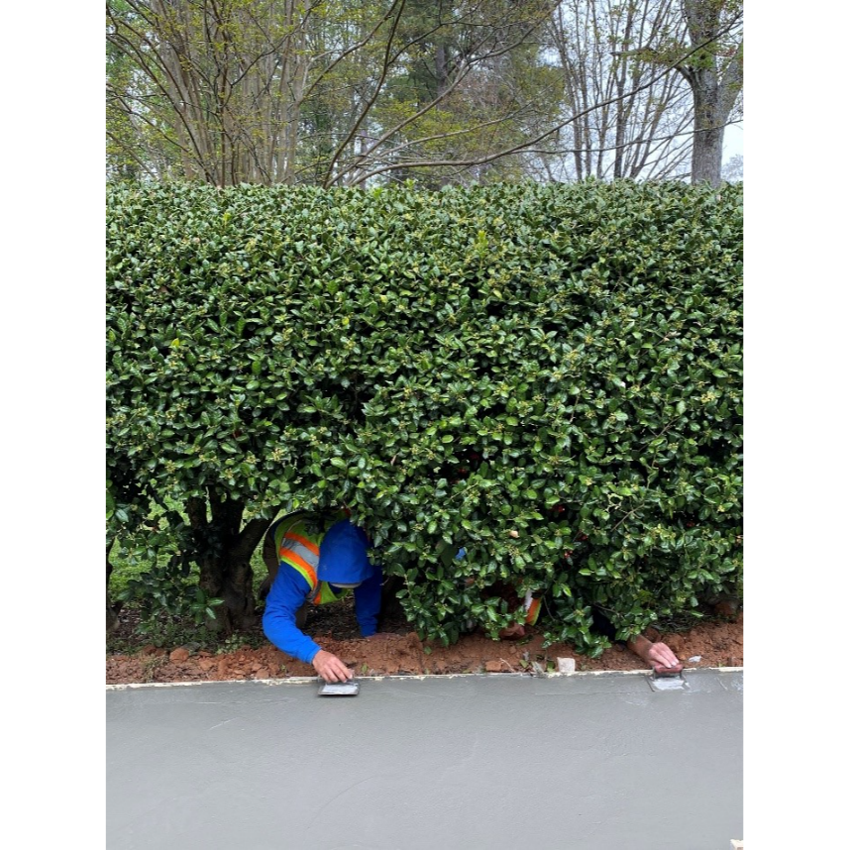
Achievements in FY 25 Budget
Projects
2,156 feet/.41 miles of sidewalks built.
  Sidewalk connection on Hugh Howell Road
3,296 feet/.62 miles of trails.
  Trails opened on Hugh Howell Road
    Marthasville Court to Stratmor Drive

Slide 9
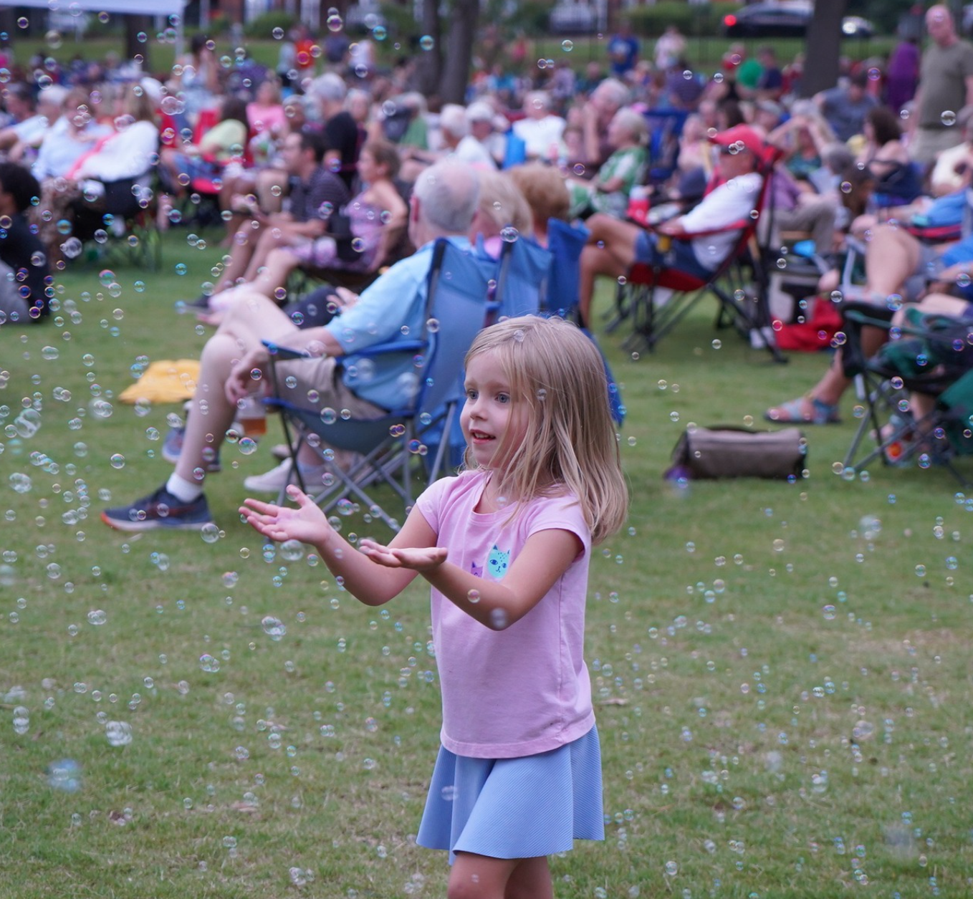
Achievements in FY 25 Budget
Events
Summer of Fun Events & Fireworks
Winter Concert Series
Movies on the Green
Tucker Restaurant Week
Hosted DeKalb Delegation, DeKalb CEO, Congressman Johnson

Slide 10
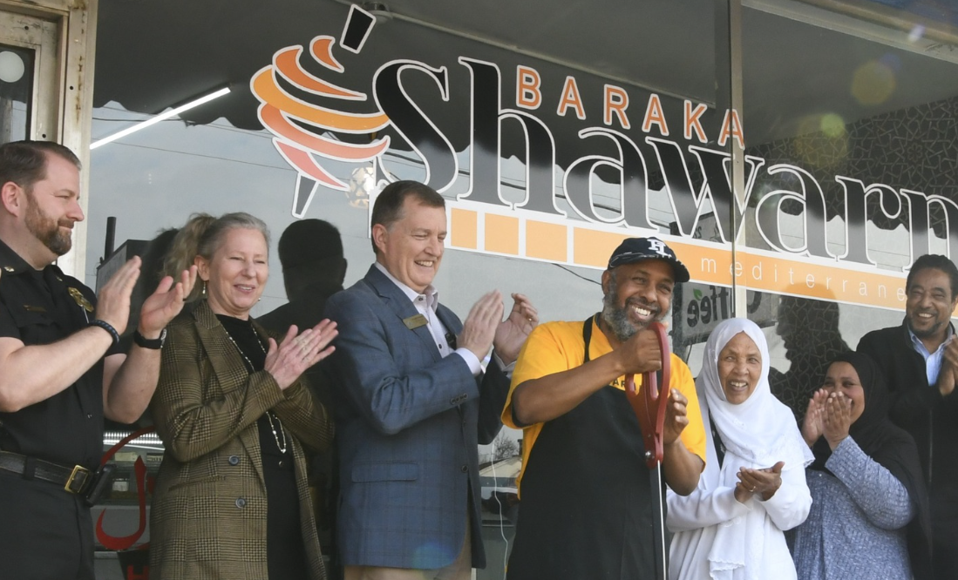
Achievements in FY 25 Budget
Programs
Completion of City Standard Guidebook
Added downtown parking
Tucker manufacturing Day
Small Business Expo
Façade grants delivered.
14 new business ribbon cuttings

Slide 11
Themes of the FY 26 Budget
Year of implementation – major projects underway
  Tucker Town Green – Place making/Economic Development
  Dams – Safety/Amenities
  Richardson Realignment- Safety/Community Development
Continued design work
  Trails – Mobility/Connections/Economic Development
Prudent use of projected future funds
  American Rescue Plan funds spent/obligated
  Economic uncertainty/finite capital funding

Slide 12
Capital Funds
220-Grant Fund
230-ARPA Fund
300-Capital Fund
320-SPLOST 1
321-SPLOST2
Operating Funds
100-General Fund
191-DDA Fund
206-Tree Fund
271-Streetlight
272-Traffic Calming
275-Hotel Motel
280-Rental Car Excise
Stormwater
Fund
560
Notes:
Each FUND has a BUDGET.
Operating Budgets include Funds that provide funding for general government services. Why are there so many? Some operating funds have special revenue that can only be used for a specific purpose, so they have their own fund and financial statements. We are legally required to keep these separate.
Examples of operating fund expenditures are salaries and benefits, facility lease, liability insurance, contracted services, supplies and repairs and maintenance.
The largest Operating Fund is the General Fund-100. This fund is where we have expenditures for salaries and benefits, leases, liability insurances, contracted services, supplies, and repair and maintenance.
Capital Budgets include Funds that provide funding for Capital Asset expenditures. Some examples of Capital Assets are construction projects for roads/paving, sidewalks, trails, parks, and equipment. Again, where are there so many? Some capital funds have special revenue that can only be used for a specific purpose, so they have their own fund and financial statements.
Our last category of Funds is Stormwater or Proprietary Fund. It is a business-type fund that we are legally required to keep separate from the other government funds.
Don’t worry – there will not be a test at the end.
Just remember, when we talk about the General Fund, we are referring to largest fund (folder) in the Operating Fund drawer of our file cabinet.

Slide 13
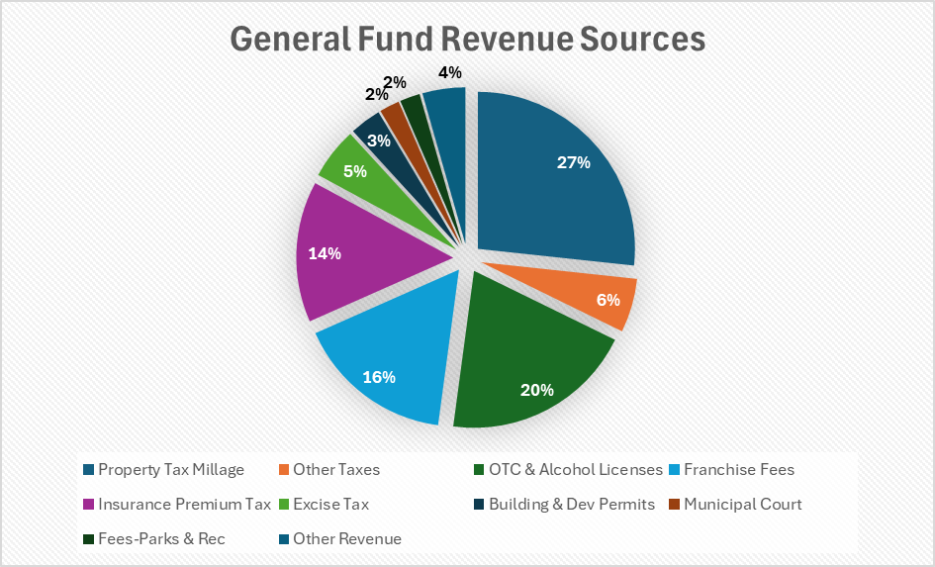
GENERAL FUND PROPOSED FY2026 BUDGET
Largest revenue sources
Property Tax 27%
Occupational Tax Certificate/Alcohol Licenses 20%
Insurance Premium 15%
Franchise Fees 16%
Notes:
Our current budget has revenue in the general fund as shown.
Taxes include Property Tax, Motor Vehicle and TAVT, intangible and real estate transfer tax.
I’ve only shown the top line items here.
All other Revenue includes interest (largest at 1M, municipal court, parks and rec fees, and transfers from Hotel Motel and Rental Car Funds.

Slide 14
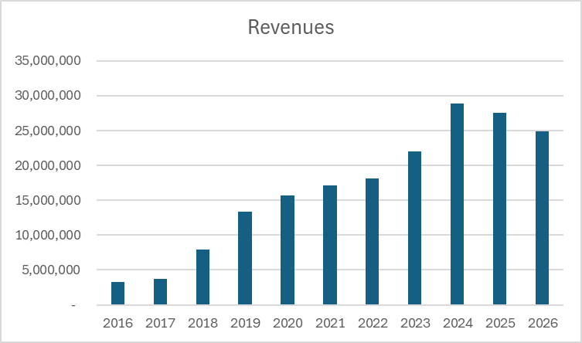
GENERAL FUND HISTORY
Revenues
Notes:
The General Fund provides Revenue as an interfund transfer to the capital fund. You can see here how revenue, expenditures, and fund balance have consistently grown over the City’s history.

Slide 15
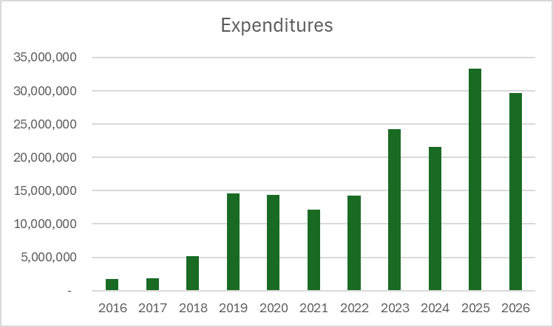
GENERAL FUND HISTORY
Expenditures
Notes:
The General Fund provides Revenue as an interfund transfer to the capital fund. You can see here how revenue, expenditures, and fund balance have consistently grown over the City’s history.

Slide 16
SPLOST II Allocation
Road Improvement & Repairs 46%
Trails & Sidewalks 31%
Parks 15%
Stormwater 8%
Roughly $6.6 Million depending upon sales tax revenue/consumer spending in DeKalb County.
Notes:
We get other revenue that is reflected in the appropriate Fund.
Current SPLOST Revenue is in Fund 321
Stormwater Fee Revenue is in the Stormwater Fund 560

Slide 17
REVENUE – OTHER FUNDS
Stormwater Fund 560 $3,438,000
$2,934,204 Stormwater Utility Fees
        $6 a month per Equivalent Residential Unit
$504,000 Transfer from SPLOST (8%)
Notes:
We get other revenue that is reflected in the appropriate Fund.
Current SPLOST Revenue is in Fund 321
Stormwater Fee Revenue is in the Stormwater Fund 560

Slide 18
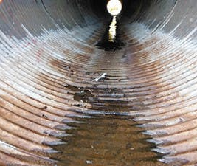
Stormwater Utility Fee Proposal
Increase the Stormwater Utility Fee to $8/month/ERU
  This generates approximately $3.9M
    Approximately 6-8 larger additional projects per year
    Begin the turnaround of the deficiencies found in Atlas’ baseline stormwater inventory.
    Addressing many years of deferred maintenance
8% SPLOST
    Approximately $500K annually
    Begin developing an Emergency Fund
    MS4 Implementation
Notes:
We get other revenue that is reflected in the appropriate Fund.
Current SPLOST Revenue is in Fund 321
Stormwater Fee Revenue is in the Stormwater Fund 560

Slide 19
CITY OF TUCKER PROPOSED PERSONNEL COSTS FY 26
Embedded City Staff with InterDev, Jacobs, Lowe Engineers, Optech and other contractors
Notes:
This slide only includes current employees
The Increase includes a 4% Merit, 2.5% COLA, and a 10% increase in medical benefits costs for ½ year (rates change in January).

Slide 20
NEW RECOMMENDED POSITION REQUESTS
Parks and Recreation
  Out of School Time Coordinator
    Expansion of Summer Camps
    Expansion of School-Year Specialty Camps
  Aquatics Coordinator
    Aquatics Programming & Facility Management
    Program Management
    Dynamo Contract Oversight
  $232K (with all benefits)
Community Development
  Deputy Community Development Director
        Expanding workload
        Implementation of ULI TAP Recommendations
  $169K (with all benefits)

Slide 21
Proposed Tucker Marshal Service
A sworn peace officer, not to be confused or conflated with a police department.
Marshals are an extension of officers of the court.
Replacing 4 part time bailiffs.
The Marshals will provide many services which will provide an extra level of service for the City and help in contributing to safer environments for staff, citizens, and visitors within our city.
Positions: 3 Full Time, 3 Part Time
Chief Marshal (FT)
Deputy Chief Marshal (FT)
Marshal (FT) 1
Marshal (PT) 3
Budget Impact
Estimated Net Increase Operating Expense: $200K
Estimated Start-Up Costs: $202K

Slide 22
Proposed Tucker Marshal Service Will:
Security checks on city properties, city events, municipal court, council meetings, city hall, parks and recreation, and all other city meetings
Make lawful arrest as peace officers in the municipal court and transport the prisoners to the county jail, bank deposits, bond hearings.
Aid the Finance department fingerprinting of alcohol and occupational licenses for new licenses and renewals, which provides a more efficient and convenient service to the business owners of Tucker
Assist code enforcement personnel in sensitive cases where serving notices and citations of City code violations must be done on derelict property.

Slide 23
Proposed Tucker Marshal Service
Will Not
Will not be conducting traffic stops
Marshals will not be writing state code violations (uniform traffic citations) – only City of Tucker ordinances.
Marshals will not be responding or dispatched to 911 calls for service
Marshals should not and will not be conducting “police work”.

Slide 24
FY 2026 Studies
Downtown Master Plan Update Space and Needs Analysis of City Property Church Street Open Space Tucker Recreation Center Small Area Plans for Existing Parks FY 25 Continuing Studies for example: Housing Lawrenceville Highway Beautification/Access Management Trails/Transportation T Mast

Slide 25
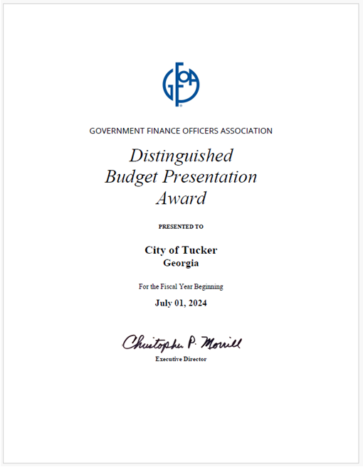
Budgeting
Adopted and Award Winning Comprehensive Financial Report
Budget Book FY 25 Available Online
Clean Audit
  Overall and Single for Federal Funds

Slide 26
Major Funded Construction Underway
Tucker Town Green $5.6 Million
Lake Erin Dam $4 Million
Johns Homestead Dam $4 Million
Richardson Realignment $1.7 Million

Slide 27
Capital Budget Planning
Council provided feedback on proposed projects.
Available funding in the General Fund that can be used for projects.
  Design
  ROW
  Construction
List of balanced project list of Capital Projects that will receive funding in FY 26

Slide 28
FY 26 Capital Budget Summary
We project $6.2M in new Capital (300) projects
We project $6.6M in new SPLOST (321) projects
We project $6.5M in new matching revenues coming in to fund 4 projects in their next phases.
  A mix of federal and state funding
All totaled, project up to $19.3M in new capital project funding

Slide 29
FY 26 Capital Budget Summary
Staff put in requests for new funding on 34 projects totaling $28 M from adopted plans.
This includes requests to begin new projects or to continue the next phase of existing projects.
In the first Draft Capital Budget presented here, I have proposed 25 projects to move forward in a balanced budget.

Slide 30
Existing Project Funding From Prior Year Budgets
*ONLY PROJECTS OVER $500K LISTED HERE

Slide 31
Major Funded Projects for FY 26
*ONLY PROJECTS OVER $500K LISTED HERE

Slide 32
Full Project List for FY 26

Slide 33
Future Considerations
We have several maturing trail and roadway projects that will be entering high-cost phases of both ROW and Construction in the next few years.
Even with grant matching funds, these projects will limit flexibility in the coming years.
For this reason, limiting new studies in the budget presented before you.
Design work does not assume immediate construction.

Slide 34
Next Steps
Budget Workshop at next Council meeting on April 28th.
Continued refinement and discussion.
1st Read and Public Hearing at May 12th Meeting.

